Slide 1
Unit 1 – Section 11 “Linear Programming”
Objectives covered
solve linear programming problems.
Use linear programming to solve
real-life problems

Slide 2
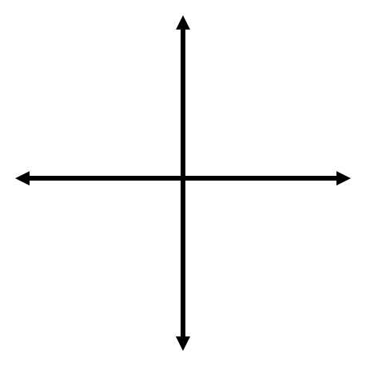
Optimization Function
Optimization Function: EX: $f(x,y)=x+3y$
Linear function
Use to find the maximum and minimum values
Notation: $f(x,y)$

Slide 3
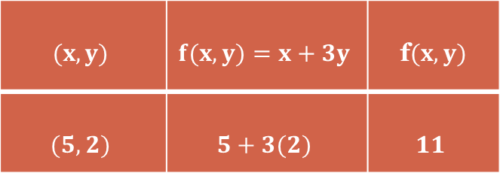

Linear Programming
Steps:
Graph the inequalities.
Label the vertices.
Make a table with three columns.
Substitute $(x,y)$to find $f(x,y)$
Directions: Find the maximum and minimum values of the optimization function. Show all work.
EX: $f\left(x,y\right)=x+3y$
$$x≥2$$
$y≥1$
$y≤\frac{−1}{2}x+$4
$$(x,y)$$ | $$f(x,y)=x+3y$$ | f$(x,y)$
$$(5,2)$$ | $$5+3(2)$$ | $$11$$

Slide 4
Cluster Examples
Directions: Find the maximum and minimum values of the optimization function. Show all work.
$f(x,y)=3y+x$
$y>0$
$y≤\frac{4}{3}x+$8
$y≤\frac{−2}{3}x+2$
Directions: Find the maximum and minimum values of the optimization function. Show all work.
$f(x,y)=2x−3y$
$x≥1$
$y≥2$
$y≤\frac{−1}{2}x+6$

Slide 5
Real Word Example: Farming
A farmer can plant up to 8 acres of land with wheat and barley. He can earn $5,000 for every acre he plants with wheat and $3,000 for every acre he plants with barley. His use of a necessary pesticide is limited by federal regulations to 10 gallons for his entire 8 acres. Wheat requires 2 gallons of pesticide for every acre planted and barley requires just 1 gallon per acre. What is the maximum profit he can make?
SOLUTION TO PROBLEM NUMBER let x = the number of acres of wheat let y = the number of acres of barley. since the farmer earns $5,000 for each acre of wheat and $3,000 for each acre of barley, then the total profit the farmer can earn is 5000*x + 3000*y. let p = total profit that can be earned. your equation for profit becomes: p = 5000x + 3000y that's your objective function. it's what you want to maximize
the constraints are: number of acres has to be greater than or equal to 0. number of acres has to be less than or equal to 8. amount of pesticide has to be less than or equal to 10. your constraint equations are: x $≥$ 0 y $≥$ 0 x + y $≤$ 8 2x + y $≤$10 To graph these equations, solve for y in those equations that have y in them and then graph the equality portion of those equations. x ≥ 0 y ≥ 0 y $≤$ 8-x y $≤$10 - 2x x = 0 is a vertical line that is the same line as the y-axis. y = 0 is a horizontal line that is the same line as the x-axis. the area of the graph that satisfies all the constraints is the region of feasibility. the maximum or minimum solutions to the problem will be at the intersection points of the lines that bound the region of feasibility.

Slide 6
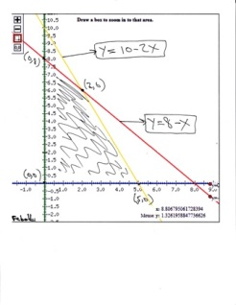
Real World Example Continued
the region of feasibility is the shaded area of the graph. you can see from this graph that the region of feasibility is bounded by the following (x,y) coordinate points: (0,0) (0,8) (2,6) (5,0)

Slide 7
Real World Example Continued
the point (0,0) is the intersection of the line x-axis with the y-axis. the point (0,8) is the intersection of the line y = 8 - x with the y-axis. the point (5,0) is the intersection of the line y = 10 - 2x with the x-axis. the point (2,6) is the intersection of the line y = 8 - x with the line y = 10 - 2x. the objective equation is: p = 5000x + 3000y profit will be maximum at the intersection points of the region of feasibility on the graph. The profit equation is evaluated at each of these points as shown in the following table.
The maximum profit occurs when the farmer plants 2 acres of wheat and 6 acres of barley. The number of acres of wheat is 2 and number of acres of barley is 6 for a total of 8 acres which is the maximum number of acres available for planting.
The number of gallons of pesticide used for wheat is 4 and number of gallons of pesticide used for barley is 6 for a total of 10 gallons of pesticide which is the maximum amount of pesticide that can be used.
Intersection point of $(x,y)$ | P
(0,0) | $0
(0,8) | $24,000
(2,6) | $28,000
(5,0) | $25,000

Slide 8
Practicing with Linear Programming
Steps:
Read the problem in its entirety.
Identify the variables x and y.
Determine the constraints. (inequality statements)
Determine the profit equation.
Graph the constraints.
Label the vertices.
Use the profit equation to determine maximum and minimum values.
Vocabulary:
Linear programing: the process of maximizing and minimizing a linear objective function subject to constraints that are linear inequalities.
Constraints: linear inequalities
Feasible Region: the area of the graph where all the constraints intersect with one another.
Objective function: Profit equation.

Slide 9
Practicing with Linear Programming
Steps:
Read the problem in its entirety.
Identify the variables x and y.
Determine the constraints. (inequality statements)
Determine the profit equation.
Graph the constraints.
Label the vertices.
Use the profit equation to determine maximum and minimum values.
Example: MANUFACTURING
A company manufactures two types of printers, an inkjet printer and a laser printer. The company can make a total of 60 printers per day, and it has 120 labor-hours per day available. It takes 1 labor hour to make an inkjet printer and 3 labor-hours to make a laser printer. The profit is $40 per inkjet printer and $60 per laser printer. How many of each type of printer should the company make to maximize its daily profit?
function: Profit equation.

Slide 10
Practicing with Linear Programming
Steps:
Read the problem in its entirety.
Identify the variables x and y.
$x=$
$y=$
Example: MANUFACTURING
A company manufactures two types of printers, an inkjet printer and a laser printer. The company can make a total of 60 printers per day, and it has 120 labor-hours per day available. It takes 1 labor hour to make an inkjet printer and 3 labor-hours to make a laser printer. The profit is $40 per inkjet printer and $60 per laser printer. How many of each type of printer should the company make to maximize its daily profit?

Slide 11
Practicing with Linear Programming
Steps:
3. Determine the constraints. (inequality statements)
Hint: Look for sentences that signify inequalities, such as less than, minimum, maximum, at most, etc.
4. Determine the profit equation.
Example: MANUFACTURING
A company manufactures two types of printers, an inkjet printer and a laser printer. The company can make a total of 60 printers per day, and it has 120 labor-hours per day available. It takes 1 labor hour to make an inkjet printer and 3 labor-hours to make a laser printer. The profit is $40 per inkjet printer and $60 per laser printer. How many of each type of printer should the company make to maximize its daily profit?

Slide 12
Practicing with Linear Programming
Steps:
5. Graph the constraints. (rewrite into slope/intercept form).
6. Label the vertices. (where the lines intersect)
7. Use the profit equation to determine maximum and minimum values.
Example: MANUFACTURING
A company manufactures two types of printers, an inkjet printer and a laser printer. The company can make a total of 60 printers per day, and it has 120 labor-hours per day available. It takes 1 labor hour to make an inkjet printer and 3 labor-hours to make a laser printer. The profit is $40 per inkjet printer and $60 per laser printer. How many of each type of printer should the company make to maximize its daily profit?

Slide 13
Practicing with Linear Programming
Steps:
Read the problem in its entirety.
Identify the variables x and y.
Determine the constraints. (inequality statements)
Determine the profit equation.
Graph the constraints.
Label the vertices.
Use the profit equation to determine maximum and minimum values.

Slide 14
Homework Assignment
Announcements

