Slide 1
Unit 1 – Section 2 “Linear Equations”
Objective Covered
The student will be able to determine the slope of a line.
The student will be able to graph equations in slope intercept form
The student will be able to graph equations using x – and y- intercepts

Slide 2
Four Types of Slopes
Rule: When reading a graph, it is important to read from left to right. Just like English, the Coordinate Plane is read from left to right.

Slide 3
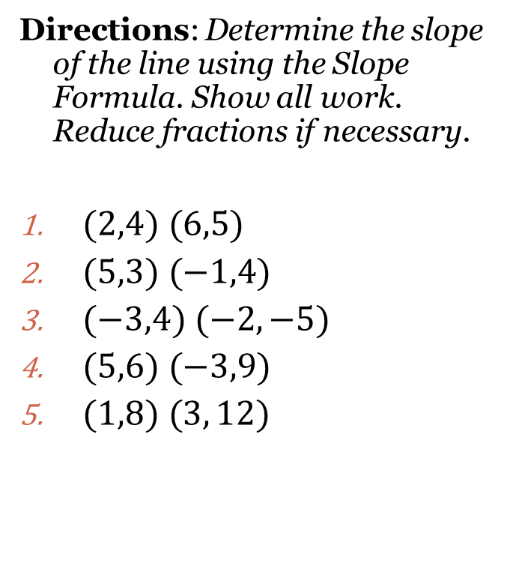
Slope Formula

Slide 4
Special Cases

Slide 5
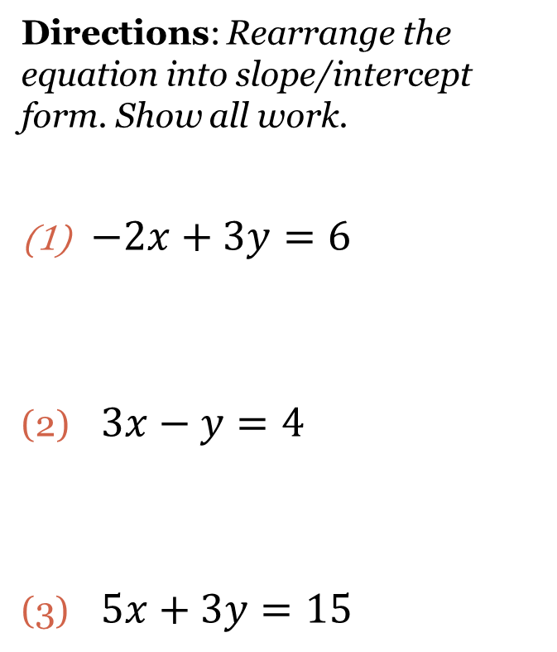
Slope/Intercept Form
Slope/Intercept form of an equation: $y=mx+b$
m: slope of a line
b: the y-intercept; where it crosses the y-axis
Directions: Rearrange the equation into slope/intercept form. Show all work.
$−2x+3y=6$
$3x−y=4$
$5x+3y=15$

Slide 6
Graphing Equations in Slope Intercept Form
Directions: Graph the equations on a Cartesian Plane. Use the graph paper provided.
$y=\frac{2}{3}x+2$
$y=3x−4$
$y=\frac{−5}{3}x+5$

Slide 7
Special Case Acronyms
HOY
H: Horizontal Line
O: 0 slope as in zero slope
Y: Y-intercept
VUX
V: Vertical Line
U: Undefined slope
X: X-intercept

Slide 8
Really Special Cases

Slide 9
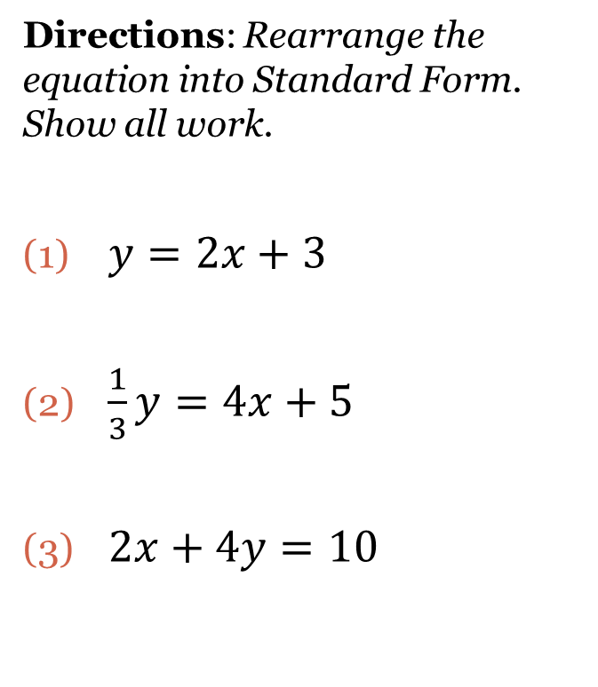
Standard Form
Standard Form of an Equation: $Ax+By=C$
X has to be positive
No fractions
No Common Factors
Directions: Rearrange the equation into Standard Form. Show all work.
$y=2x+3$
$\frac{1}{3}y=4x+5$
$2x+4y=10$

Slide 10
X and Y Intercepts
X-Intercept: The point on a line that lies on the x-axis; denoted by (x,0)
Y-Intercept: The point on a line that lies on the y-axis; denoted by (o,y).
Y
Y
X
X

Slide 11
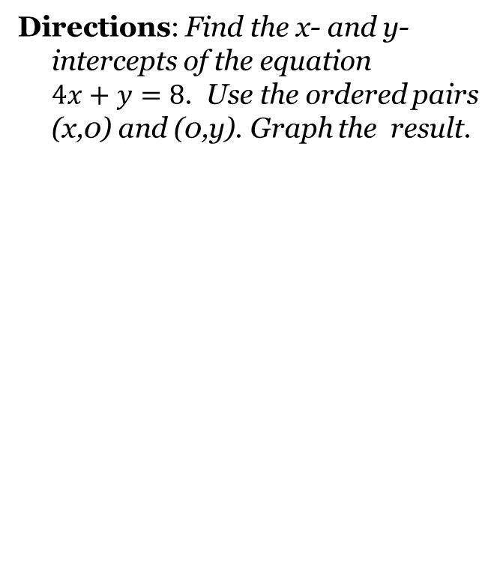
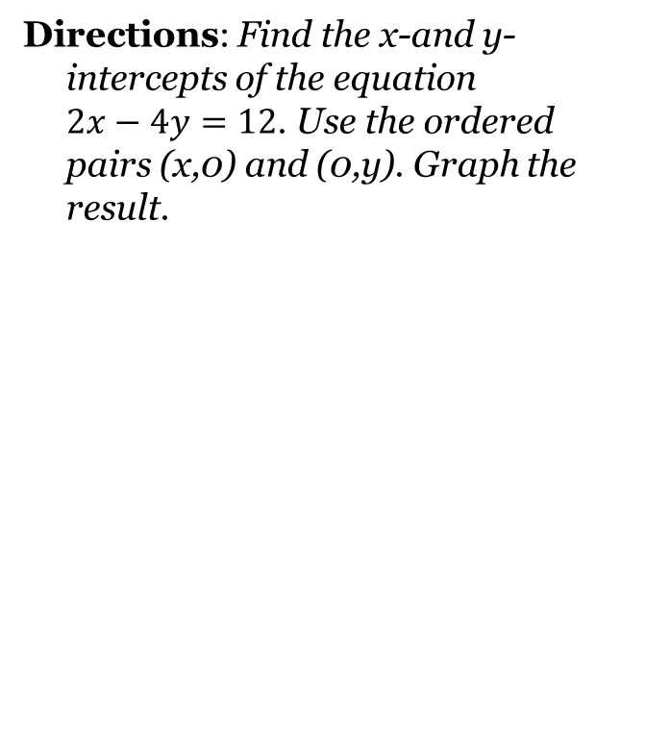
Graphing with X- and Y-Intercepts

Slide 12
Writing Equations by Solving for Y.
Rule: Rearrange the equation into slope/intercept form y$=mx+b$.
Directions: Write the equation into slope intercept form. Identify the slope and the y-intercept. Show all work.
2x+3y=9
-4x+11y=-22
2x=10

Slide 13
Closing Questions
Directions: Write down the answer to the following questions. Be prepared to discuss the answers in class.
How are equations graphed using slope/intercept form?
Part 1: Use any method to graph $3x+2y=14$ Part 2: Which method did you use and why?

Slide 14
Homework Assignment
Announcements

