Slide 1
Unit 1- Section 3“Functions, and Evaluating Functions”
Objective Covered
The student will understand the differences and similarities of relation and functions.

Slide 2
The Coordinate Plane
Definitions:
Cartesian plane: A graph using two variables x and y.
X-axis: The horizontal axis on a graph.
Y-axis: The vertical axis on a graph.
Ordered pair: A location, most commonly known as a point, denoted by (x,y).
Y
X

Slide 3
Quadrants
A Coordinate plane is divided into four parts, denoted by Roman Numerals.
Y
II
I
(-,+)
(+,+)
X
(-,-)
(+,-)
III
IV

Slide 4
Relations
Relation: A set of ordered pairs.
Domain: All of the x values in a function.
Range: All of the y values in a function.
Directions: Use the given relation to find the domain and range.
$$\left\{\left(3,4\right),\left(−2,1\right),\left(1,1\right),\left(3,5\right),\left(0,−2\right)\right\}$$
D:
R:

Slide 5
Functions
Function: A set of ordered pairs in which all domain values are different.
Vertical Line Test: If an imaginary vertical line passes through just one point on the graph, then it is a function. If it crosses more than one point, it is not a function.
Directions: Use the vertical line test to determine which of the following graphs are functions.
Y
Y
Y
Y
X
X
X
X

Slide 6

Practice Problems
Directions: Given the relations, answer the questions.
A= $\{\left(1,4\right),\left(3,−2\right),\left(2,4\right), \left(−1,5\right), \left(−3,1\right)\}$
B= {(1,0),(-3,5),(-3,2),(-1,-2)}
(1) What is the domain?
A.
B.
(2) What is the range?
A.
B.
(3) Graph the points on a Coordinate Plane.
A.
B.
(4) Label the quadrants in which each point belongs to.
A.
B.
(5) Is the relation a function?
A.
B.

Slide 7
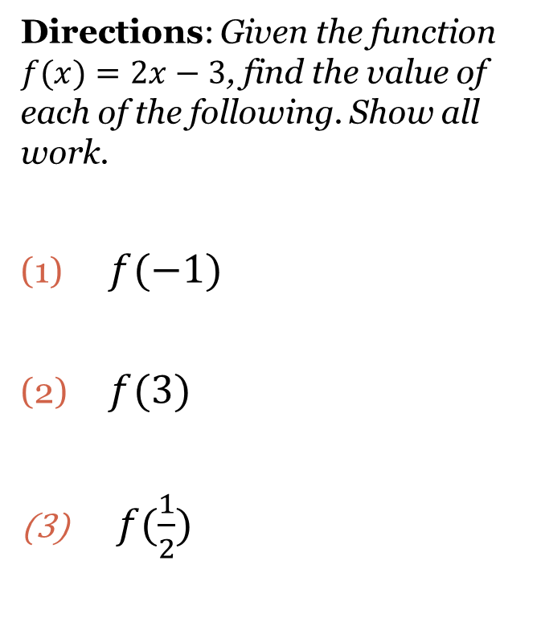
Evaluating Functions
Directions: Given the function $f(x)=2x−3$, find the value of each of the following. Show all work.
$f(−1)$
$f(3)$
$f(\frac{1}{2})$

Slide 8
Cluster Examples
Directions: Given the function $g(x)=3x+1$, evaluate each of the following. Show all work.
$g(2)$
$g(2m)$
$g(a−1)$
Directions: given the function $h(x)$=$x^{2}+3$, evaluate each of the following. Show all work.
$h(−1)$
$h$(9)

Slide 9
Closing Questions
Directions: Respond to the following questions.
What is the purpose of using the Vertical Line Test?
What is the standard function notation?
What makes a relation a function?
How do you evaluate $x^{2}+5x+1$ for $f\left(3\right)?$

Slide 10
Homework Assignment
Announcements

