Slide 1
1.4 “Applications of Linear Functions and Linear Regression”
Objective
To interpret linear graphs.
To write a linear function

Slide 2
Applying Linear Functions
When a real world situation can be modeled with a linear equation, its graph can be analyzed to find and predict specific information about the situation.
$$y=mx+b$$
M=slope
B= y-intercept
Words associated with slope:, proportion, rate of change, per, each
Words associated with y-intercept: starting point, at, total
Directions: Model each situation with a linear function and graph.
A health food store has 15 bottles of one vitamin in stock. The manufacturer ships these vitamins in boxes of 20. Write a linear function that relates the number of boxes to the total number of bottles of this vitamin at the store.
A spring goods store sells cans of tennis balls. There are 3 tennis balls in each can. The coach of the tennis team is buying supplies. Write a linear function that relates the number of cans to the total number of tennis balls. Graph the function.

Slide 3
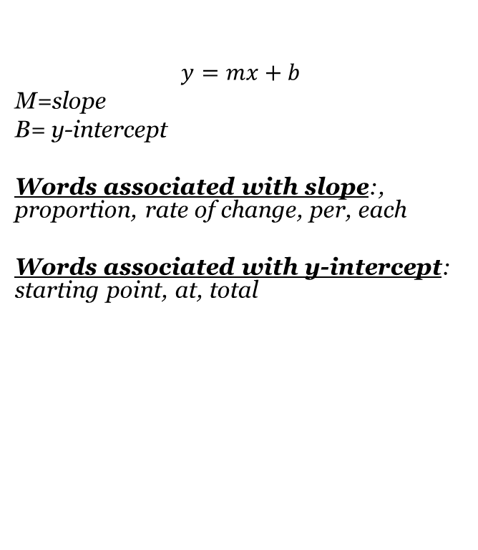
Applying Linear Functions
Directions: Model each situation with a linear function and a graph. It is reasonable to include negative numbers in the range?
A gas station that fills portable propane tanks (such as are used for camping and for outdoor barbecues) charge $2.60 per gallon.
The weight of a bucket of golf balls is a function of the number of balls, each of which weights 1.6 oz. The bucket itself weights 2 lbs.
A newly started high school hopes to enroll 80 students in its first year and to increase enrollment by 40 students per year over the next five years.
$$y=mx+b$$
M=slope
B= y-intercept
Words associated with slope:, proportion, rate of change, per, each
Words associated with y-intercept: starting point, at, total

Slide 4
Homework Assignment
Announcements

