Slide 1
Unit 2 – Section 3 “Factoring Quadratic Expressions”
Objectives covered
The student will factor quadratic equations using different methods.

Slide 2
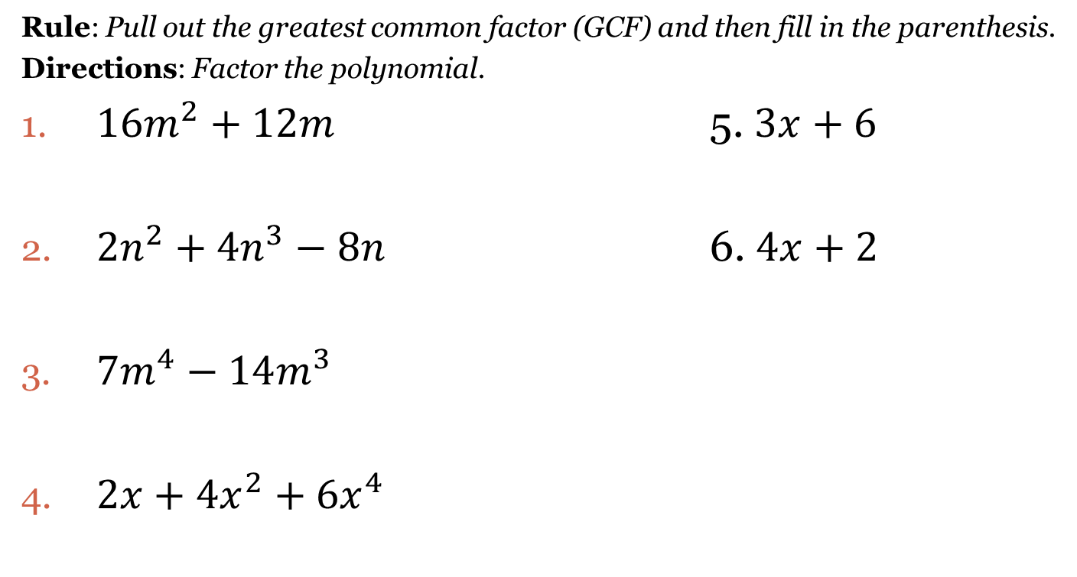
Backwards Distribution
Rule: Pull out the greatest common factor (GCF) and then fill in the parenthesis.
Directions: Factor the polynomial.
$16m^{2}+12m$ 5. $3x+6$
$2n^{2}+{4n}^{3}−8n$ 6. $4x+2$
$7m^{4}−14m^{3}$
$2x+4x^{2}+6x^{4}$

Slide 3
Factor By Grouping
Steps:
Separate the polynomial in half.
Factor the 1st half using Backwards Distribution
Repeat step 2 on the 2nd half of the polynomial
If the parenthesis match, continue.
Parenthesis is one factor.
The “factored” terms form the other.
Directions: Factor by grouping the following polynomials.
$4x^{2}+2x+6x+3$
$x^{2}−5x−3x+15$
$2x^{2}−6x+2x−6$
$3x^{2}−9x−5x+15$

Slide 4
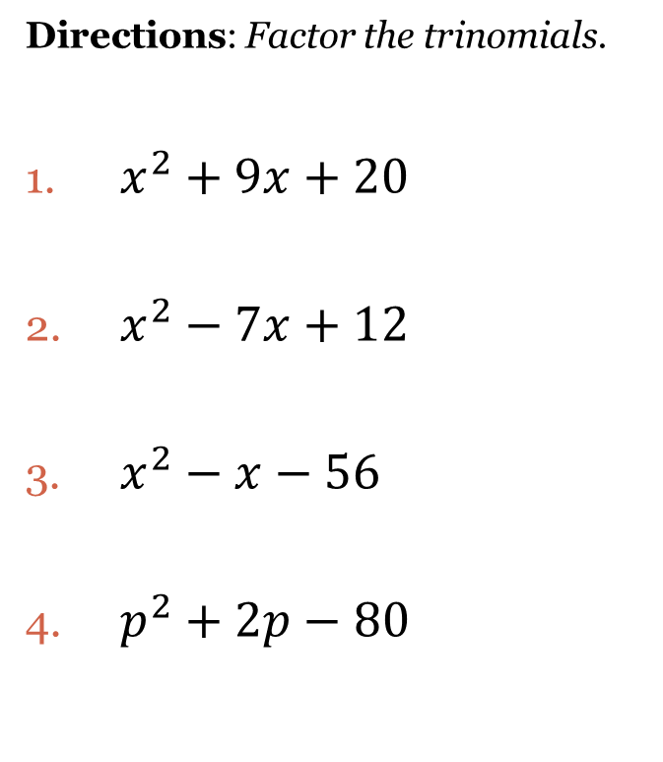
Factoring Trinomials: $x^{2}+Bx+C$
Given $x^{2}+Bx+C$, answer the following magic question:
What are the factors of “C”, that add up to “B”?
Directions: Factor the trinomials.
$x^{2}+9x+20$
$x^{2}−7x+12$
$x^{2}−x−56$
$p^{2}+2p−80$

Slide 5
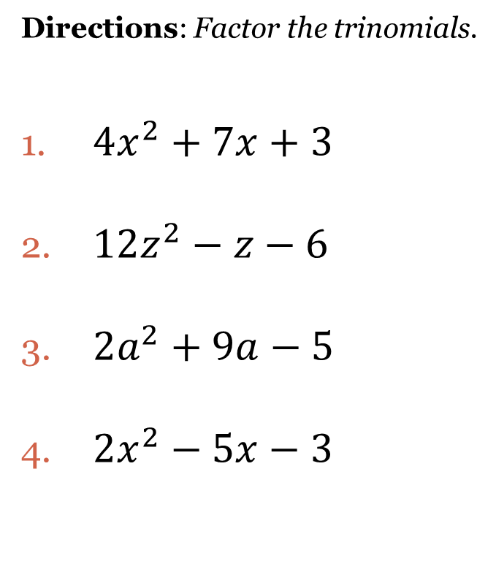
Factoring Trinomials with Leading Coefficients ${Ax}^{2}+Bx+C$
Steps:
Multiply the leading coefficient “A” by the constant “C”.
What are the factors of “AC” that add up to “B”?
Factor.
Divide each number by the leading coefficient used in step one “A”.
Reduce/Divide/Cancel.
Rewrite any denominator in front of the variable.
Directions: Factor the trinomials.
$4x^{2}+7x+3$
$12z^{2}−z−6$
$2a^{2}+9a−5$
$2x^{2}−5x−3$

Slide 6

Factoring Differences of Squares
Rule: $a^{2}−b^{2}=(a+b)(a−b)$
Conditions:
Must be a binomial.
Must have a “-” sign in between.
Must be able to take the square root of both terms.
Directions: Factor each binomial.
$x^{2}−25$
$4x^{2}−81$
$b^{4}−16$
$3a^{2}−27$
$y^{2}x^{2}−16$
$x^{2}+25$

Slide 7
Closing Questions
Directions: Respond to the following questions. Be prepared to discuss your answers with the class.
1. What methods would you use to factor ${4x}^{2}−36$?
2. Factor the quadratic expression: $25x^{2}+15x+2$?
3. Which method of factoring do you like best? Why?

Slide 8
Homework Assignment
Announcements

