Slide 1
Unit 2 – Section 4 “Equations with Variables on Both Sides”
Objective covered
The student will solve an equation by moving variables to one side.

Slide 2
Pre-Assessment
Directions: Solve the equation. Show all work. Be prepared to discuss your answer with the class.
$$4x−5=2+3x$$

Slide 3
The Five Steps of Solving Equations
1. Distribute
2. Combine Like Terms
3. Move all the variables to one side by adding or subtracting.
4. Move the Number furthest from the variable.
5. Use the opposite operation to solve.

Slide 4
Equation Cluster #1

Slide 5
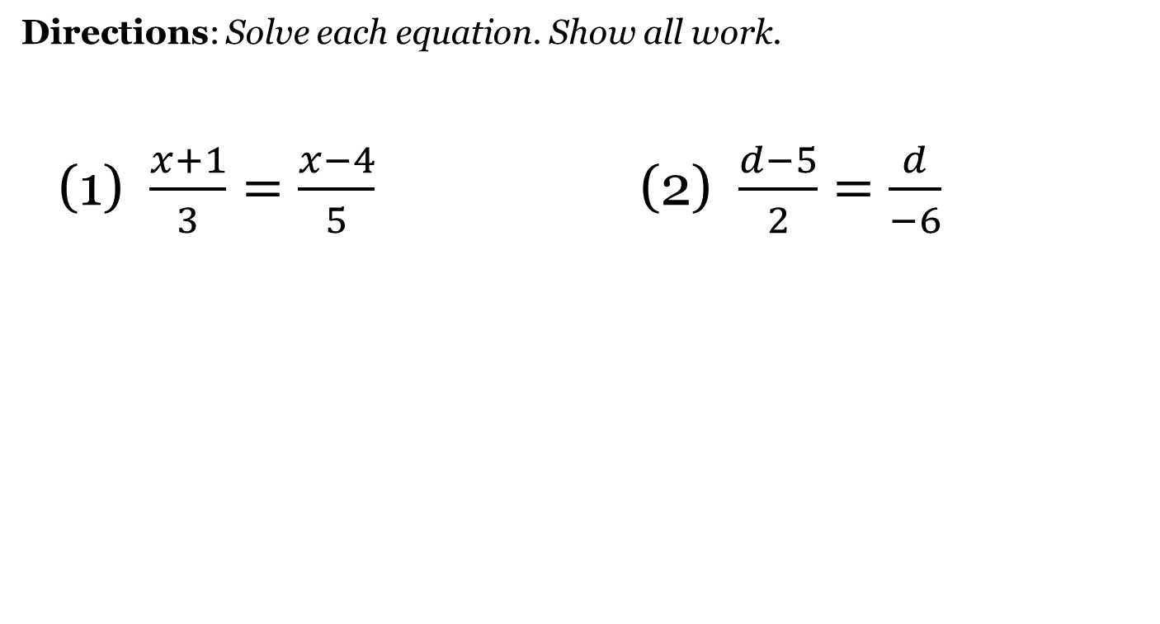
Equation Cluster #2

Slide 6
Special Case #1
NO SOLUTION
*Variables cancel each other out.
*Two numbers are unequal.

Slide 7
Special Case #2
INFINITE SOLUTION
*Variables will cancel each other out.
*Two numbers are equal.

Slide 8
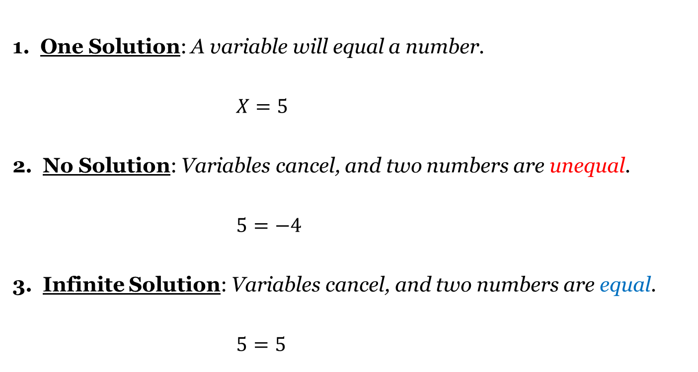
Three Types of Solutions

Slide 9
Closing Questions
Directions: Respond to the following questions. Be prepared to discuss your answers with the class.
What are the five steps of solving an equation?
What are the three different types of solutions?
Solve the following equation: $3x−6=5x+2$

Slide 10
Homework Assignment
Announcements

