Slide 1
Unit 2 – Section 5 “Writing Quadratic Functions from Points”
Objective
The student will write an equation of a quadratic function given the vertex and a point on the graph.

Slide 2
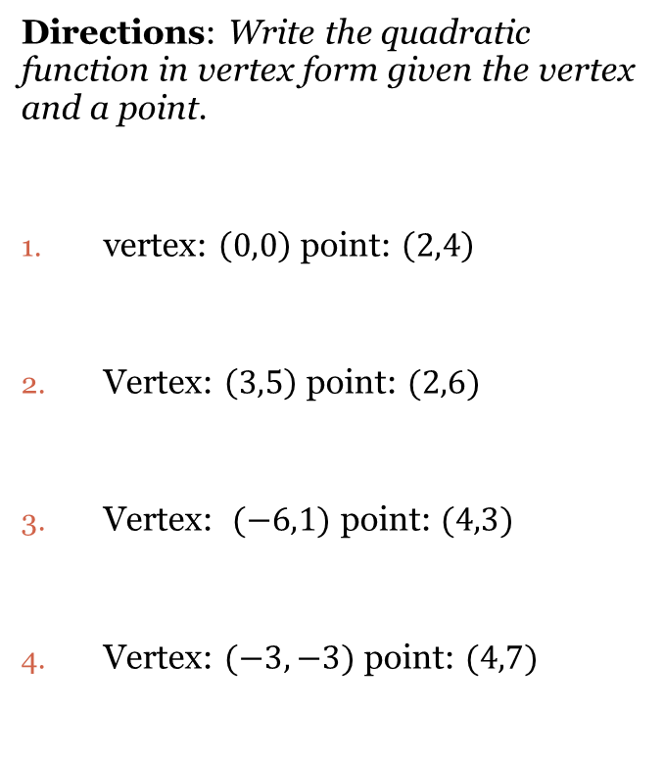
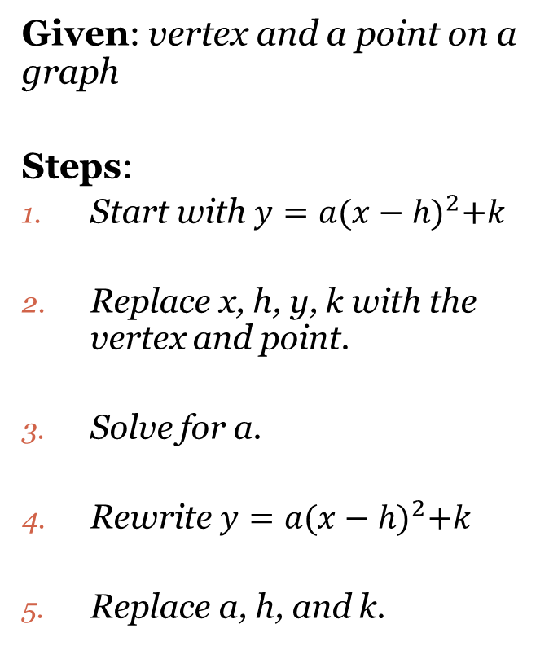
Writing Equations in Vertex Form
Given: vertex and a point on a graph
Steps:
Start with $y=a{(x−h)}^{2}+k$
Replace x, h, y, k with the vertex and point.
Solve for a.
Rewrite $y=a{(x−h)}^{2}+k$
Replace a, h, and k.
Directions: Write the quadratic function in vertex form given the vertex and a point.
vertex: $\left(0,0\right)$ point: $\left(2,4\right)$
Vertex: $\left(3,5\right)$ point: $(2,6)$
Vertex: $(−6,1)$ point: $(4,3)$
Vertex: $(−3,−3)$ point: $(4,7)$

Slide 3
Closing Questions
Directions: Response to the following questions. Be prepared to discuss your answers with the class.
Write the quadratic equation in vertex form given the vertex $(1,5)$ and $(−2,6)$.

Slide 4
Homework Assignment
Announcements

