Slide 1
Unit 2- Section 6 “Perform Operations with Complex Numbers”
Objectives
The student will simplify square roots containing negative radicands
The student will solve quadratic equations that have pure imaginary solutions
The student will add, subtract, and multiply complex numbers.

Slide 2
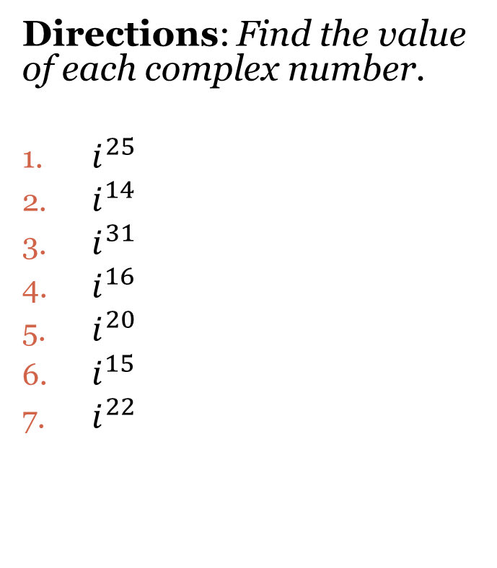
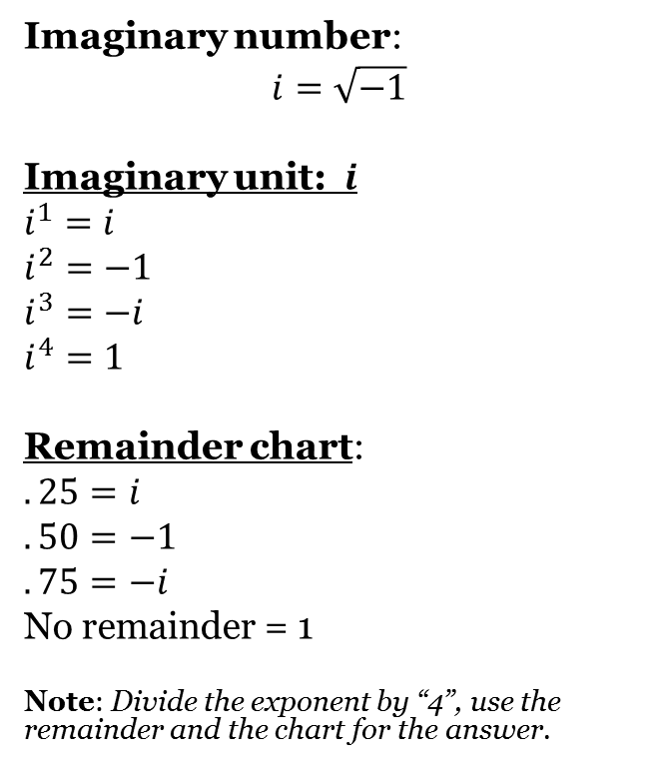
Complex Numbers
Imaginary number:
$$i=\sqrt{−1}$$
Imaginary unit: $i$
$$i^{1}=i$$
$$i^{2}=−1$$
$$i^{3}=−i$$
$$i^{4}=1$$
Remainder chart:
$$.25=i$$
$$.50=−1$$
$$.75=−i$$
No remainder = 1
Note: Divide the exponent by “4”, use the remainder and the chart for the answer.
Directions: Find the value of each complex number.
$i^{25}$
$i^{14}$
$i^{31}$
$i^{16}$
$i^{20}$
$i^{15}$
$i^{22}$

Slide 3
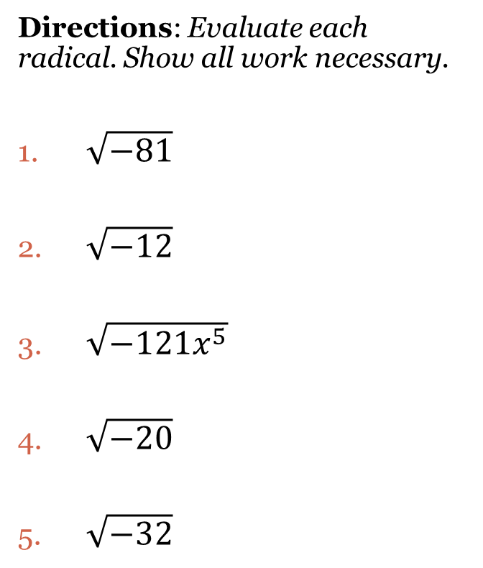
Evaluating Radical and Complex Numbers
$$\sqrt{{−b}^{2}}=bi$$
Note: It may be necessary to simplify the radical using the Factor Tree method.
Note: Put “$i$” on the outside of the radical.
EX: $\sqrt{−40x^{4}}=2x^{2}i\sqrt{10}$
Directions: Evaluate each radical. Show all work necessary.
$\sqrt{−81}$
$\sqrt{−12}$
$\sqrt{−121x^{5}}$
$\sqrt{−20}$
$\sqrt{−32}$

Slide 4
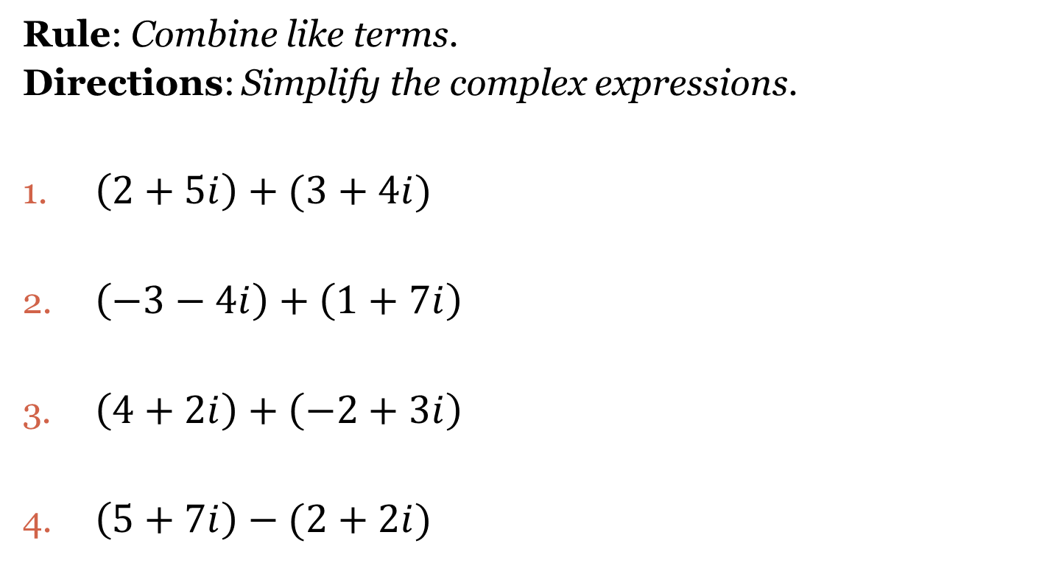
Adding Complex Numbers
Rule: Combine like terms.
Directions: Simplify the complex expressions.
$\left(2+5i\right)+(3+4i)$
$\left(−3−4i\right)+\left(1+7i\right)$
$\left(4+2i\right)+\left(−2+3i\right)$
$\left(5+7i\right)−(2+2i)$

Slide 5
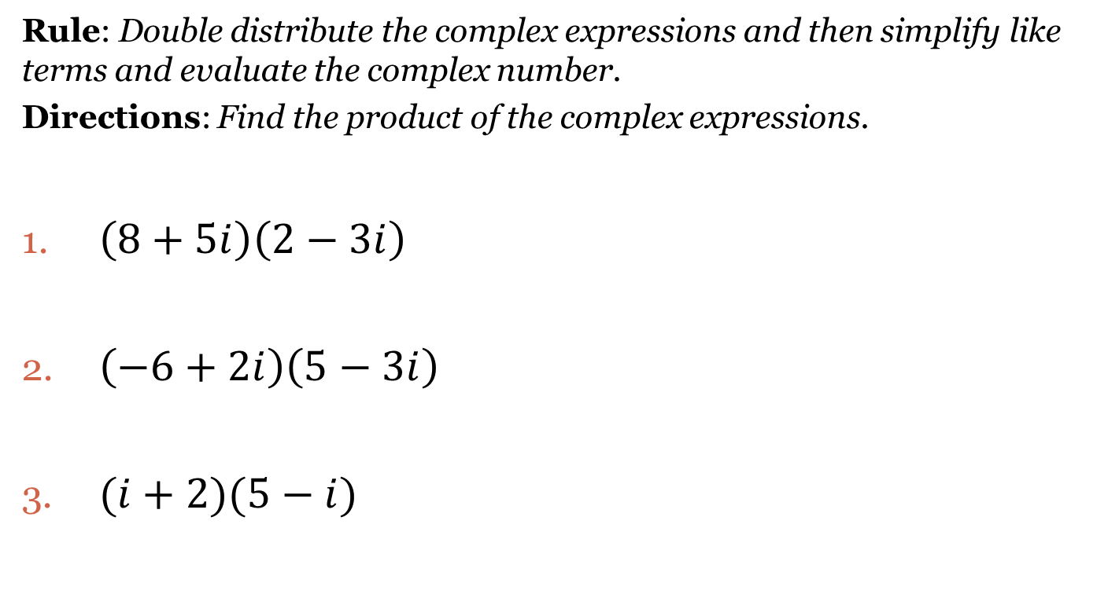
Double Distribution
Rule: Double distribute the complex expressions and then simplify like terms and evaluate the complex number.
Directions: Find the product of the complex expressions.
$\left(8+5i\right)\left(2−3i\right)$
$\left(−6+2i\right)\left(5−3i\right)$
$(i+2)(5−i)$

Slide 6

Cluster Examples of Double Distribution
Directions: Find the product of the complex expressions.
1. $(5i−1)(3i+5)$ 2. $(2−i)(i+7)$

Slide 7

Simplifying Conjugates
Rule: Double distribute each pair of conjugates and simplify.
Directions: Find the product of each pair of conjugates. Show all work.
1. $(6+3i)(6−3i)$ 2. $(9−7i)(9+7i)$ 3. $(5i−2)(5i+2)$

Slide 8
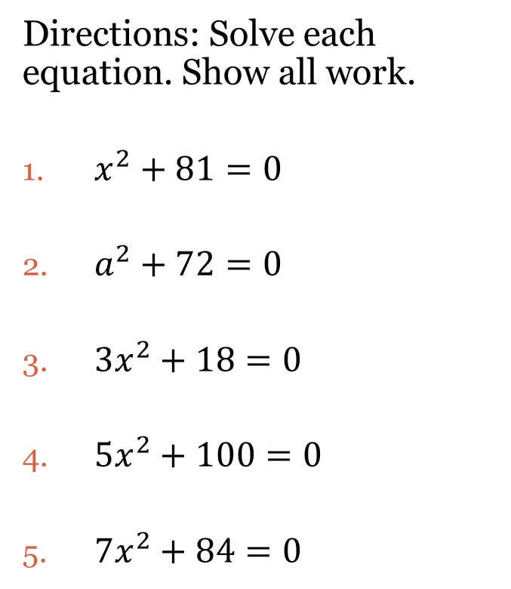
Solving Equations
Steps:
Isolate the variable
Take the square root of both sides.
Simplify the radical.
Directions: Solve each equation. Show all work.
$x^{2}+81=0$
$a^{2}+72=0$
$3x^{2}+18=0$
$5x^{2}+100=0$
$7x^{2}+84=0$

Slide 9
Closing Questions
Directions: Respond to the following questions. Be prepared to discuss your answers with the class.
Solve the equation: $5x^{2}=−100$.
Use double distribution to simplify the following: $(i+2)(i−4)$

Slide 10
Homework Assignment
Announcements

