Slide 1
Unit 2 – Section 6 “Solving Inequalities
Objective
The student will solve inequalities
The student will describe solutions with graphs.

Slide 2
Inequality Symbols
< Less than
Fewer than
> Greater than
More than
≤ Less than or equal to
At most
No more than
≥ Greater than or equal to
At least
No less than
≠ Not equal to
Directions: Write an algebraic expression for each verbal statement.
X is no more than 5.
X is at most 3.
X is more than 2.
X is greater than or equal to 0.

Slide 3
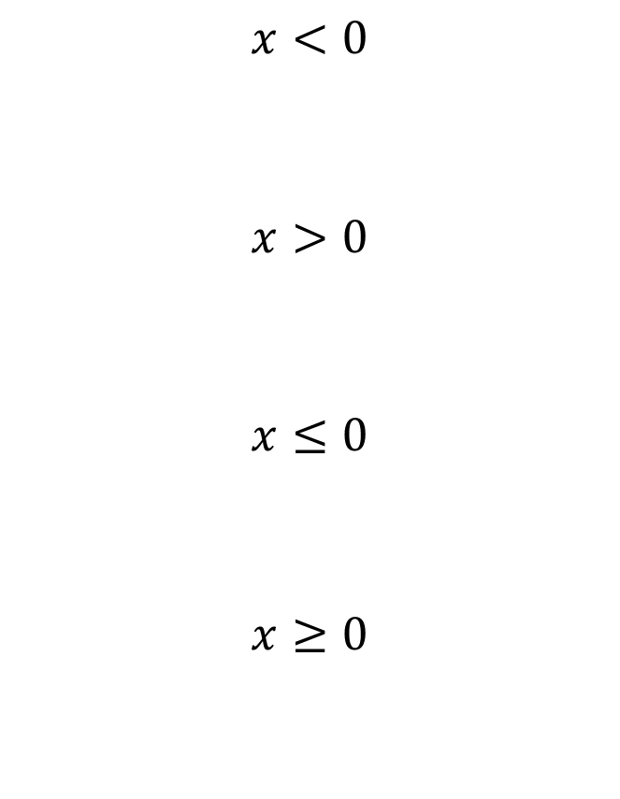
Graphing Inequalities

Slide 4
Solving Inequalities with Addition and Subtraction

Slide 5
Special Case: “The Case of Negative Variables”

Slide 6
When multiplying or dividing by a negative number, flip the inequality sign.

Slide 7
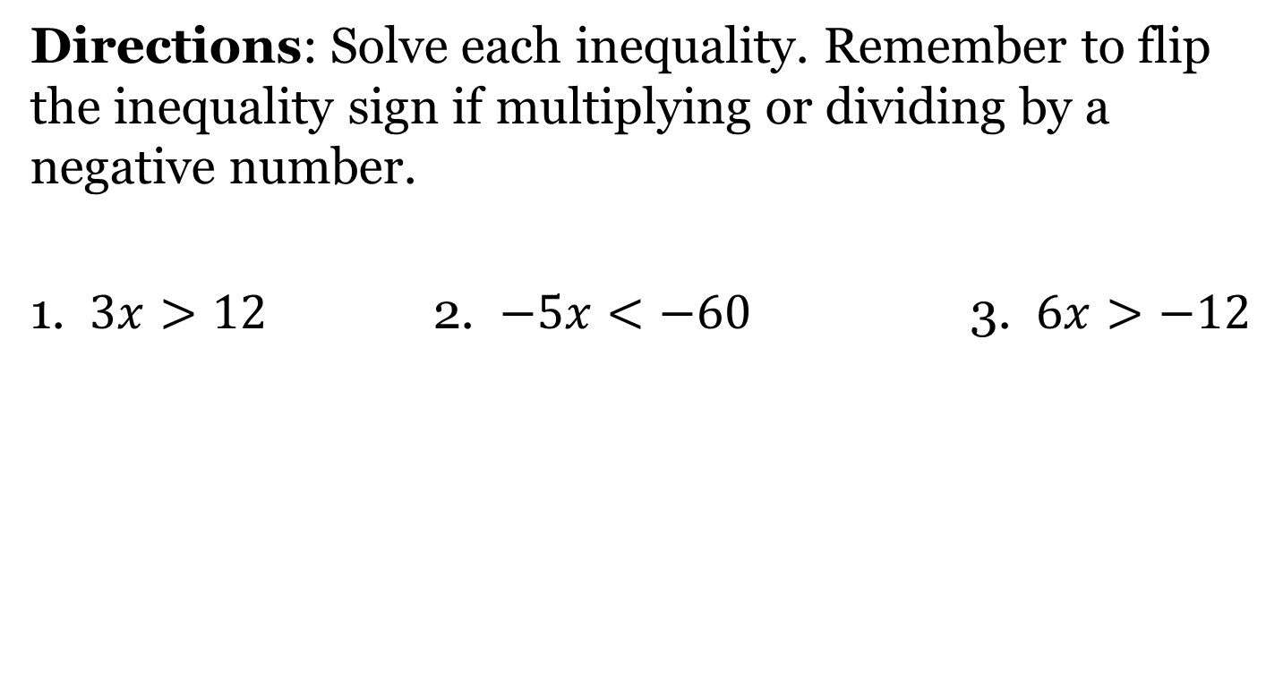
Solving Inequalities: Multiplication/Division Part 1

Slide 8
Solving Inequalities Multiplication/Division Part 2

Slide 9
Solving Inequalities Multiplication and Division Part 3

Slide 10
Solving Verbal Statements
Directions: Write an algebraic expression. Solve the inequality. Show all work.
3 multiplied by x is no more than 18.
X decreased by 1, is at most 2.

Slide 11
Closing Questions Part 1

Slide 12
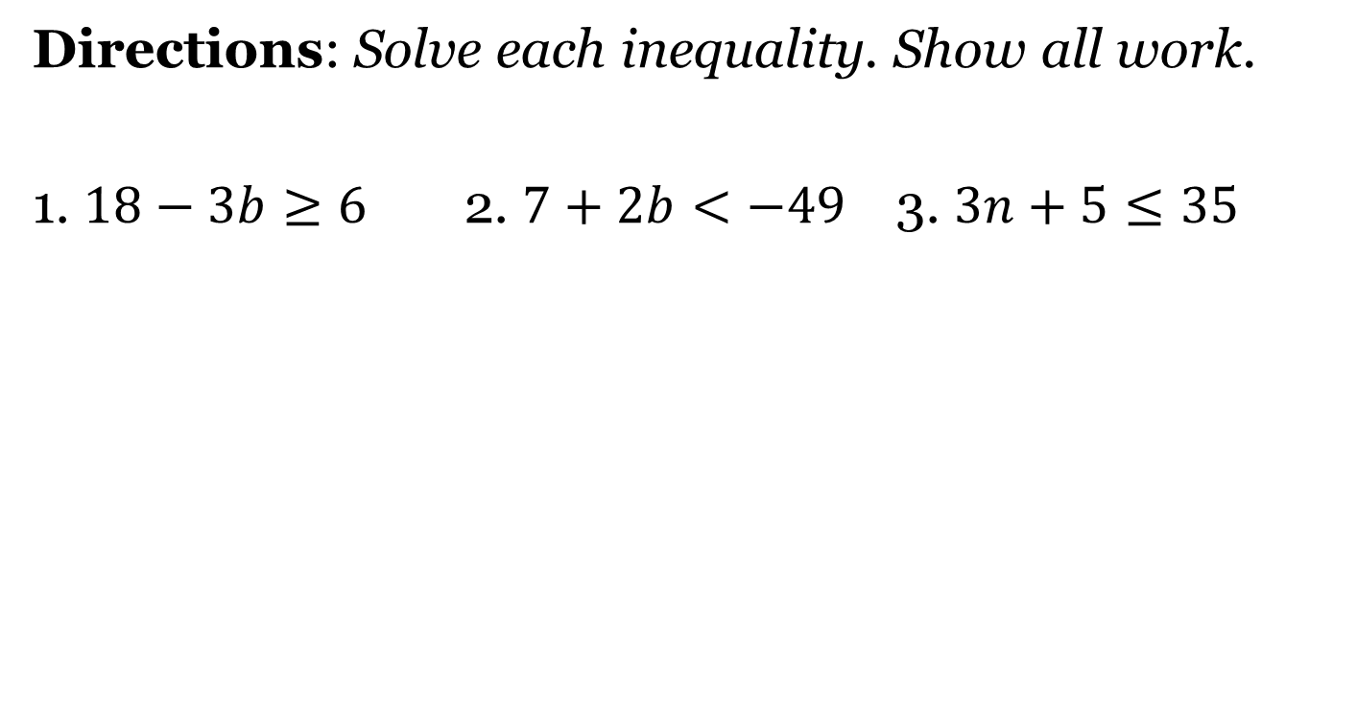
Multistep Inequalities Cluster Examples #1
Graph the solution for numbers 1&2

Slide 13
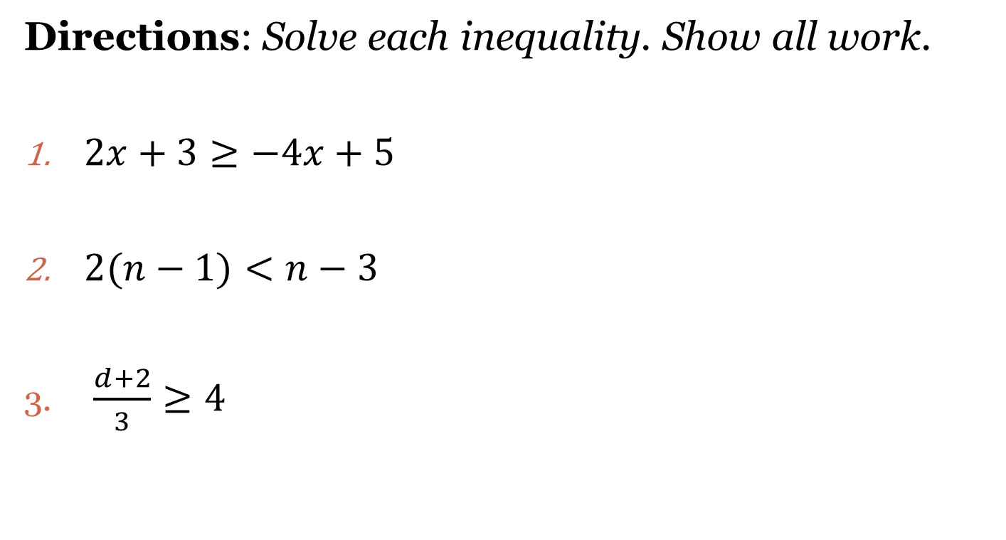
Multistep Inequalities Cluster Examples #2

Slide 14
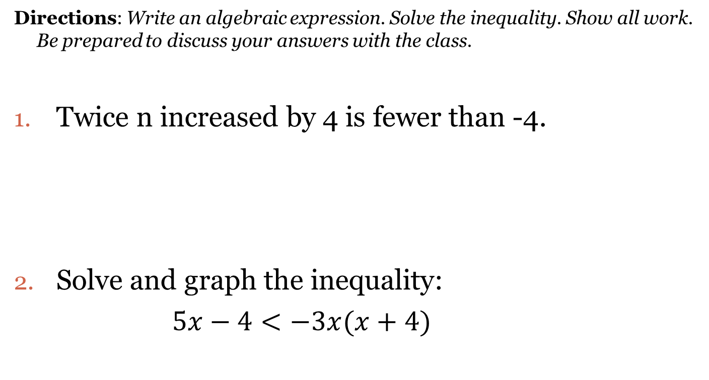
Closing Questions: Solving Verbal Statements Part 2
Directions: Write an algebraic expression. Solve the inequality. Show all work. Be prepared to discuss your answers with the class.
Twice n increased by 4 is fewer than -4.
Solve and graph the inequality:
$5x−4<−3x(x+4)$

Slide 15
Homework Assignment
Announcements

