Slide 1
Unit 2 – Section 7“Completing the Square”
Objectives Covered
The student will solve a quadratic function by completing the square
The student will rewrite an equation in vertex form using the completing the square method

Slide 2
Purpose of Completing the Square
The purpose of completing the square is to find solutions that cannot be found by factoring.
Factoring yields solutions that are rational and real.
Completing the square yields solutions that are irrational, rational, complex, and real.
In other words, irrational solutions nor complex solutions can be found by factoring, therefore, completing the square is necessary.

Slide 3
Completing the Square
Directions: Solve the polynomial by completing the square.
$x^{2}−8x=20$
$x^{2}+12x+27=0$
$a^{2}+6a+8=0$
${2a}^{2}+16a+30=0$
Note: All the solutions are real and rational.
Completing the Square: Finding solutions to quadratic equations.
$${ax}^{2}+bx+c$$
Steps:
Get everything equal to the constant.
Factor by the coefficient of “$x^{2}$”
Take the coefficient of $"x“$ and:
Divide it by 2. (remember this #)
Square it.
Add the result to both sides.
Factor the left side, simplify the right.
Take the square root of both sides.
Solve for x.

Slide 4
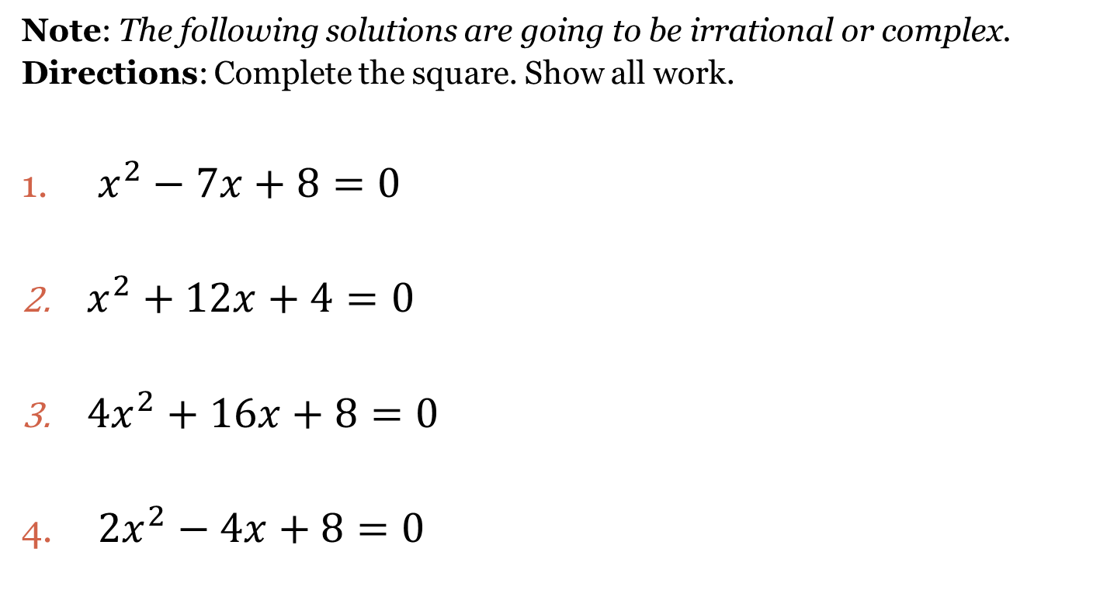
Completing the Square
Note: The following solutions are going to be irrational or complex.
Directions: Complete the square. Show all work.
$x^{2}−7x+8=0$
$x^{2}+12x+4=0$
${4x}^{2}+16x+8=0$
$2x^{2}−4x+8=0$

Slide 5
Completing the Square by Rewriting in Vertex Form
Steps:
Place function in quadratic form: ${y=ax}^{2}+bx+c$
Place parenthesis: ${(ax}^{2}+bx)+c$
Factor out the coefficient of “$x^{2}$” (if necessary), resulting in:
${a(x}^{2}+bx)+c$.
4. Take the coefficient b and:
Divide it by 2. (remember this #)
Square it.
Add on the inside subtract from the out .
5. Factor the parenthesis, simplify the outside.
New function: $y=a{(x−h)}^{2}+k$
Directions: Write each equation in parabola form by completing the square. Label the vertex and the axis of symmetry.
$y=x^{2}+4x+1$
$y=x^{2}+4x+3$
$y={2x}^{2}−12x+6$

Slide 6
Closing Questions
Directions: Respond to the following questions. Be prepared to discuss the answers with the class.
Solve $x^{2}−18x+32=0$ by completing the square.
Rewrite the function $f\left(x\right)=x^{2}−18x+32$ in vertex form.

Slide 7
Homework Assignment
Announcements

