Slide 1
Unit 3 – Section 2 “Properties and Characteristics of Polynomial Equations”
Objectives:
To classify polynomials
Use operations to evaluate polynomial functions

Slide 2
Polynomial Function Terminology
Polynomial Function: Functions for equations with a degree $≥2$.
Degree: highest number exponent.
Descending order: the terms of a polynomial arranged in order from greatest to least according to the exponent.
End Behavior: the direction of the graph as it continues to the left and right.

Slide 3
Classification of Polynomials
Monomial: One algebraic term resulted by a product of a coefficient, variables, and exponents.
EX: $3x^{2}y$
Polynomial: Two or more algebraic terms separated by “+” or “-”.
EX: $3x^{2}y+4x^{2}y^{5}−7x^{3}+12y^{6}$
Binomial*: Two algebraic terms separated by “+” or “-”.
EX: $x^{2}+x$
Trinomial**: Three algebraic terms separated by a “+” or “-”.
EX: $x^{2}+5x+6$
*Binomials and Trinomials are also Polynomials.
**Trinomials will be covered extensively in factoring.

Slide 4
Classifying Polynomials
Directions: Use the following functions and label the following:
The degree of the polynomial
Name of the polynomial using the number of terms.
1. $x^{3}+9$ 2. $4x^{2}−3x+1$ 3. $x^{4}−3x^{3}−2x+1$
4. $3x$ 5. $2x^{5}−4x^{3}+2x^{2}$

Slide 5
Adding and Subtracting Polynomials
Rule: Combine coefficients with like terms and keep everything else the same. If subtracting, do K.C.C.
Directions: Find the sum or difference of the polynomial.
${(−4x}^{3}−3x+10x^{2})−({8x}^{2}+2x−x^{3}−x^{4})$
$\left({2x}^{2}+3xy+5y^{2}\right)+\left(4x^{2}−3xy−2y^{2}\right)$
$\left(x^{3}+5x\right)−\left({2x}^{3}−3x\right)$
($x^{2}+3x+5)+(−2x^{2}−5x+9)$

Slide 6
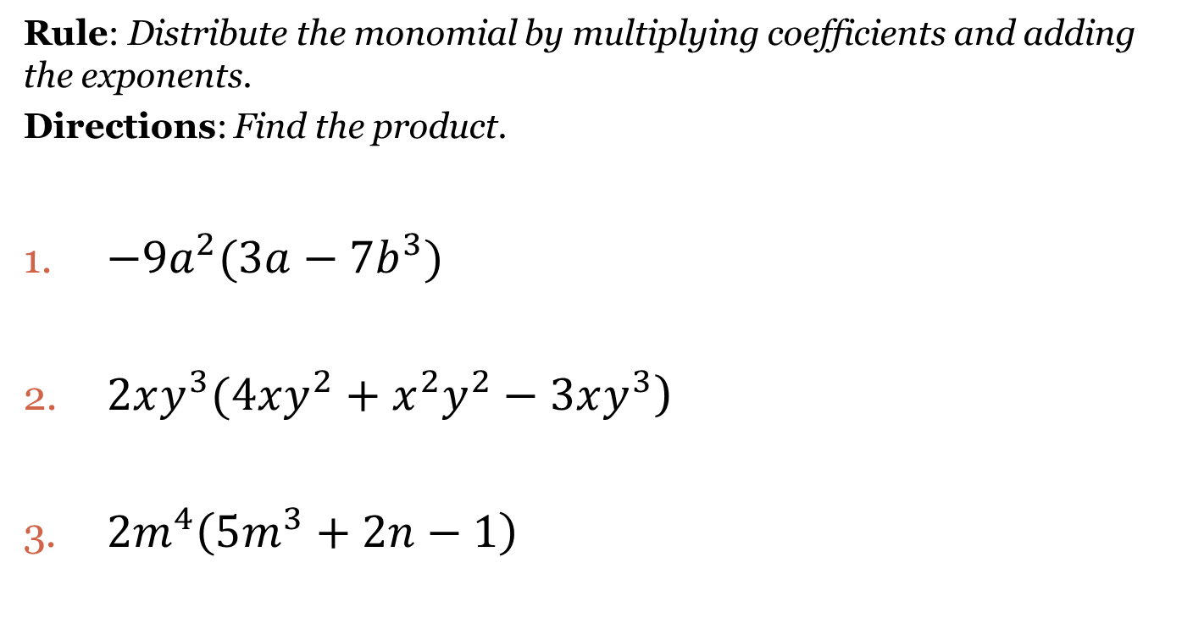
Distribution of a Monomial to a Polynomial
Rule: Distribute the monomial by multiplying coefficients and adding the exponents.
Directions: Find the product.
$−9a^{2}(3a−7b^{3})$
$2xy^{3}(4xy^{2}+x^{2}y^{2}−3xy^{3}$)
$2m^{4}\left(5m^{3}+2n−1\right)$

Slide 7
Double Distribution
Rule: Distribute the first term to both terms in the second polynomial, distribute the second term to polynomial, simplify like terms.
Directions: Find the product of the binomials.
$({3y}^{2}−2)(−2y+1)$
$(x−2)({2x}^{2}+10x−4)$
${(x+3)}^{2}$
${(x−1)}^{2}$
$(x+1)(x^{2}−3x+5)$

Slide 8
Closing Questions
Directions: Respond to the following questions. Be prepared to discuss your answers with the class.
Provide an example of a trinomial of degree 6.
Find the product of the following:
$\left(x^{3}−2\right)\left(x^{2}−5\right)$

Slide 9
Homework Assignment
Announcements

