Slide 1
Unit 3 – Section 3 “Functions”
Objectives covered
The student will evaluate functions using order of operations.
The student will identify whether a relation or graph is a function.
The student will investigate functions using the vertical line test.

Slide 2
Functions

Slide 3
Vertical Line Test
Vertical Line Test: If an imaginary vertical line passes through just one point on the graph, then it is a function. If it crosses more than one point, it is not a function.
Directions: Use the vertical line test to determine which of the following graphs are functions.
Y
Y
Y
Y
X
X
X
X

Slide 4
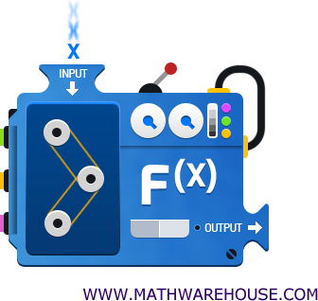
X- input
Y- output
When x is put into the function, use order of operations to find y.
If the equation is $2x+4$, find the y-value given the x-value.
$x=2$
$x=−3$
$x=5$
$x=−1$
Y

Slide 5
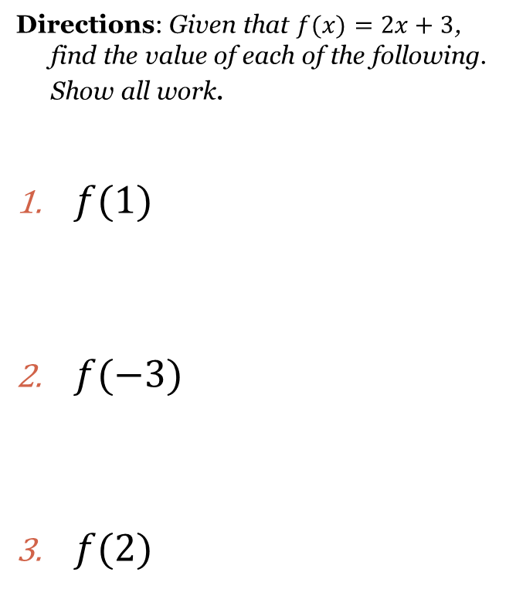
Evaluating Functions

Slide 6
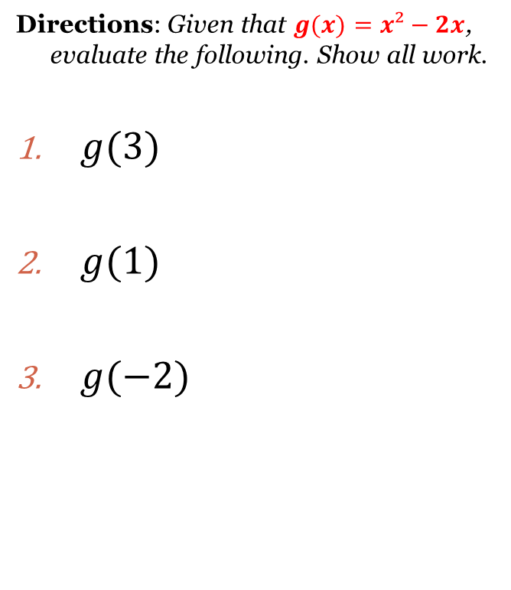
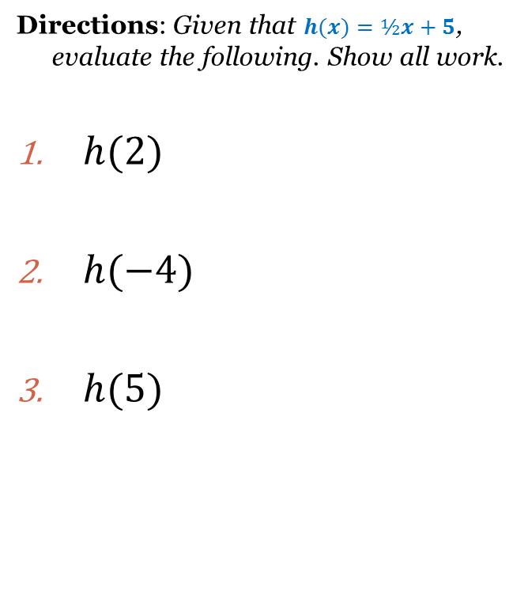
Cluster Examples

Slide 7
Closing Questions
Directions: Respond to the following questions. Be prepared to discuss your answers with the class.
What is the purpose of using the Vertical Line Test?
Are all relations considered functions, or, are all functions considered relations? Explain.
Given the function $f\left(x\right)=−2x+5$, find $f(−6)$.

Slide 8
Homework Assignment
Announcements

