Slide 1
Unit 3 -Section 4 “Factor and Solve Polynomial Equations”
Objectives
To solve polynomial equations by graphing.
To solve polynomials equations by factoring

Slide 2

Factoring a Cube
Steps:
Make the binomial by figuring out the cube of each term.
Create the trinomial by using the factored binomial.
Square the first term.
Multiply the two terms and change the sign.
Square the last term.
Check using S.O.AP.
S=Same sign
O=Opposite sign
AP=Always positive
Directions: Factor each cube.
$x^{3}+27$
$x^{3}−8$
$x^{3}−216y^{3}$
$a^{3}−b^{3}$
$x^{3}+1$

Slide 3
Solving Polynomial Equations
Steps:
Factor the cube.
Set each ( ) equal to zero and solve.
For the trinomial factor, use completing the square or the quadratic formula.
$$x=\frac{−b±\sqrt{b^{2}−4ac}}{2a}$$
Directions: Solve each polynomial equation.
$x^{3}+8=0$
$x^{3}−27=0$

Slide 4
Factoring Using a Quadratic Pattern
Directions: Factor each polynomial completely.
$x^{4}+7x^{2}+6$
$x^{4}−6x^{2}−27$

Slide 5
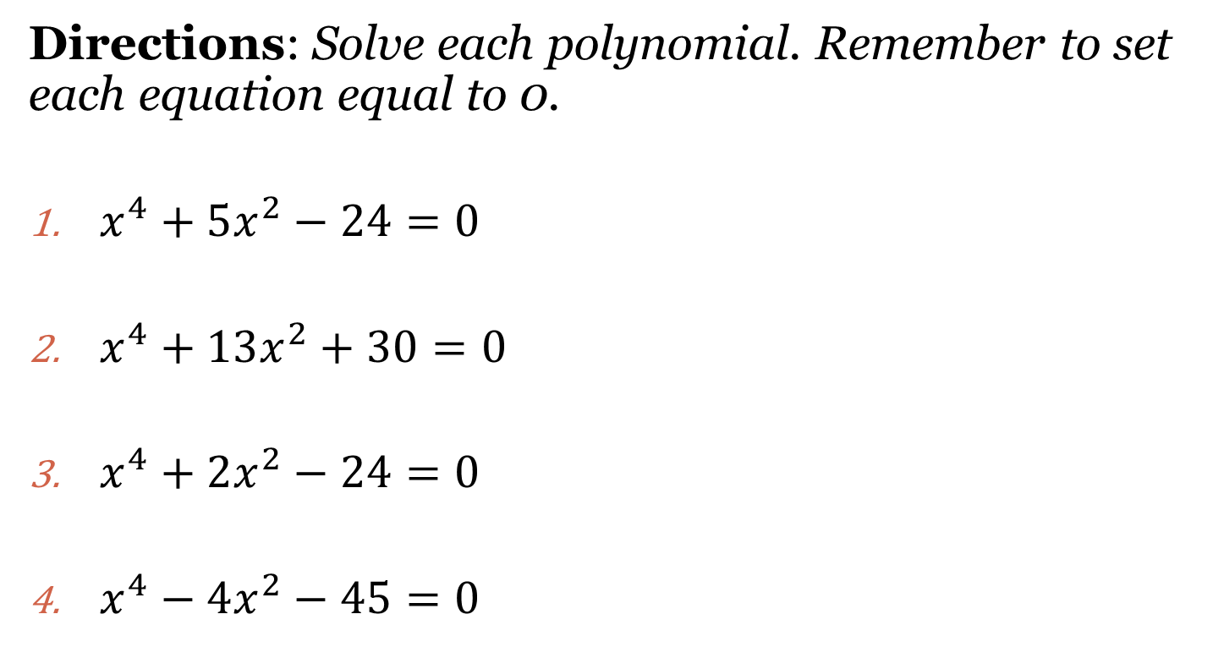
Solve by Factoring by Using a Quadratic Pattern
Directions: Solve each polynomial. Remember to set each equation equal to 0.
$x^{4}+5x^{2}−24=0$
$x^{4}+13x^{2}+30=0$
$x^{4}+2x^{2}−24=0$
$x^{4}−4x^{2}−45=0$

Slide 6
Factor By Grouping (and Solve)
Steps:
Separate the polynomial in half.
Factor the 1st half using Backwards Distribution
Repeat step 2 on the 2nd half of the polynomial
If the parenthesis match, continue.
Parenthesis is one factor.
The “factored” terms form the other.
Directions: Factor by grouping the following polynomials.
$4x^{3}+2x^{2}+6x+3$=0
$x^{3}−5x^{2}−3x+15=0$
$2x^{3}−6x^{2}+2x−6=0$
$3x^{3}−9x^{2}−5x+15=0$

Slide 7
Closing Questions
Directions: Respond to the following questions. Be prepared to discuss the answers with the class.
Solve the equation: $8x^{3}+1=0$.
Solve the equation: $x^{3}−5x^{2}+x−5=0$.

Slide 8
Homework Assignment
Announcements

