Slide 1
Unit 3-Section 4 “Functions, Tables, Graphs”
Objectives
The student will apply a function to a graph by using tables.

Slide 2
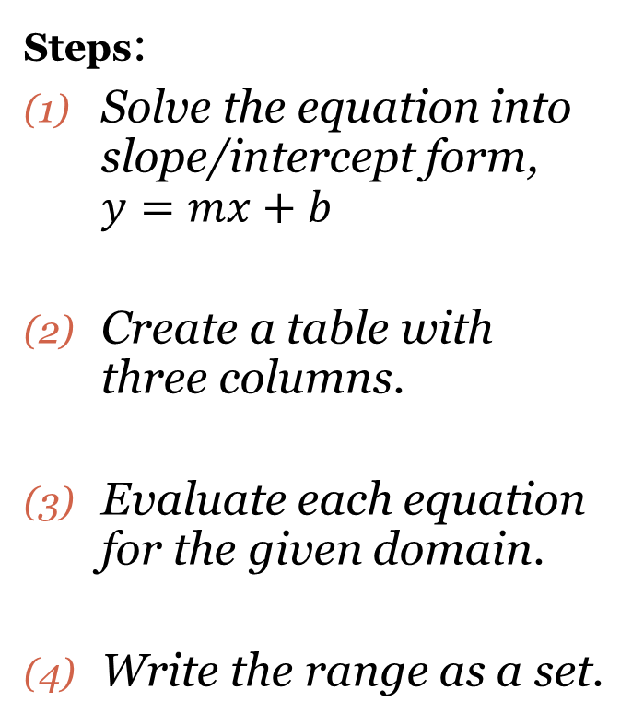

Using the Domain to Find the Range
$$X$$ | $$Function$$ | $$Y$$ | $$(x,y)$$
$y=\frac{1}{2}x+5 \left\{−6,−4,0,2\right\}$
$y=3x−2 \{−5,−1,6\}$

Slide 3
Graphing Linear Equations
Steps:
Solve the equation into slope/intercept form, y=mx+b.
Create a table with four columns.
Evaluate each equation for the given domain.
Write the relation as a set of ordered pairs.
Graph the line on the Coordinate Plane.
$$X$$ | $$Function$$ | $$Y$$ | $$(x,y)$$

Slide 4
Closing Questions
Directions: Respond to the following questions, be prepared to discuss your answers with the class.
1. How do you graph the function $f\left(x\right)=5x$, using the domain $\{−2,−1,0,2\}$?

Slide 5
Homework Assignment
Announcements

