Slide 1
Unit 3 – Section 5 “Graphing Polynomial Functions” Part 2
Objectives
The student will be able to identify local maximum and minimum points on a graph.
The student will be able to determine the degree of the polynomial based on finite differences.
The student will utilize technology to write a function in polynomial form.

Slide 2
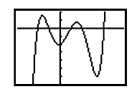
Maximum and Minimum Points
Maximum Number of Turning Points:
The total number of turning points possible, is 1 less than the degree of a polynomial.
Local Maximum and Minimum. Functions can have "hills and valleys": places where they reach a minimum or maximum value. It may not be the minimum or maximum for the whole function, but locally it is.
Directions: Determine the total number of possible turning points for each polynomial functions.
1.
2.
3.

Slide 3
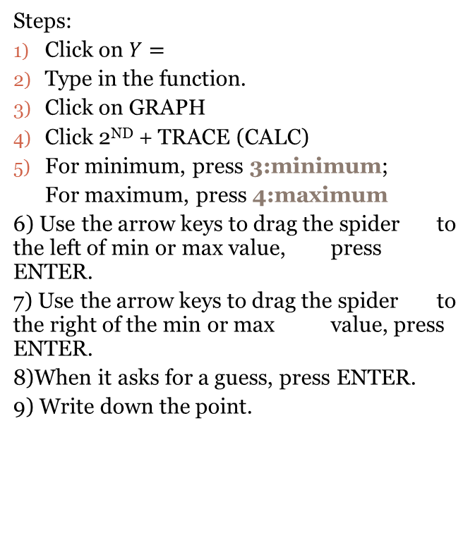
Using the TI-84 Calculator to find the Local Maximum and Local Minimum
Steps:
Click on $Y=$
Type in the function.
Click on GRAPH
Click 2ND + TRACE (CALC)
For minimum, press 3:minimum;
For maximum, press 4:maximum
6) Use the arrow keys to drag the spider to the left of min or max value, press ENTER.
7) Use the arrow keys to drag the spider to the right of the min or max value, press ENTER.
8)When it asks for a guess, press ENTER.
9) Write down the point.
Directions: Find the local maximum and minimum values of the polynomials.
1.
2.
3.

Slide 4
Finite Differences
Finite Differences: A method for determining the degree of the polynomial that models a set of data.
Steps:
Given a table, with coordinates,
Subtract the corresponding y values. If the difference is the same, stop, if not, continue.
Subtract the new corresponding y values. If the difference is the same, stop, it not, continue…
Once the differences become the same, determine the number of columns it took to reach that constant value. That is the degree of the polynomial.
Directions: Determine the degree of the polynomial that matches the tables.
X | Y
1 | -10
2 | -9
3 | -4
4 | 5
5 | 18
6 | 35
X | Y
-2 | -23
0 | -5
4 | 55
6 | 193
8 | 467
X | Y
-6 | -9
-3 | 16
0 | 26
3 | 41
6 | 78
9 | 151

Slide 5
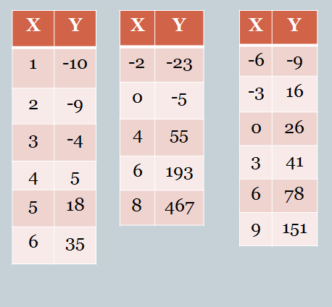
Using Finite Differences and the TI-84 Calculator to write a Polynomial Function
After finding the degree of the polynomial using the table….
Calculator Directions for TI-83 and TI-84
To enter data:
1. Go to Stat→Edit→$L_{1}$, enter all data for x.
2. Scroll to $L_{2}$, enter a; data for y.
3. Go to Stat→Calc→ 5:QuadReg (degree 2) 6:CubicReg (degree 3)
7:QuartReg (degree 4)
To delete data:
Go to Stat→Edit
Highlight $L_{1}$, push Clear
Highlight $L_{2}$, push Clear
Directions: Determine the polynomial function using the tables and calculator.

Slide 6
Closing Questions
Directions: Respond to the following questions. Be prepared to discuss your answers with the class.
Using the table above,
Determine the degree of the polynomial.
Use the calculator to write the function in polynomial form.
Graph the function and label a local maximum value and a local minimum value.
X | 0 | 1 | 2 | 3 | 4 | 5
Y | -4 | -6 | 0 | 20 | 60 | 126

Slide 7
Homework Assignment
Announcements

