Slide 1
Unit 3 –Section 5 Part 3 “Writing Polynomial Functions in Factored Form”
Objectives Covered
The student ill be able to identify zeros from graphs.
The student will be able to use different algebraic properties to determine the value of “a” in a polynomial function.

Slide 2
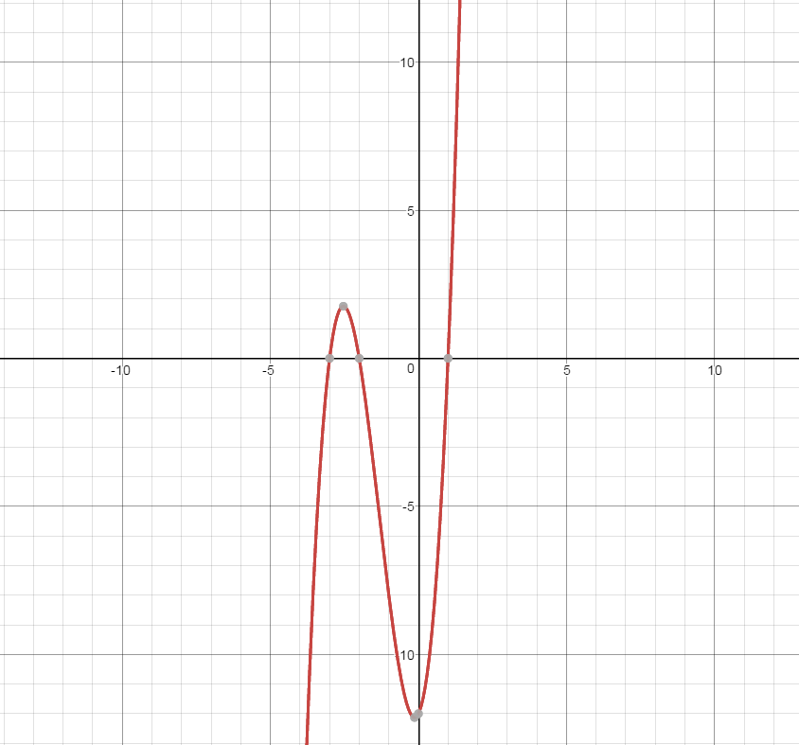
Writing Polynomial Functions in Factored Form
Steps:
Label the zeros (x-intercepts).
C/B/W: List whether the zero is a cross/bounce/wiggle.
Write factors with exponents.
Replace (x,y) with point given, and put “a” in the front.
Solve for “a”.
Rewrite step 4 with replacing the value of a in front.
Note:
Cross=1
Bounce=2
Wiggle=3
Write an equation of the following polynomial using the point (2,40).

Slide 3
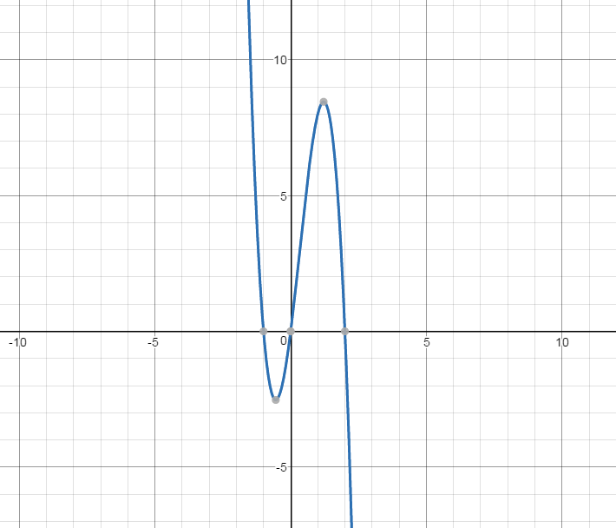
Writing Polynomial Functions in Factored Form
Steps:
Label the zeros (x-intercepts).
C/B/W: List whether the zero is a cross/bounce/wiggle.
Write factors with exponents.
Replace (x,y) with point given, and put “a” in the front.
Solve for “a”.
Rewrite step 4 with replacing the value of a in front.
Note:
Cross=1
Bounce=2
Wiggle=3
Write an equation of the following polynomial using the point (2,40).
Write an equation of the following polynomial using the point (1,8).

Slide 4
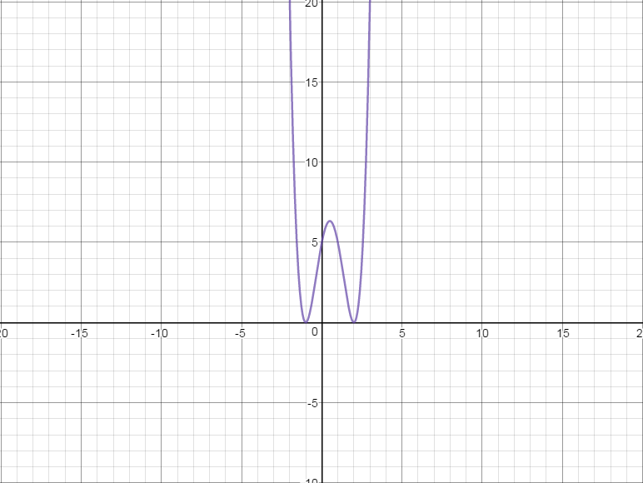
Writing Polynomial Functions in Factored Form
Steps:
Label the zeros (x-intercepts).
C/B/W: List whether the zero is a cross/bounce/wiggle.
Write factors with exponents.
Replace (x,y) with point given, and put “a” in the front.
Solve for “a”.
Rewrite step 4 with replacing the value of a in front.
Note:
Cross=1
Bounce=2
Wiggle=3
Write an equation of the following polynomial using the point (1,5).

Slide 5
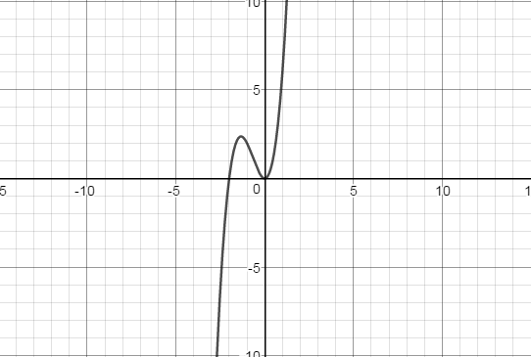
Writing Polynomial Functions in Factored Form
Steps:
Label the zeros (x-intercepts).
C/B/W: List whether the zero is a cross/bounce/wiggle.
Write factors with exponents.
Replace (x,y) with point given, and put “a” in the front.
Solve for “a”.
Rewrite step 4 with replacing the value of a in front.
Note:
Cross=1
Bounce=2
Wiggle=3
Write an equation of the following polynomial using the point (3,90).

Slide 6
Homework Assignment
Announcements

