Slide 1
Unit 3 – Section 7 “Applications of Polynomial Functions”
Objectives Covered
The student will apply real world applications to solving polynomial functions.
The student will apply geometry principles to polynomial functions.

Slide 2
Solving Polynomials
Steps:
Set up an equation.
Set the equation equal to zero.
Factor and solve.

Slide 3
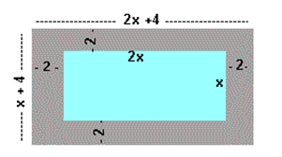
Draw a Picture

Slide 4
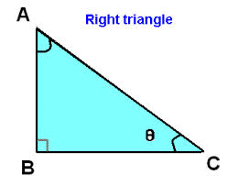
Use the Pythagorean Theorem
In a right triangle, the length of the longer leg is 7 more inches than the shorter leg. The length of the hypotenuse is 8 more inches than the length of the shorter leg.
If the shortest leg is represented by x, write expressions for the longer leg and the hypotenuse in terms of x. Label them on the diagram.
Write an equation using the Pythagorean Theorem that relates the three sides together and solve it for the value of x.
Find all three side lengths, and check your answer by verifying that $a^{2}+b^{2}=c^{2}$.

Slide 5
Homework Assignment
Announcements

