Slide 1
Unit 4 – Section 1 “Simplifying Radicals”
Objectives
To simplify radicals involving products
To simplify radicals involving quotients

Slide 2
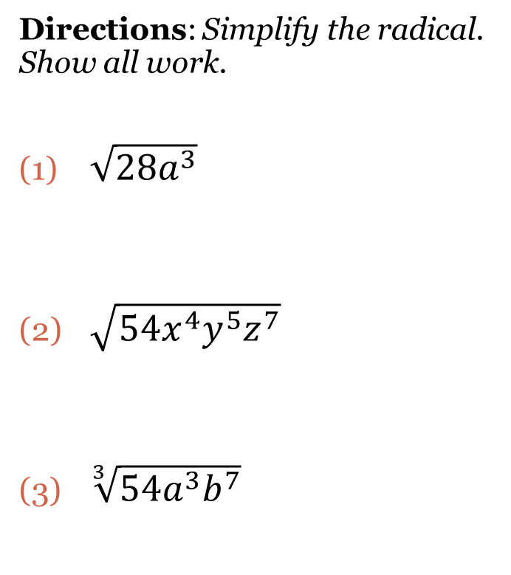
Simplifying Radicals
Steps:
Do a factor tree to find the prime factorization.
Circle the pairs.*
For each pair circled, write that number once on the outside of the radical sign.
Everything not circled is written on the inside.
Multiply to simplify.
*If the radical is a cube root, circle groups of 3, if it is a fourth root, circle groups of 4, etc.
Directions: Simplify the radical. Show all work.
$\sqrt{28a^{3}}$
$\sqrt{{54x}^{4}y^{5}z^{7}}$
$\sqrt[3]{{54a}^{3}b^{7}}$

Slide 3

Cluster Examples
Directions: Simplify the radical. Show all work.
1. $\sqrt{{60xy}^{3}}$ 2. $\sqrt[3]{{54a}^{3}b^{7}}$ 3. $\sqrt[4]{{400x}^{4}y^{12}}$

Slide 4
Multiplication of Radicals
Rule: Multiply the radicals together before simplifying.
Directions: Simplify the radicals. Show all work.
$\sqrt{{10x}^{2}y}∙\sqrt{{40xy}^{3}}$
$\sqrt{{12m}^{2}n}∙\sqrt{{6mn}^{2}}$
$\sqrt[4]{{4t}^{3}}∙\sqrt[4]{{8t}^{2}v^{5}}$

Slide 5

Division of Radicals
Rule: Laws of Exponents for Division: Divide the coefficients, subtract the exponents.
Directions: Simplify the radicals. Show all work.
1. $\frac{\sqrt{64}}{\sqrt{2}}$ 2. $\frac{\sqrt[5]{160}}{\sqrt[5]{5}}$ 3. $\frac{\sqrt{84x^{7}y^{15}}}{\sqrt{7x^{2}y^{12}}}$ 4. $\frac{\sqrt{24m^{16}n^{5}}}{\sqrt{8m^{6}n^{5}}}$

Slide 6
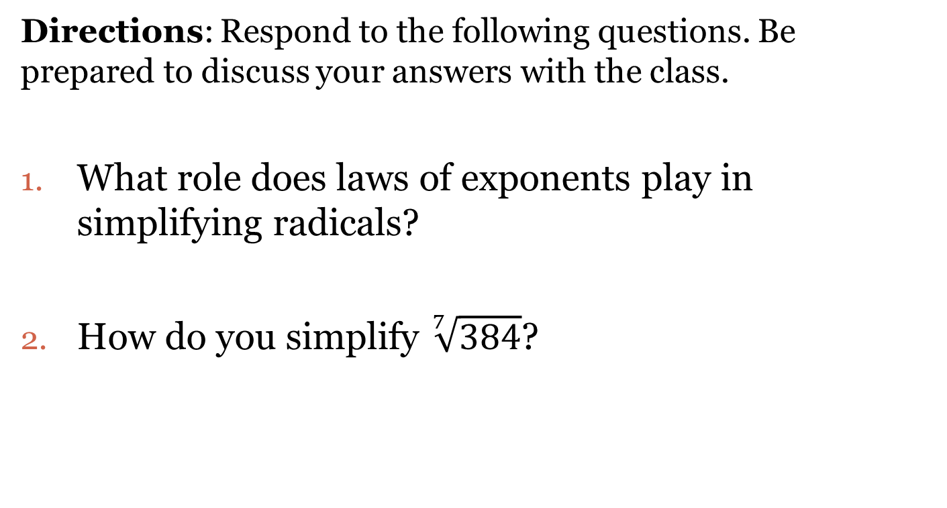
Closing Questions
Directions: Respond to the following questions. Be prepared to discuss your answers with the class.
What role does laws of exponents play in simplifying radicals?
How do you simplify $\sqrt[7]{384}$?

Slide 7
Homework Assignment
Announcements

