Slide 1
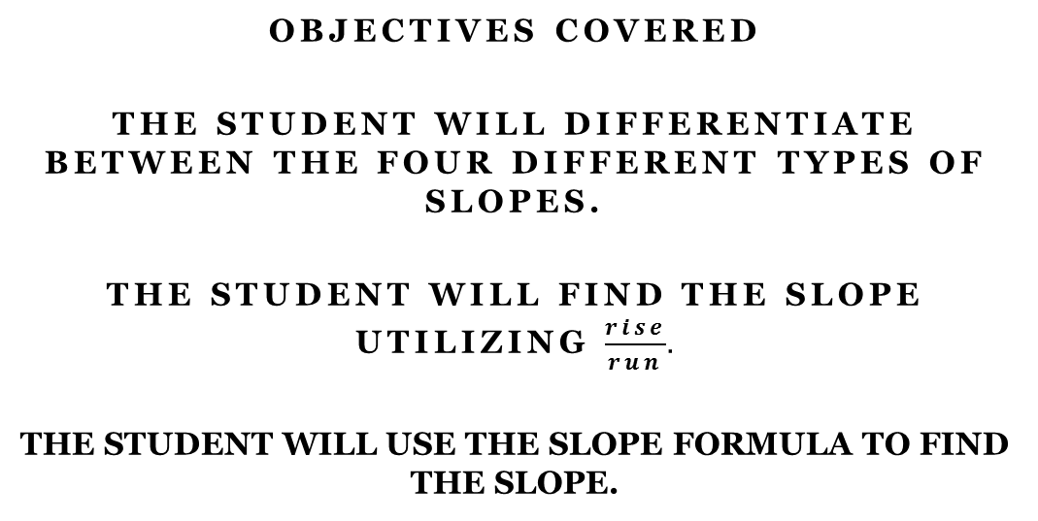
Unit 4 – Section 1 “Slope of a Line”

Slide 2
Slopes
Q: Where can you find slopes?
Slope: A proportional distance between two points; the change in y divided by the change in x.
The variable m in the equation y=mx+b.
The value of a slope is calculated three ways:
T-Table
Rise/Run
Slope Formula

Slide 3
The Four Types of Slopes
Rule: When reading a graph, it is important to read from left to right. Just like English, the Coordinate Plane is read from left to right.

Slide 4
Rise/Run

Slide 5
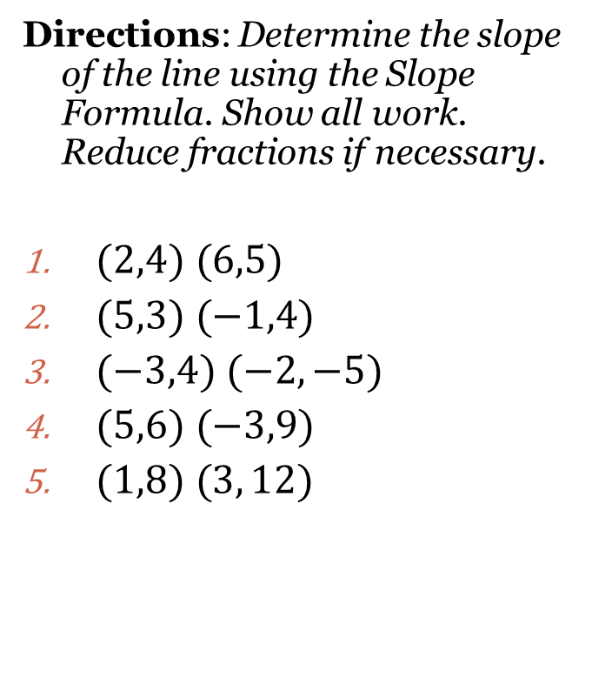
Slope Formula

Slide 6
Special Cases

Slide 7
Special Case Acronyms: WARNING: This will be good to know for future use.
HOY
H: Horizontal Line
O: 0 slope as in zero slope
Y: Y-intercept
VUX
V: Vertical Line
U: Undefined slope
X: X-intercept

Slide 8
Closing Questions

Slide 9
Homework Assignment
Announcements

