Slide 1
Unit 4 – Section 2 “Graphing Slope/Intercept Form: Special Cases” Part 2
Objectives Covered
Graphing Equations in Slope Intercept Form

Slide 2
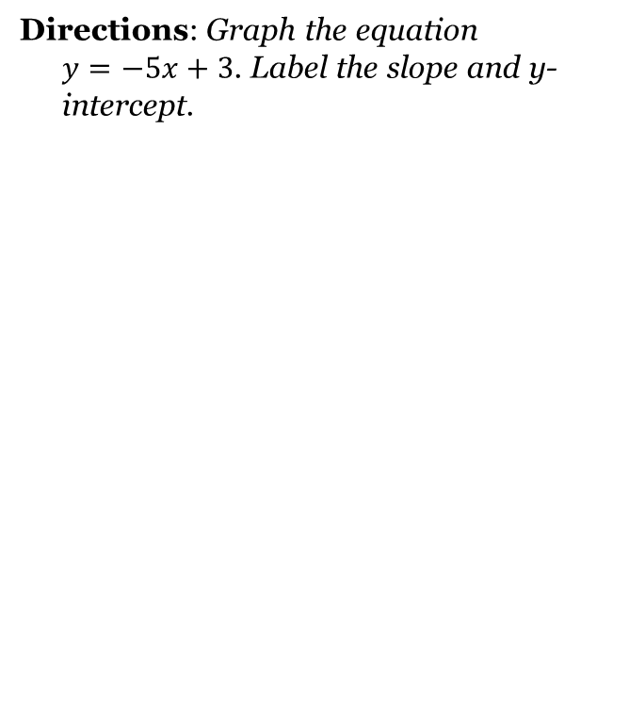
Special Case #1 “The Case of the Whole Number Slope”

Slide 3
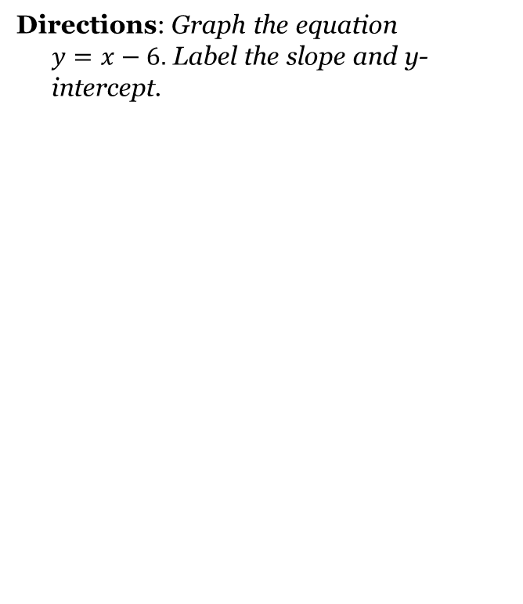
Special Case #2 “The Case of Positive X”

Slide 4
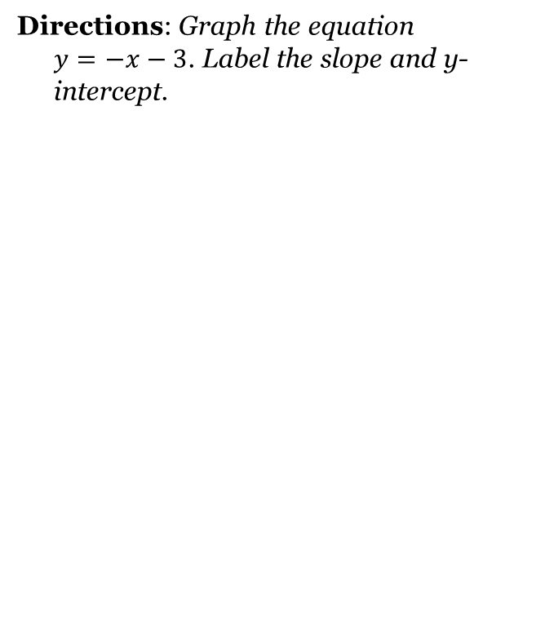
Special Case #3 “The Case of Negative X”

Slide 5
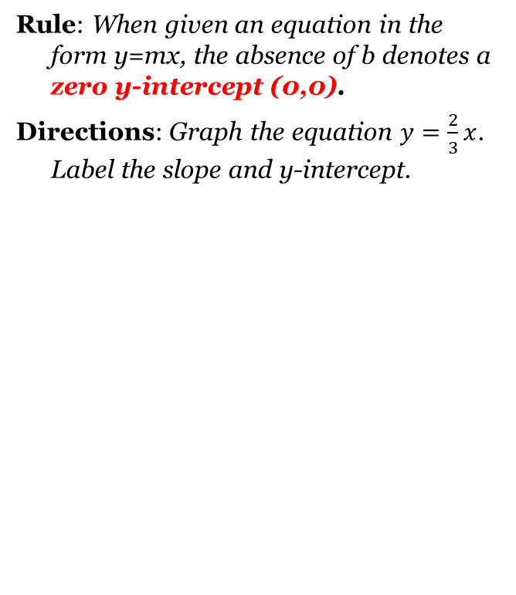
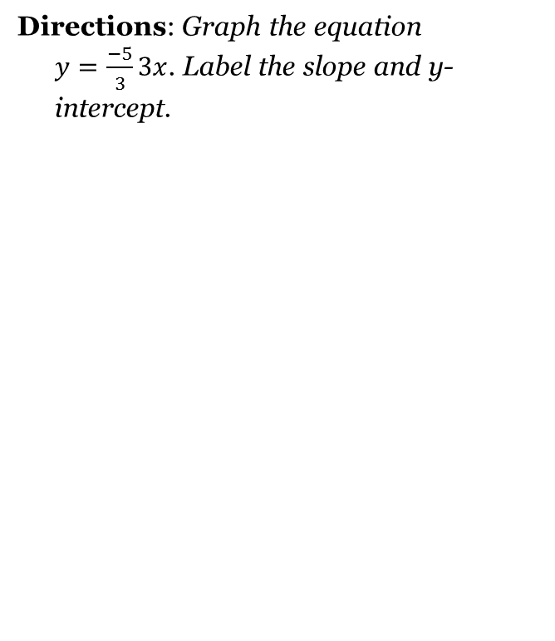
Special Case #4 “The Case of the Zero Y-Intercept.”

Slide 6
Special Case Acronyms: WARNING: Remember This?
HOY
H: Horizontal Line
O: 0 slope as in zero slope
Y: Y-intercept
VUX
V: Vertical Line
U: Undefined slope
X: X-intercept

Slide 7
Really Special Cases

Slide 8
Closing Questions
Directions: Respond to the following questions. Be prepared to discuss your answers with the class.
Graph the following functions:
$y=x+3$
$y=−4x$
$x=2$

Slide 9
Homework Assignment
Announcements

