Slide 1
Unit 4 –Section 3 “Rational Exponents”
Objectives Covered
The student will be able to write a radical using rational exponents
The student will be able to evaluate a rational exponent using radicals.

Slide 2
Translating POSITIVE Rational Exponents into Radicals and Vice Versa
$$\sqrt[n]{b^{x}}=b^{\frac{x}{n}}$$
Directions: Rewrite each algebraic expression with rational exponents as a radical.
1. $2^{\frac{1}{3}}$ 2. $4^{\frac{5}{2}}$ 3. $1^{\frac{3}{8}}$

Slide 3
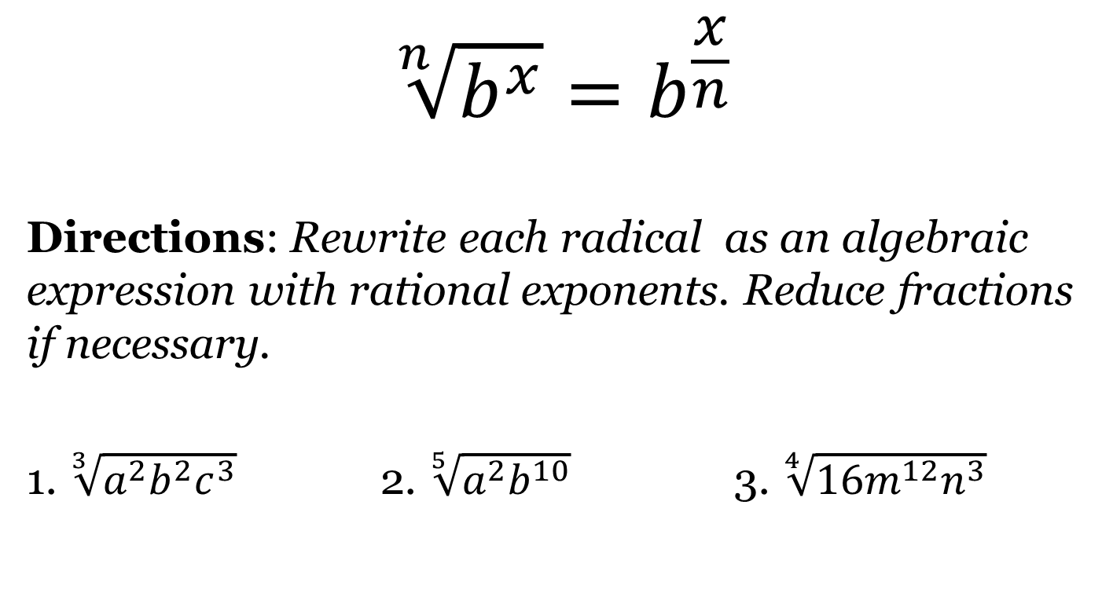
Translating POSITIVE Rational Exponents into Radicals and Vice Versa
$$\sqrt[n]{b^{x}}=b^{\frac{x}{n}}$$
Directions: Rewrite each radical as an algebraic expression with rational exponents. Reduce fractions if necessary.
1. $\sqrt[3]{a^{2}b^{2}c^{3}}$ 2. $\sqrt[5]{a^{2}b^{10}}$ 3. $\sqrt[4]{{16m}^{12}n^{3}}$

Slide 4
Translating NEGATIVE Rational Exponents into Radicals and Vice Versa
$$b^{\frac{−x}{n}}=\frac{1}{\sqrt[n]{b^{x}}}$$
Directions: Rewrite each algebraic expression with rational exponents as a radical.
1. $2^{\frac{−1}{3}}$ 2. $4^{\frac{−2}{5}}$ 3. $2^{\frac{−3}{4}}$

Slide 5

Simplifying Rational Exponents
Directions: Rewrite the rational exponents as a radical and simplify.
1. ${36}^{\frac{1}{2}}$ 2. ${64}^{\frac{1}{3}}$ 3. ${49}^{\frac{−1}{2}}$
4. ${36}^{\frac{3}{2}}$ 5. ${27}^{\frac{4}{3}}$ 6. $({\frac{1}{8})}^{\frac{−1}{3}}$

Slide 6
Radicals to Rational Exponents
Directions: Write each radical as an algebraic expression with rational exponents.
$\frac{1}{\sqrt[5]{w^{4}}}$ 2. $\frac{10b^{2}c^{2}}{c\sqrt[3]{8b^{4}}}$
3. $\sqrt[6]{a^{2}b^{6}c^{12}}$ 4. $\frac{x}{\sqrt[8]{y}}$

Slide 7
Closing Questions
Directions: Respond to the following questions. Be prepared to discuss your answers with the class.

Slide 8
Homework Assignment
Announcements

