Slide 1
Unit 4 – Section 4“Function Operations and Composition”
Objectives Covered
The student will perform operations on functions.
The student will compose two functions

Slide 2
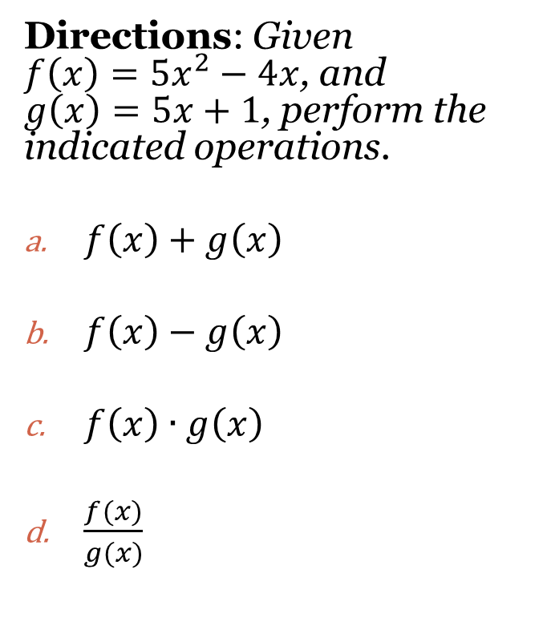
Function Operations
Function Operations: Taking two or more functions and adding, subtracting, multiplying, or dividing them.
$$f+g\left(x\right)=f\left(x\right)+g\left(x\right)$$
$$f−g\left(x\right)=f\left(x\right)−g\left(x\right)$$
$$f×g\left(x\right)=f(x)×g(x)$$
$$\frac{f}{g}\left(x\right)=\frac{f(x)}{g(x)}$$
Directions: Given $f\left(x\right)={5x}^{2}−4x$, and $g\left(x\right)=5x+1$, perform the indicated operations.
$f\left(x\right)+g\left(x\right)$
$f\left(x\right)−g\left(x\right)$
$f\left(x\right)∙g\left(x\right)$
$\frac{f(x)}{g(x)}$

Slide 3
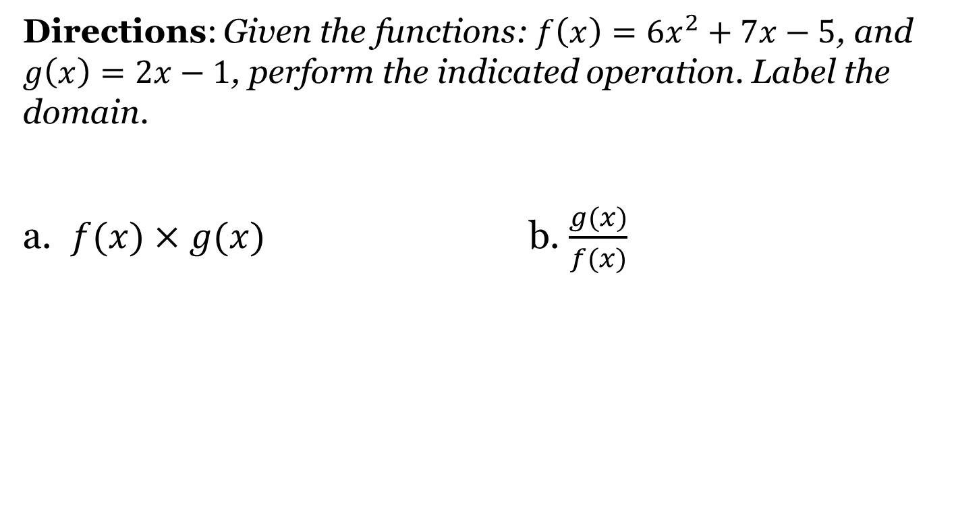
Function Operations
Directions: Given the functions: $f\left(x\right)=6x^{2}+7x−5$, and $g\left(x\right)=2x−1$, perform the indicated operation. Label the domain.
a. $f(x)×g(x)$ b. $\frac{g(x)}{f(x)}$

Slide 4

Compositions of Functions
Given f(x) and g(x):
$fog(x)$: $f(g(x))$: “f of g of x”
$gof\left(x\right): g(f(x)):$ “g of f of x”

Slide 5
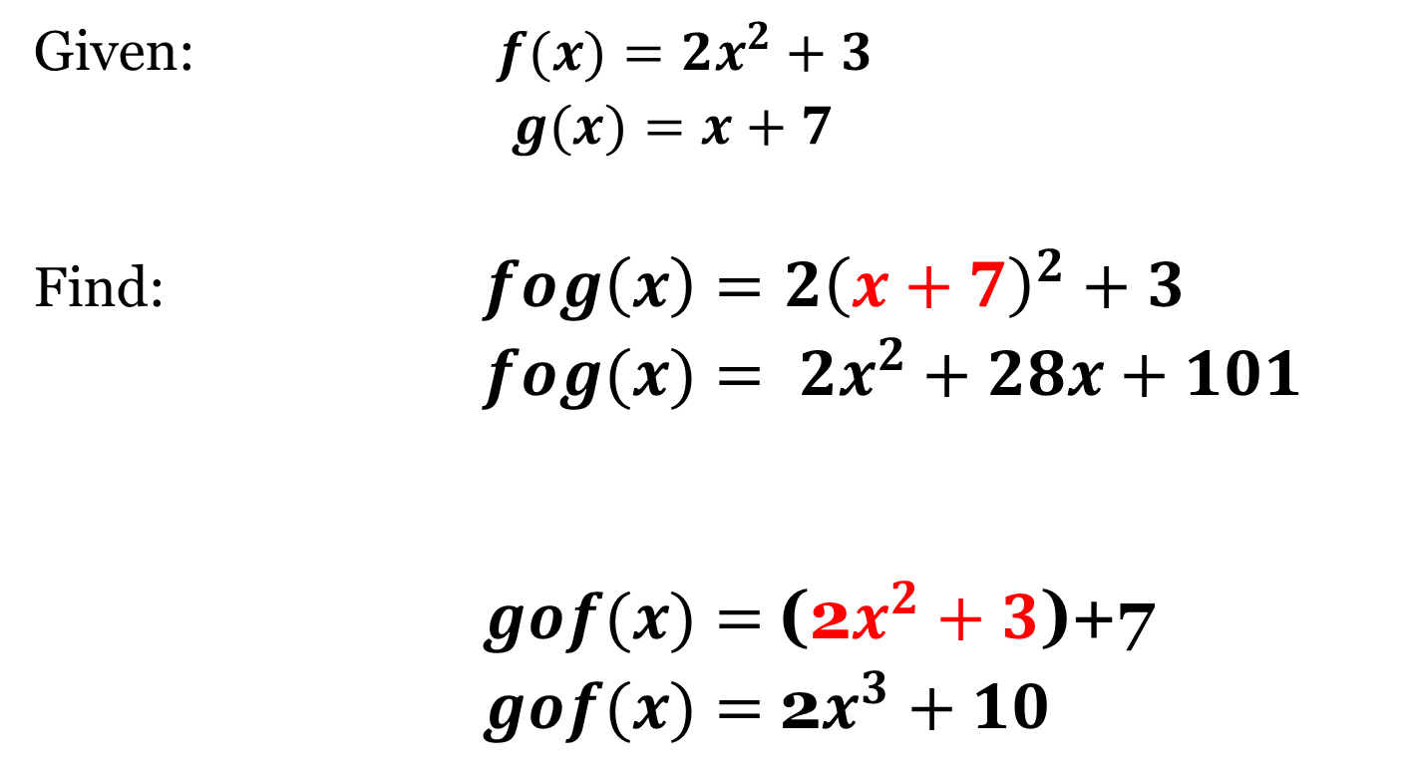
Composition Functions
Given: $f(x)=2x^{2}+3$
$g(x)=x+7$
Find: $fog\left(x\right)=2{\left(x+7\right)}^{2}+3$
$fog(x)= 2x^{2}+28x+101$
$gof(x)=$(2$x^{2}+3$)+7
$gof(x)=$2$x^{3}+10$

Slide 6
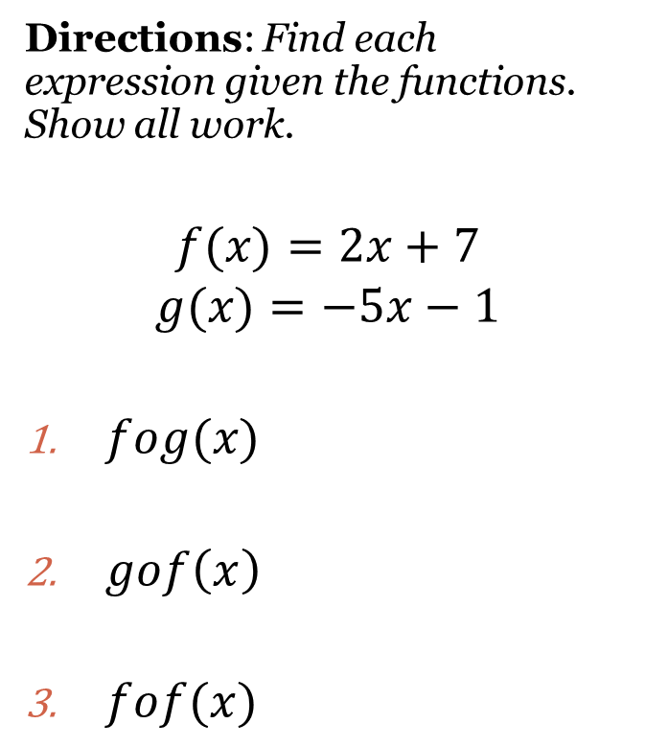
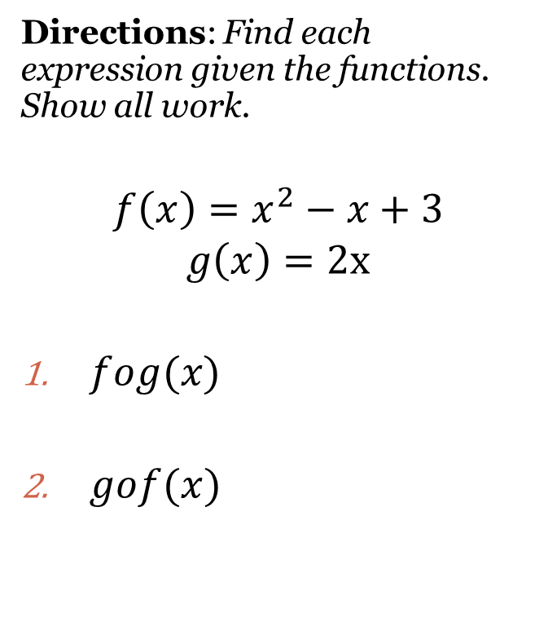
Composition Functions
Directions: Find each expression given the functions. Show all work.
$$f\left(x\right)=x^{2}−x+3$$
$$g\left(x\right)=2x$$
$fog(x)$
$gof(x)$
Directions: Find each expression given the functions. Show all work.
$$f(x)=2x+7$$
$$g(x)=−5x−1$$
$fog(x)$
$gof\left(x\right)$
$fof(x)$

Slide 7
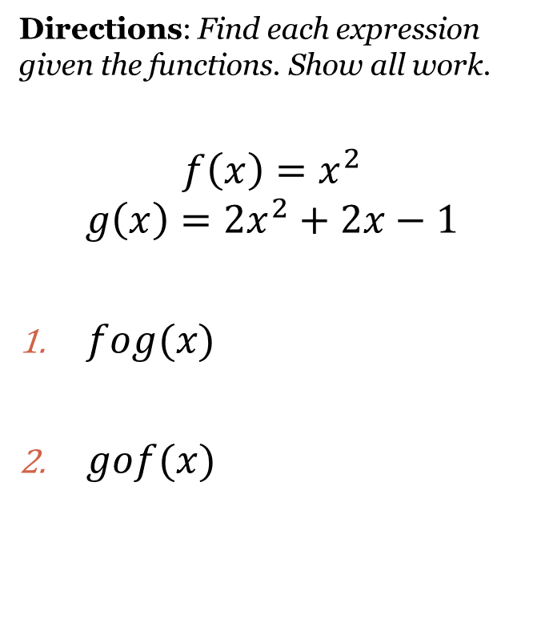
Cluster Examples #1
Directions: Find each expression given the functions. Show all work.
$$f\left(x\right)=x^{2}$$
$$g\left(x\right)=2x^{2}+2x−1$$
$fog(x)$
$gof(x)$
Directions: Use the functions on the left to find the values given.
$fog(2)=$
$gof(−3)=$

Slide 8
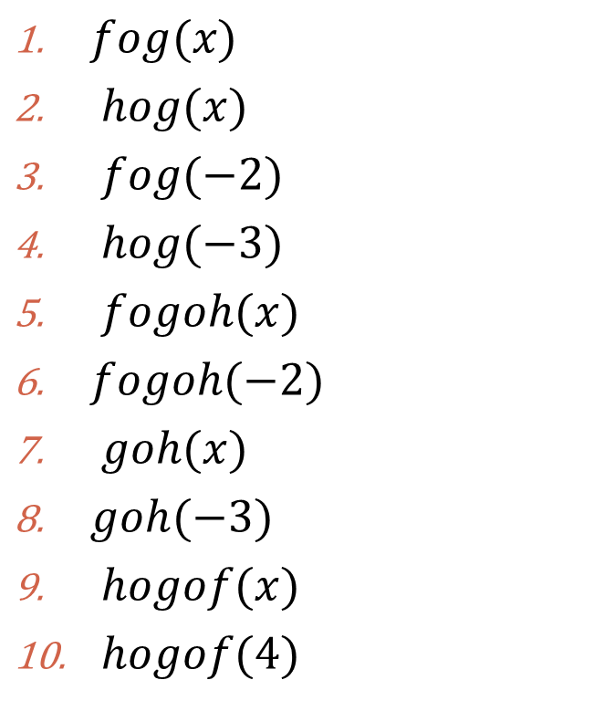
Cluster Examples #2
Directions: Find each expression or value given the following functions:
$$f\left(x\right)=x^{2}+5$$
$$g\left(x\right)=9x−1$$
$$h\left(x\right)=−2x$$
$fog(x)$
$hog(x)$
$fog(−2)$
$hog(−3)$
$fogoh(x)$
$fogoh(−2)$
$goh(x)$
$goh(−3)$
$hogof(x)$
$hogof(4)$

Slide 9
Homework Assignment
Announcements

