Slide 1
Unit 4 – Section 6 “Domain/Range Interval Notation”
Objectives
Determine the domain/range of graphs.
Determine the domain algebraically.

Slide 2
Interval Notation: Algebraically
To find the domain algebraically:
The domain is always $\left(−∞,∞\right)$ EXCEPT:
Variables in the denominator. Set the equation $≠0$, solve for x.
Variables under the square root. Set the equation $≥0$, solve for x.
Directions: Find the domain and write it in interval notation.
$f\left(x\right)=\frac{2x+1}{x+3}$
$f\left(x\right)=\frac{3}{x^{2}−2x−3}$
$f\left(x\right)=\sqrt{x+3}$

Slide 3
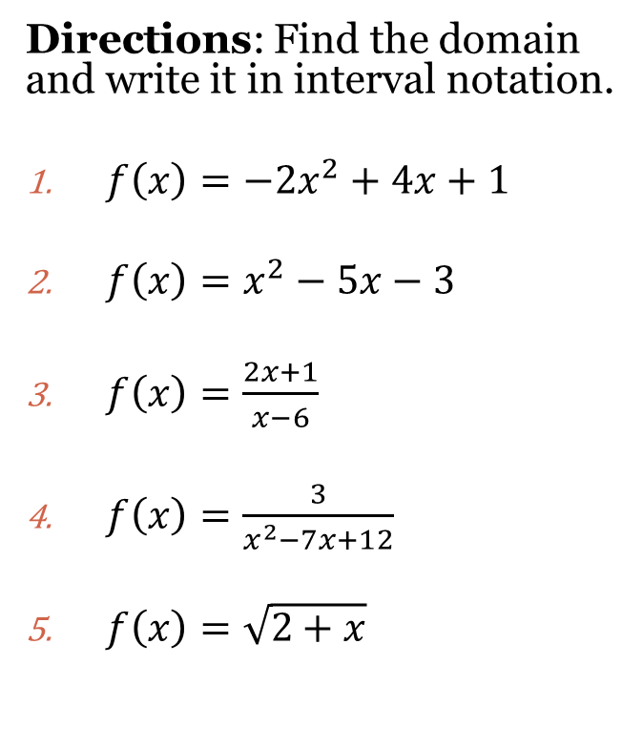
Interval Notation
$$x=domain$$
$$y=range$$
All Real Numbers in Interval Notation: $(−∞,∞)$
(…) Parenthesis exclude starting/ending values
[…] Brackets include starting/ending values.
Note: All polynomial functions are$(−∞,∞)$
Directions: Find the domain and write it in interval notation.
$f\left(x\right)=−2x^{2}+4x+1$
$f\left(x\right)=x^{2}−5x−3$
$f\left(x\right)=\frac{2x+1}{x−6}$
$f\left(x\right)=\frac{3}{x^{2}−7x+12}$
$f\left(x\right)=\sqrt{2+x}$

Slide 4
Closing Question
Directions: Respond to the following questions. Be prepared to discuss your answers with the rest of the class.
How would you find the domain of the function:
$$f\left(x\right)=\frac{x+3}{\sqrt{x−2}}$$

Slide 5
Homework Assignment
Announcements

