Slide 1
Unit 5 – Section 1 “Solving Logarithms/Exponentials with Common Bases”
Objectives:
To write and evaluate logarithmic expressions

Slide 2

Writing and Evaluating Logarithmic Expressions
Logarithm:
$y=b^{x}$ → $\log_{b}y=x$
$\log_{b}y$= “log base b of y.”
Directions: Write each expression in logarithmic form.
$729=3^{6}$
$32=2^{5}$
$\frac{1}{8}={\frac{1}{2}}^{3}$
${10}^{0}=1$

Slide 3
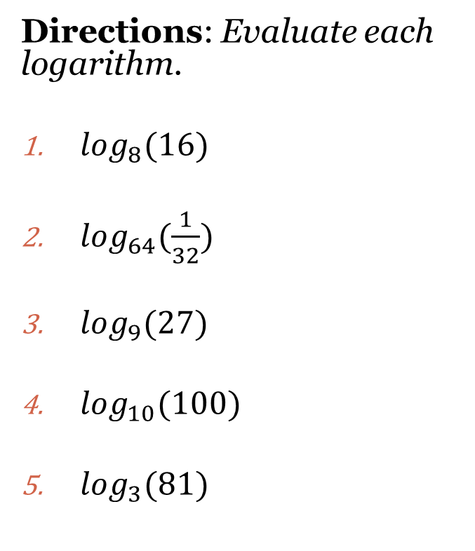
Evaluating Logarithms
Steps:
Convert to exponential form.
Change each side to the same base proportionally.
Set exponents equal to each other.
Solve.
$y=b^{x}$ → $\log_{b}y=x$
Directions: Evaluate each logarithm.
$\log_{8}(16)$
$\log_{64}(\frac{1}{32})$
$\log_{9}(27)$
$\log_{10}(100)$
$\log_{3}(81)$

Slide 4

Practice with Logarithms
Directions: Rewrite each logarithm as an exponential form.
$\log_{13} 1=0$
$\log_{3} 3=1$
$\log_{4 }64=3$
$\log_{4} v=u$
Directions: Rewrite each exponential form as a logarithm.
$y^{2}=x$
${16}^{2}=256$
${20}^{−2}=\frac{1}{400}$
$a^{−1}=b$
Directions: Evaluate each expression.
$\log_{3} 1$
$\log_{7} 343$
$\log_{2} 32$
$\log_{\frac{1}{7}} \frac{1}{49}$
$\log_{9} \frac{1}{81}$

Slide 5
Homework Assignment
Announcements

