Slide 1
Chapter 5 Section 3 “Graphing Linear Inequalities”
Objectives
To graph a linear inequality

Slide 2
Graphs of Inequalities with a < Symbol
Less than symbol: < with a positive slope.
Less than symbol: < with a negative slope.
NOTE: A less than sign yields a dashed line and is shaded BELOW the graph

Slide 3
Graphs of Inequalities with a > Symbol
Greater than symbol: > with a positive slope.
Greater than symbol: > with a negative slope.
NOTE: A greater than sign yields a dashed line and is shaded ABOVE the graph

Slide 4
Graphs of Inequalities with a $≤$ Symbol
Less than or equal to: $≤$with a positive slope.
Less than or equal to: $≤$ with a negative slope.
NOTE: A less than or equal to sign yields a solid line and is shaded BELOW the graph.

Slide 5
Graphs of Inequalities with a $≥$ Symbol
Greater than or equal to: $≥$with a positive slope.
Greater than or equal to: $≥$ with a negative slope.
NOTE: A greater than or equal to sign yields a solid line and is shaded ABOVE the graph

Slide 6
Special Cases: Graphs of Inequalities
Graphs of $x<0 and x>0$ respectively.
Graphs of $y>0 and y<0$ respectively.
The same applies for the symbols $≤and ≥$ but with a SOLID line.

Slide 7
Symbols and Shading
< dash/below
> dash/above
< solid/below
> solid/above

Slide 8

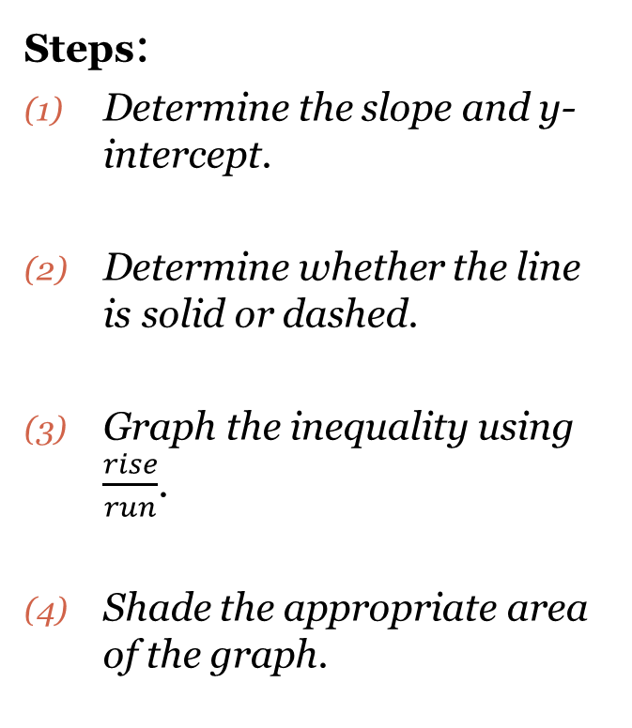
Graphing Inequalities
Steps:
Determine the slope and y-intercept.
Determine whether the line is solid or dashed.
Graph the inequality using $\frac{rise}{run}$.
Shade the appropriate area of the graph.
Directions: Graph the inequality.
EX: $y<x+1$

Slide 9

Cluster Examples #1
Directions: Graph the inequality.
$y>\frac{2}{3}x−5$
$y≥\frac{−1}{4}x+2$
$y≤\frac{−3}{4}x+5$

Slide 10

Cluster Examples #2
Directions: Rearrange the equation into slope/intercept form. Show all work.
(1) $−2x+y>3$ (2) $3x−y>1$

Slide 11
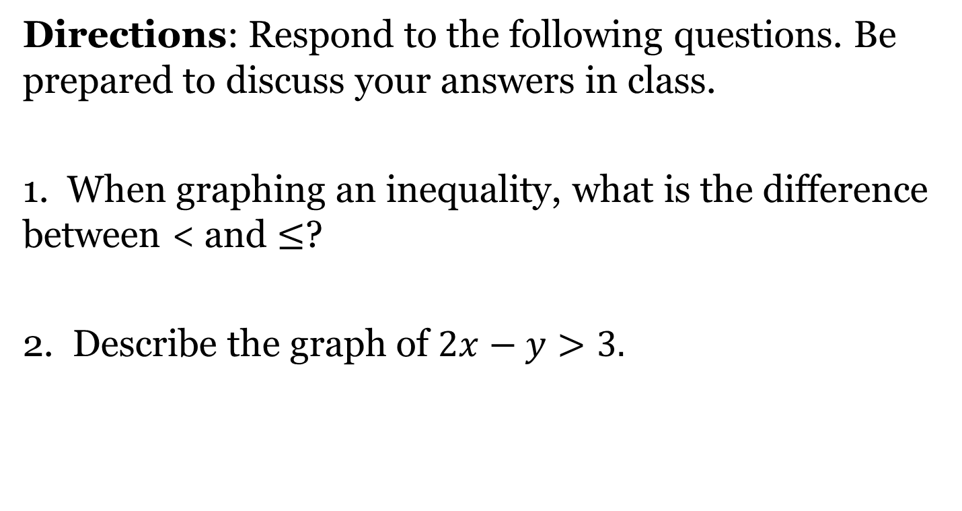
Closing Questions
Directions: Respond to the following questions. Be prepared to discuss your answers in class.
1. When graphing an inequality, what is the difference between < and $≤$?
2. Describe the graph of $2x−y>3.$

Slide 12
Homework Assignment
Announcements

