Slide 1
Unit 5 – Section 4“Solving Exponential Equations”
Objectives
To solve exponential equations.

Slide 2
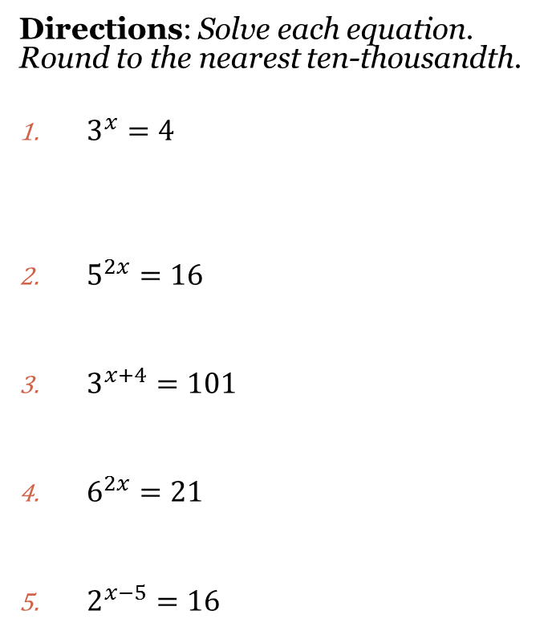
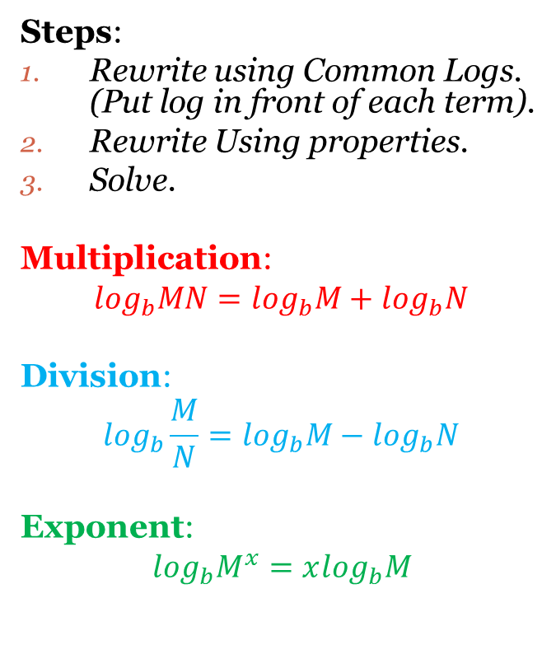
Solving Exponential Equations
Steps:
Rewrite using Common Logs. (Put log in front of each term).
Rewrite Using properties.
Solve.
Multiplication:
$$\log_{b}MN=\log_{b}M+\log_{b}N$$
Division:
$$\log_{b}\frac{M}{N}=\log_{b}M−\log_{b}N$$
Exponent:
$\log_{b}M^{x}=x\log_{b}M$
Directions: Solve each equation. Round to the nearest ten-thousandth.
$3^{x}=4$
$5^{2x}=16$
$3^{x+4}=101$
$6^{2x}=21$
$2^{x−5}=16$

Slide 3

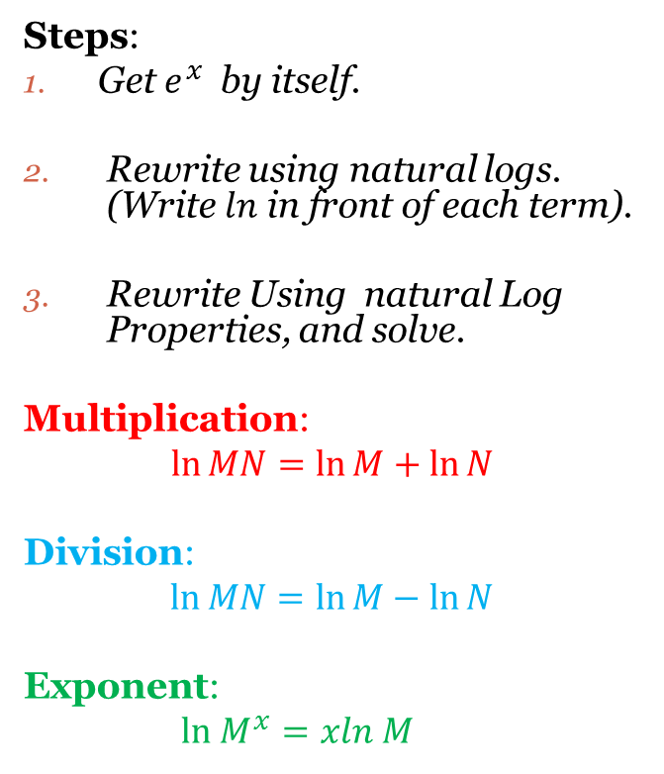
Solving Exponential Equations
Steps:
Get $e^{x}$ by itself.
Rewrite using natural logs. (Write $ln$ in front of each term).
Rewrite Using natural Log Properties, and solve.
Multiplication:
$$\ln{MN}=\ln{M}+\ln{N }$$
Division:
$$\ln{MN}=\ln{M}−\ln{N }$$
Exponent:
$ln M^{x}=xln M$
Directions: Solve each exponential equation.
$e^{x+1}=30$
$e^{2x}=9.1$
$4e^{3x}+1.2=14$

Slide 4
Closing Questions
Directions: Respond to the following closing questions. Be prepared to discuss your answers with the class.
1. $5^{x}=20$ 2. $e^{−4x}+1=15$

Slide 5
Homework Assignment
Announcements

