Slide 1
Unit 5 – Section 6 “Exponential Growth/Decay and $A=Pe^{rt}$”
Objectives
To solve word problems involving exponential growth and decay.

Slide 2
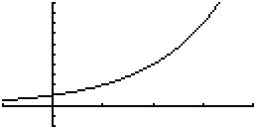
Exponential Functions
Formula
$$y=a∙b^{x}$$
a: $constant ≠0$
b: $b>0 but b≠1$
Real World Examples of Exponential Functions:
Population
Investment
Car/House value
$$y=a∙b^{x}$$

Slide 3
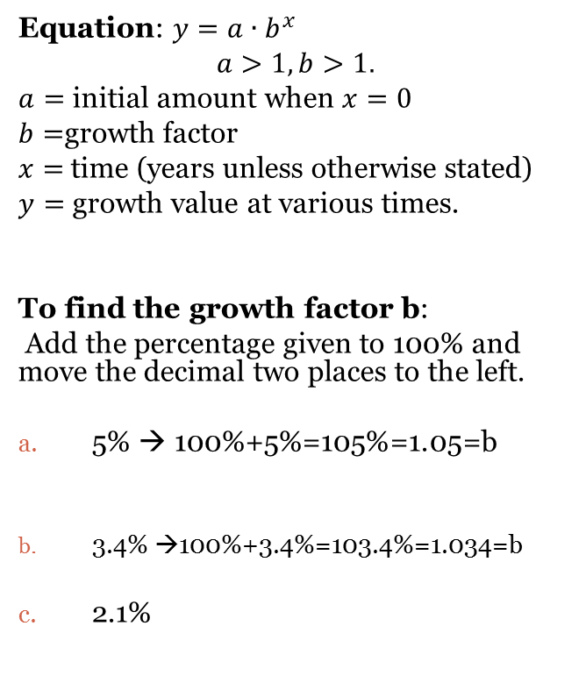
Exponential Growth
Equation: $y=a∙b^{x}$
$$a>1, b>1.$$
$a=$ initial amount when $x=0$
$b=$growth factor
$x=$time (years unless otherwise stated)
$y=$ growth value at various times.
To find the growth factor b:
Add the percentage given to 100% and move the decimal two places to the left.
5% → 100%+5%=105%=1.05=b
3.4% →100%+3.4%=103.4%=1.034=b
2.1%
Solving word problems with exponential growth.
Steps:
Relate: What equation/function is associated with the problem?
This unit: $y=a∙b^{x}$
Define: What do each of your variables represent? Include any numbers listed in the problem.
$A=initial amount which is:______$
$B=growth factor which is:________$
Write the equation by replacing a and b.
Use the equation to answer any further questions.

Slide 4
Exponential Growth
Directions: Use the following information to write/model a function showing exponential growth.
You buy a house for $130,000. It appreciates 6% per year. How much is it worth in 10 years?
A population of 100 frogs increases at an annual rate of 22%. How many frogs will there be in 5 years?
Solving word problems with exponential growth.
Steps:
Relate: What equation/function is associated with the problem?
This unit: $y=a∙b^{x}$
Define: What do each of your variables represent? Include any numbers listed in the problem.
$A=initial amount which is:______$
$B=growth factor which is:________$
Write the equation by replacing a and b.
Use the equation to answer any further questions.
Finding the growth factor:
5% → 100%+5%=105%=1.05=b

Slide 5
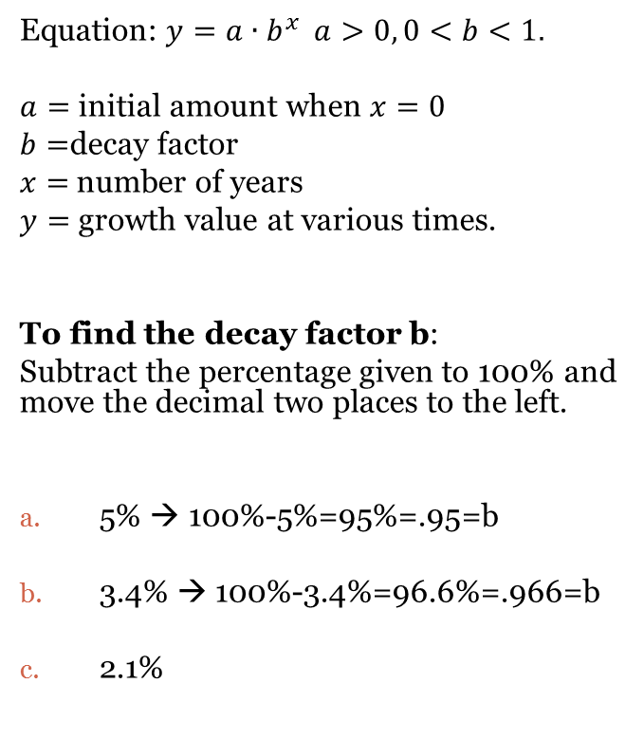
Exponential Decay
Equation: $y=a∙b^{x} a>0, 0<b<1.$
$a=$ initial amount when $x=0$
$b=$decay factor
$x=$number of years
$y=$ growth value at various times.
To find the decay factor b:
Subtract the percentage given to 100% and move the decimal two places to the left.
5% → 100%-5%=95%=.95=b
3.4% → 100%-3.4%=96.6%=.966=b
2.1%
Directions: Use the following information to write/model a function showing exponential decay.
In 1990, the population of Washington, D.C. was about 604,400 people. Since then the population has decreased about 1.8% per year. Write an equation that models this situation, and use it to find the population of Washington DC today.
Suppose the population of a certain endangered species has decreased 2.4% each year. Suppose there were 60 of these animals in a given area in 1999. Write an equation that models this situation and use it to find the population in the year 2006.

Slide 6
Continuously Compounded Interest Formula
A$=Pe^{rt}$
A= amount in account
P=principal
r= rate of annual interest
t=time in years
Directions: Find the amount for each word problem.
Suppose you invest $100 at an annual interest rate of 4.8% compounded continuously. How much will you have in the account after three years?
Suppose you invest in $1300 at an annual interest rate of 4.3% compounded continuously. Find the amount you will have in the account after three years.

Slide 7
$$A=Pe^{rt}$$
An initial investment of $200 is now valued at $254.25. The interest rate is 6%, compounded continuously. How long has the money been invested?
How long will it take $3000 to double if it is invested in an account that pays 3% compounded continuously?

Slide 8
Closing Questions
Directions: Respond to the following questions. Be prepared to discuss your answers with the class.
If the growth factor is 1.30, what is the initial percentage of growth?
In 1995, there were 85 rabbits in Central Park. The population increased by 12% each year. How many rabbits were in Central Park in 2005?
Use $A=Pe^{rt}$ to find the following: How long will it take $4000 to triple if it is invested at 5% compounded continuously?

Slide 9
Homework Assignment
Announcements

