Slide 1
Unit 6 – Part 1 “Graphing Rational (Reciprocal) Functions” Easy
Objectives Covered
To graph reciprocal functions
To graph translations of reciprocal functions.

Slide 2

Graphing Reciprocal Functions
Reciprical Function: $y=\frac{a}{x−h}+k$
$h$ is excluded from the domain.
“$a$” is stretch/shrink factor
$+a$ Quadrants I & III
$−a$ Quadrants II&IV
$k$ is the up/down shift
$$f\left(x\right)=\frac{1}{x}$$
+
-
₊ ₋

Slide 3
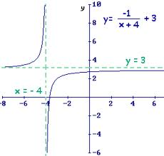

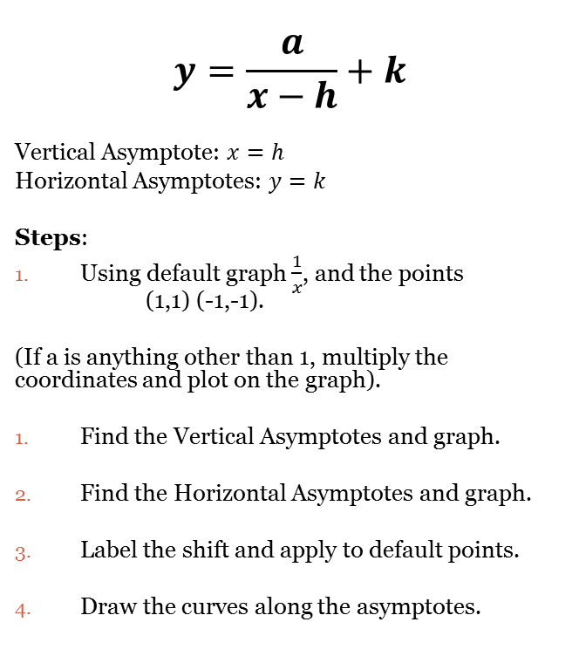
Graphing Translations of Reciprocal Functions
$$y=\frac{a}{x−h}+k$$
Vertical Asymptote: $x=h$
Horizontal Asymptotes: $y=k$
Steps:
Using default graph $\frac{1}{x}$, and the points (1,1) (-1,-1).
(If a is anything other than 1, multiply the coordinates and plot on the graph).
Find the Vertical Asymptotes and graph.
Find the Horizontal Asymptotes and graph.
Label the shift and apply to default points.
Draw the curves along the asymptotes.
Directions: Graph the following reciprocal functions.
$y=\frac{3}{x+1}−2$
$y=\frac{−1}{x+5}−3$
$y=\frac{1}{x+2}+2$
$y=\frac{−2}{x−4}+3$
$y=\frac{2}{x+1}−1$

Slide 4
Closing Questions
Directions: Respond to the following prompt. Be prepared to discuss your answers with the class.
Graph the following functions:
1. $y=\frac{2}{x+5}−3$ 2. $y=\frac{−1}{x−3}+6$

Slide 5
Homework Assignment
Announcements

