Slide 1
Unit 7 – Section 1 “Properties of Exponents &1&2”
Objectives Covered
To Multiply Powers
To work with scientific notation
To raise a Power to a Power
To Raise a Product to a Power

Slide 2
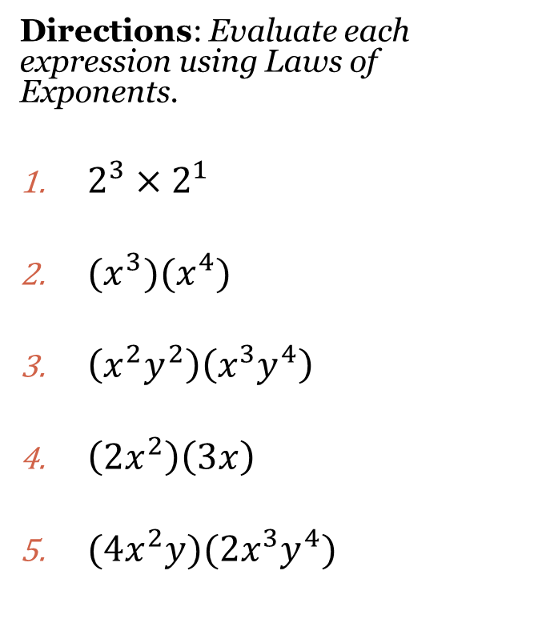
Laws of Exponents
MULTIPLICATION: When multiplying variables add the exponents.
$$a^{m}×a^{n}=a^{m+n}$$
**When multiplying variables, multiply the coefficients.**
Directions: Evaluate each expression using Laws of Exponents.
$2^{3}×2^{1}$
${(x}^{3})(x^{4})$
$\left(x^{2}y^{2}\right)\left(x^{3}y^{4}\right)$
$\left(2x^{2}\right)\left(3x\right)$
$(4x^{2}y)(2x^{3}y^{4})$

Slide 3
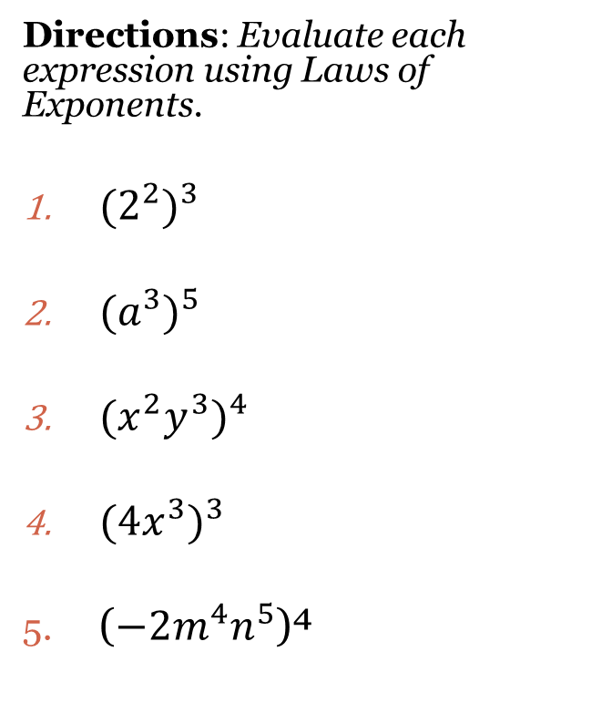
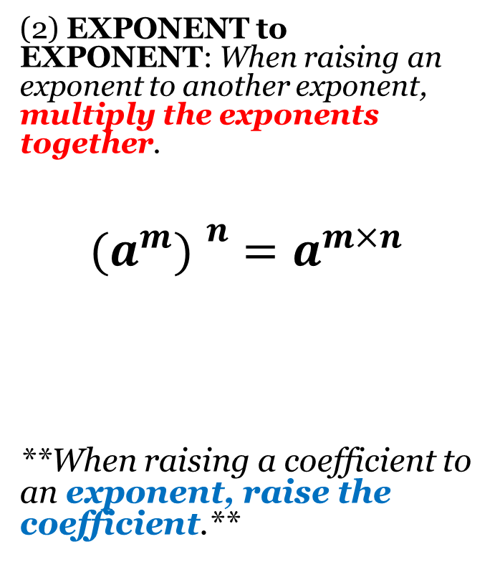
Laws of Exponents
(2) EXPONENT to EXPONENT: When raising an exponent to another exponent, multiply the exponents together.
$$({a^{m}) }^{n}=a^{m×n}$$
**When raising a coefficient to an exponent, raise the coefficient.**
Directions: Evaluate each expression using Laws of Exponents.
${{(2}^{2})}^{3}$
${{(a}^{3})}^{5}$
$(x^{2}y^{3})^{4}$
${({4x}^{3})}^{3}$
($−2m^{4}n^{5}$)⁴

Slide 4
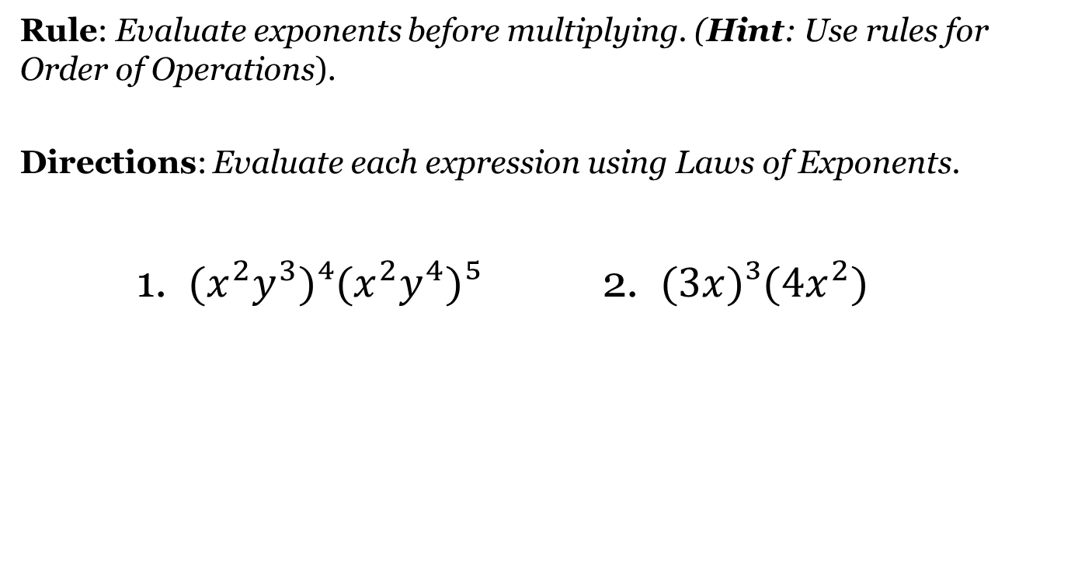
Combining Laws #1 & #2
Rule: Evaluate exponents before multiplying. (Hint: Use rules for Order of Operations).
Directions: Evaluate each expression using Laws of Exponents.
1. $(x^{2}y^{3})⁴(x^{2}y^{4})⁵$ 2. $(3x)³(4x^{2})$

Slide 5
Closing Questions
Combining Laws #1 & #2
Rule: Evaluate exponents before multiplying. (Hint: Use rules for Order of Operations).
Directions: Evaluate each expression using Laws of Exponents.
1. $(x^{2}y^{3})⁴(x^{2}y^{4})⁵$ 2. $(3x)³(4x^{2})$

Slide 6
Homework Assignment
Announcements

