Slide 1
Unit 7 – Section 1 “Laws of Exponents Part 2”
Objectives Covered
To Divide Powers with the Same base
To raise a quotient to a Power
To simplify expressions with zero and negative exponents
To evaluate exponential expressions

Slide 2
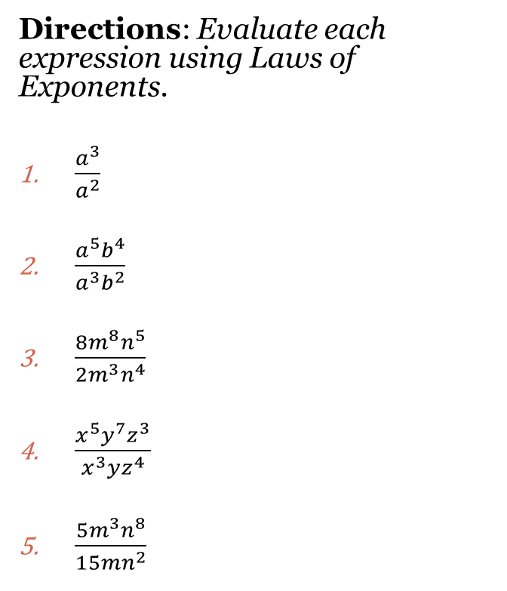
Laws of Exponents
(3) DIVISION: When dividing variables, subtract the exponents.
$\frac{a^{m}}{a^{n}}=a^{m−n}$
**When dividing variables, divide the coefficients.**
Directions: Evaluate each expression using Laws of Exponents.
$\frac{a^{3}}{a^{2}}$
$\frac{a^{5}b^{4}}{a^{3}b^{2}}$
$\frac{{8m}^{8}n^{5}}{{2m}^{3}n^{4}}$
$\frac{x^{5}y^{7}z^{3}}{x^{3}yz^{4}}$
$\frac{{5m}^{3}n^{8}}{15mn^{2}}$

Slide 3

Laws of Exponents
(4) NEGATIVE EXPONENTS: Variables with negative exponents move to the bottom of the fraction and the exponent becomes positive.
$a^{−n}$=$\frac{1}{a^{n}}$
**Negative coefficients stay in place.**
Directions: Evaluate each expression using Laws of Exponents.
$2^{−1}$
$x^{−3}$
$\frac{a^{4}}{a^{5}}$

Slide 4

Cluster Examples
Directions: Evaluate each expression using Laws of Exponents.
1. $\frac{m^{−4}n^{3}}{m^{6}n^{−8}}$ 2. $\frac{{16b}^{4}c}{{−4bc}^{3}}$ 3.$\frac{a^{4}b^{7}}{a^{5}b^{−10}}$ 4. $\frac{m^{7}p^{−2}q^{3}}{m^{8}p^{−5}q^{12}}$

Slide 5
Laws of Exponents
(5) ZERO EXPONENTS: Anything to the zero power always equals “1”.
$$a^{0}=1$$
Directions: Evaluate each expression using Laws of Exponents.
1. $3^{0}$ 2. $3^{0}$ 3. ${(ax)}^{0}$

Slide 6
Laws of Exponents
Multiplication: When multiplying variables, add the exponents’ multiply the coefficients.
Exponent to Exponent: When raising an exponent to another exponent, multiply the exponents; raise the coefficients.
Division: When dividing variables, subtract the exponents; divide the coefficient.
Negative Exponents: Move variables with negative exponents to the bottom of the fraction and make the exponent positive.
Zero Exponents: Anything to the zero power always equals 1.

Slide 7
Closing Questions
Directions: Respond to the following questions. Be prepared to discuss your answers with the class.
1. Evaluate: $\frac{{(2x^{3}y^{5}z^{2})}^{3}}{{({4x}^{3}y^{5})}^{2}}$

Slide 8
Homework Assignment
Announcements

