Slide 1
Unit 7 – Section 3 “Adding and Subtracting Polynomials”
Objectives Covered
To describe and classify polynomials
To add and subtract polynomials

Slide 2
Adding Polynomials
Rule: Combine the like terms. Do not change the exponents.
Directions: Find the sum of the polynomials.
$\left(4x+6y\right)+\left(3x+9y\right)$
${(6x}^{2}+3x)+\left(x^{2}−4x−3\right)$
$\left(x^{2}−3x+6\right)+\left(7x^{2}−x−5\right)$

Slide 3
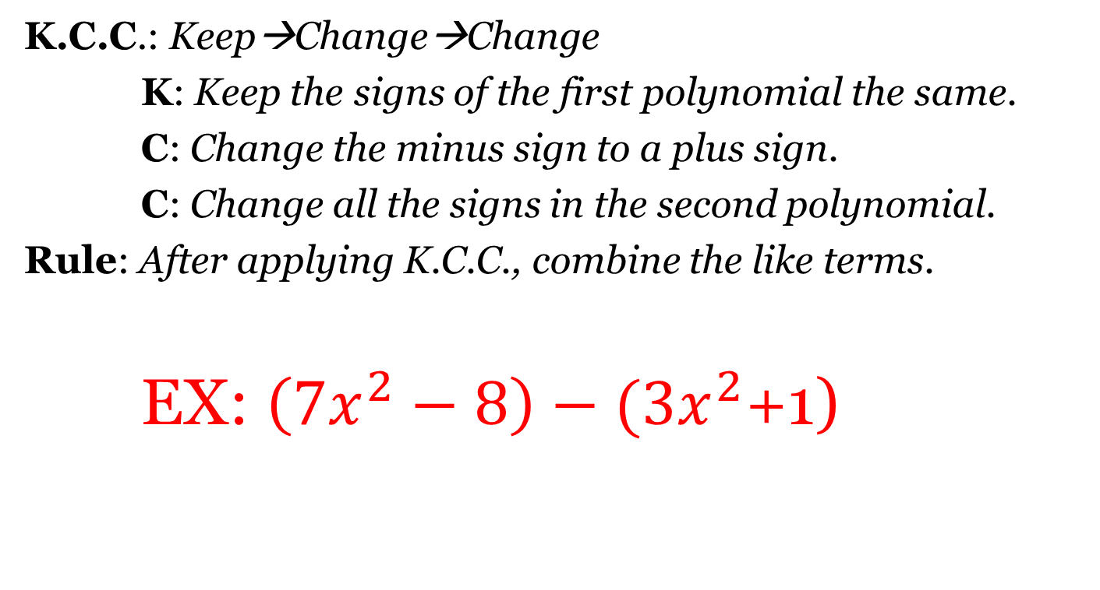
Subtracting Polynomials
K.C.C.: Keep→Change→Change
K: Keep the signs of the first polynomial the same.
C: Change the minus sign to a plus sign.
C: Change all the signs in the second polynomial.
Rule: After applying K.C.C., combine the like terms.
EX: $\left(7x^{2}−8\right)−(3x^{2}$+1)

Slide 4
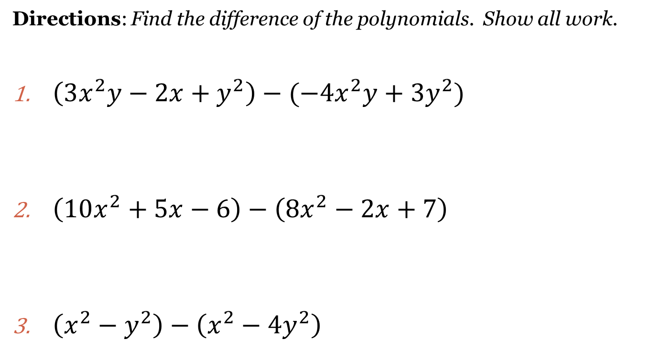
Subtracting Polynomials
Directions: Find the difference of the polynomials. Show all work.
$\left(3x^{2}y−2x+y^{2}\right)−(−4x^{2}y+3y^{2})$
$\left(10x^{2}+5x−6\right)−\left(8x^{2}−2x+7\right)$
$\left(x^{2}−y^{2}\right)−\left(x^{2}−4y^{2}\right)$

Slide 5
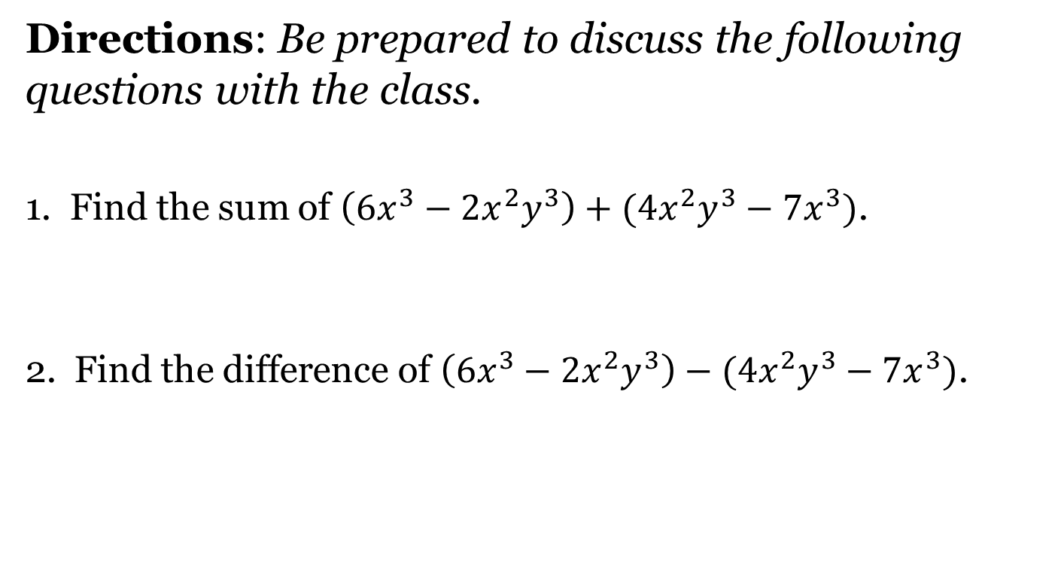
Closing Questions
Directions: Be prepared to discuss the following questions with the class.
1. Find the sum of $\left(6x^{3}−2x^{2}y^{3}\right)+(4x^{2}y^{3}−7x^{3})$.
2. Find the difference of $\left(6x^{3}−2x^{2}y^{3}\right)−(4x^{2}y^{3}−7x^{3})$.

Slide 6
Homework Assignment
Announcements

