Slide 1
Unit 8 – Section 2 “Factoring Using the Distributive Property, AKA Backwards Distribution”
Objectives Covered
The student will be able to use the distributive property in reverse.

Slide 2

Distributive Property Review
Directions: Use the distributive property to evaluate each expression.
(1) $2(a+b)$ (2) $3x{(x}^{2}+5)$

Slide 3
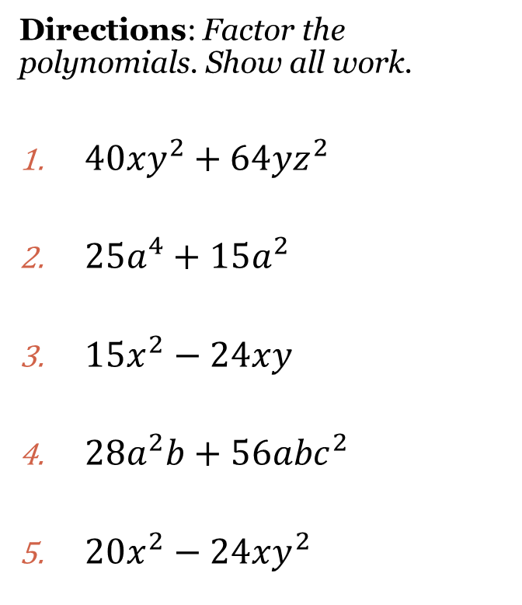
Backwards Distribution
Steps:
Determine the GCF of both terms. (Do a prime factorization of both terms of the polynomial).
Write the GCF on the outside of a set of parenthesis and divide it under each term.
Use Laws of Exponents to divide.
Simplify but DO NOT distribute.
Directions: Factor the polynomials. Show all work.
${40xy}^{2}+{64yz}^{2}$
${25a}^{4}+{15a}^{2}$
${15x}^{2}−24xy$
${28a}^{2}b+{56abc}^{2}$
${20x}^{2}−24xy^{2}$

Slide 4
Special Case “The Case of the Empty Box”
Rule: If nothing is left in the box, put a “1”.
Directions: Factor the polynomial. Show all work.
$${12x}^{3}−6x^{2}$$

Slide 5
Closing Questions
Directions: Respond to the following questions. Be prepared to discuss your answers with the class..
Factor the following polynomial:
$$4x^{4}y^{3}+12x^{2}y^{6}$$

Slide 6
Homework Assignment
Announcements

