Slide 1
Unit 8 – Section 3 “Factoring Trinomials $x^{2}+bx+c$”
Objectives Covered
To Factor trinomials without a leading coefficient

Slide 2
Factoring Trinomials
The Magic Question: What are the factors of “c” that add to “b”?
Directions: Factor the Trinomials.
$x^{2}+12x+27$
$a^{2}+22a+21$
$x^{2}+5x+6$

Slide 3

Cluster Examples
Directions: Factor the trinomials.
$x^{2}−5x−24$
$c^{2}+2c−3$
$y^{2}−12y+27$
$x^{2}−2x−63$
$a^{2}−9a+20$

Slide 4
Perfect Square Trinomials
Perfect Square Trinomials: The two factors are the same.
Directions: Factor the trinomials.
$x^{2}+6x+9$
$x^{2}−12x+36$
$x^{2}+14x+49$

Slide 5
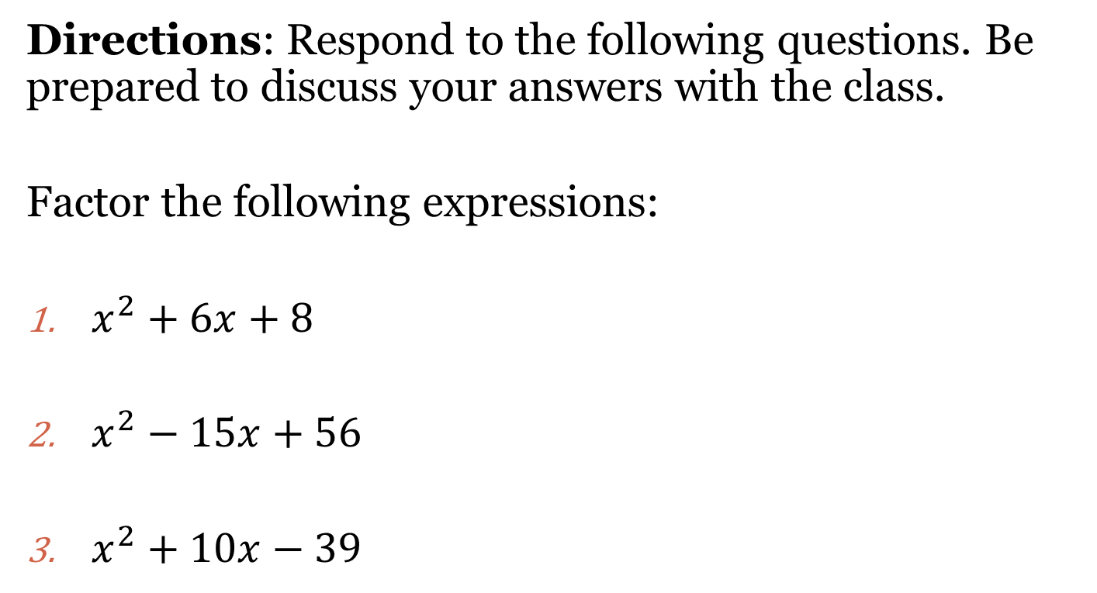
Closing Questions
Directions: Respond to the following questions. Be prepared to discuss your answers with the class.
Factor the following expressions:
$x^{2}+6x+8$
$x^{2}−15x+56$
$x^{2}+10x−39$

Slide 6
Homework Assignment
Announcements

