Slide 1
Extension: Applications of Quadratic Functions
Objectives
The student will be able to solve real world applications using properties of Quadratic Functions.

Slide 2
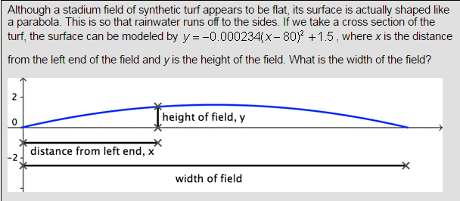
Determining the width of Quadratic Functions
To determine the width, determine the x value of the vertex and double it.
Question: What is the distance, 1/4th of the way?

Slide 3
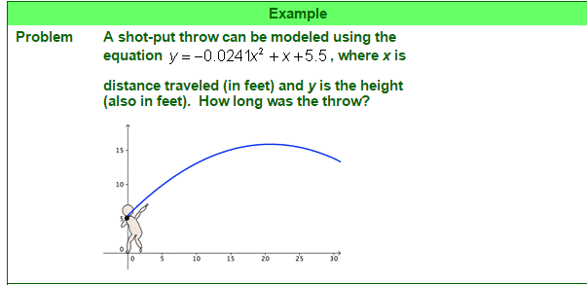
Finding Distance = Solving Quadratics
Hints:
If the ball hits the ground where $y=0$, then we must solve the quadratic function.
Solve using any method (factoring, completing square, quadratic formula, etc.)
Extension: Are both solutions valid for this scenario?

Slide 4
Finding Distance = Solving Quadratics
An object is launched at 19.6 meters per second (m/s) from a 58.8-meter tall platform. The equation for the object's height s at time t seconds after launch is s(t) = –4.9t² + 19.6t + 58.8, where s is in meters. When does the object strike the ground?
Extension: Are both solutions valid?

Slide 5
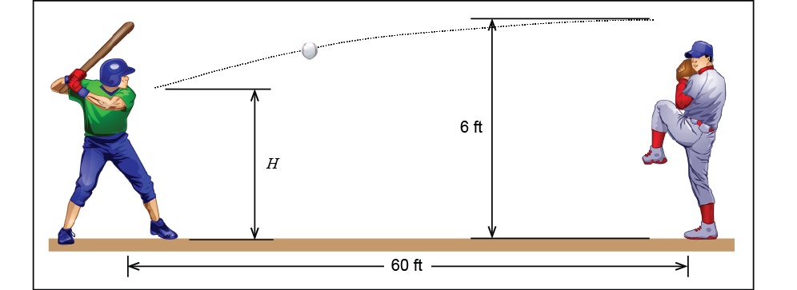
Determining Maximum/Minimum Values
A baseball player swings and hits a pop fly straight up in the air to the catcher. The height of the baseball in meters t seconds after the hit is given by the quadratic function
$$h\left(t\right)=−4.9t^{2}+34.3t+1$$
How long does it take for the baseball to reach its maximum height? What is the maximum height obtained by the baseball?
Hint:
How do we find the vertex?
Extension: Look at the solution and describe it in full detail.

Slide 6
Determining Maximum/Minimum Values

Slide 7
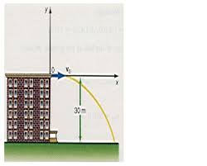
Closing Question
Directions: Respond to the following question. Be prepared to discuss your answers with the class.

Slide 8
Homework Assignment
Announcements

