Slide 1
Unit 1 – Section 10 “Graphs and Systems of Inequalities”
Objective Covered:
The student will graph linear equations and linear inequalities in two variables.

Slide 2
Graphs of Inequalities with a < Symbol
Less than symbol: < with a positive slope.
Less than symbol: < with a negative slope.
NOTE: A less than sign yields a dashed line and is shaded BELOW the graph

Slide 3
Graphs of Inequalities with a > Symbol
Greater than symbol: > with a positive slope.
Greater than symbol: > with a negative slope.
NOTE: A greater than sign yields a dashed line and is shaded ABOVE the graph

Slide 4
Graphs of Inequalities with a $≤$ Symbol
Less than or equal to: $≤$with a positive slope.
Less than or equal to: $≤$ with a negative slope.
NOTE: A less than or equal to sign yields a solid line and is shaded BELOW the graph.

Slide 5
Graphs of Inequalities with a $≥$ Symbol
Greater than or equal to: $≥$with a positive slope.
Greater than or equal to: $≥$ with a negative slope.
NOTE: A greater than or equal to sign yields a solid line and is shaded ABOVE the graph

Slide 6
Special Cases: Graphs of Inequalities
Graphs of $x<0 and x>0$ respectively.
Graphs of $y>0 and y<0$ respectively.
The same applies for the symbols $≤and ≥$ but with a SOLID line.

Slide 7

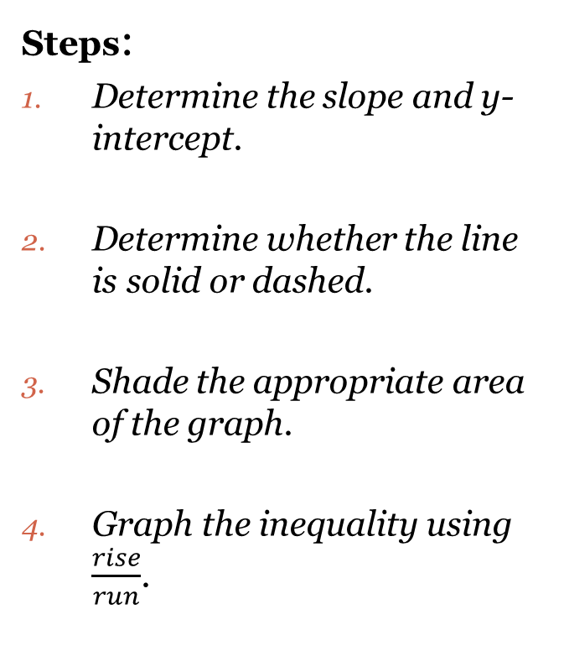
Graphing Inequalities
Steps:
Determine the slope and y-intercept.
Determine whether the line is solid or dashed.
Shade the appropriate area of the graph.
Graph the inequality using $\frac{rise}{run}$.
Directions: Graph the inequality.
EX: $y<x+1$

Slide 8

Cluster Examples #1
Directions: Graph the inequality.
$y>\frac{2}{3}x−5$
$y≥\frac{−1}{4}x+2$
$y≤\frac{−3}{4}x+5$

Slide 9

Cluster Examples #2
Directions: Rearrange the equation into slope/intercept form. Show all work.
(1) $−2x+y>3$ *(2) $3x−y>1$
*Why does the inequality sign change?

Slide 10
Graphs of Absolute Value Inequalities
$$y<\left|x\right|$$
$$y>\left|x\right|$$
If using a less than or equal to ($≤$) or greater than or equal to ($≥$), use a SOLID line. If the absolute value has a negative sign on the outside, the graph faces downward.

Slide 11

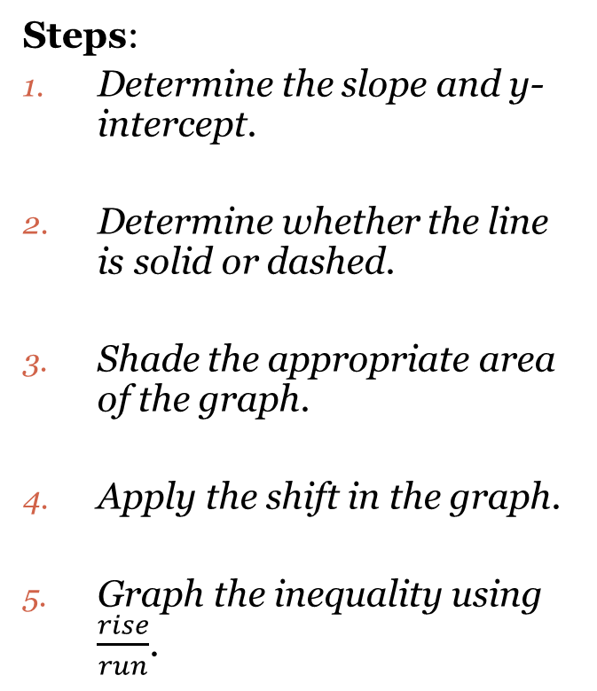
Graphing Absolute Value Inequalities
Steps:
Determine the slope and y-intercept.
Determine whether the line is solid or dashed.
Shade the appropriate area of the graph.
Apply the shift in the graph.
Graph the inequality using $\frac{rise}{run}$.
Directions: Graph the inequality $y≥\left|x\right|+2$.

Slide 12

Graphing Absolute Value Inequalities
Directions: Graph the absolute value inequality. Show all work.
$y<\left|x+1\right|−2$
$y≤\left|x−2\right|+5$
$y>−\left|x\right|+4$

Slide 13
Graphing Systems of Inequalities
Directions: Using the graph paper, graph the system of inequalities and shade in the correct solution area.
$x≥5$
$y<−x+3$
$y<\frac{−1}{3}x+2$
$y>x−4$
3) $y<−1/3x−4$
$y>\frac{2}{3}x+1$

Slide 14
Graphing Systems of Inequalities
Directions: Using the graph paper, graph the system of inequalities and shade in the correct solution area.
y$≤3$
$0≤x≤5$
$y>−x$
$y<2x+1$
$y>2x−2$
$y>−3x+8$

Slide 15
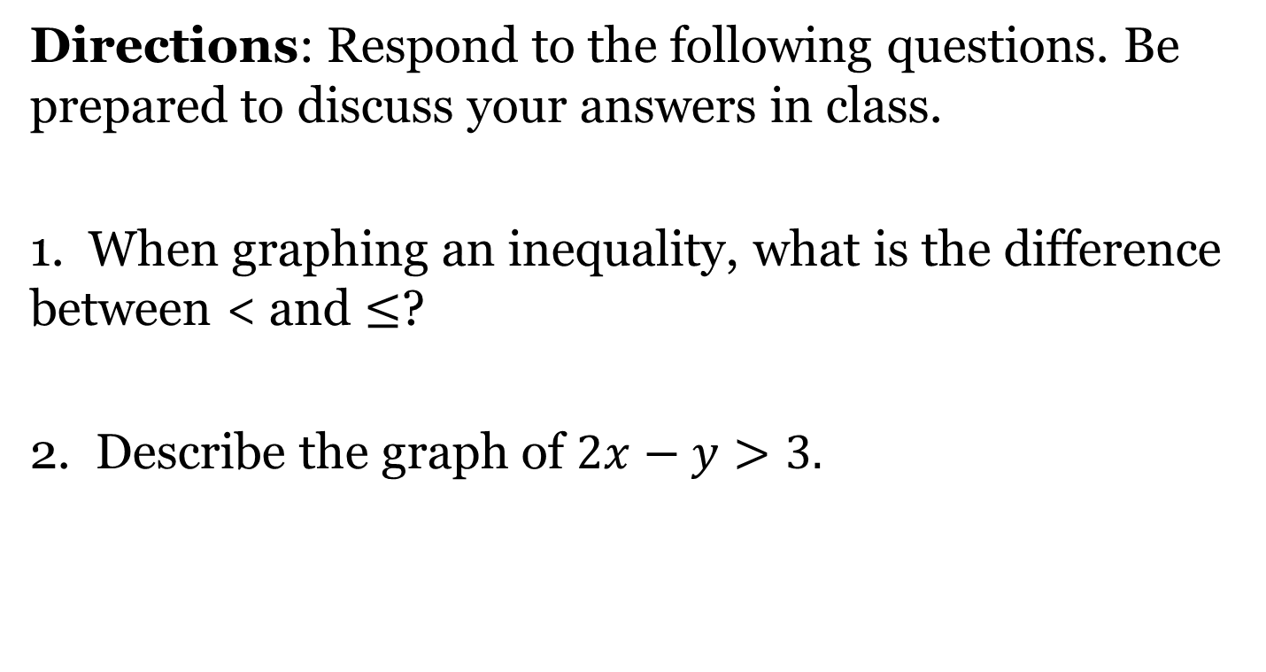
Closing Questions
Directions: Respond to the following questions. Be prepared to discuss your answers in class.
1. When graphing an inequality, what is the difference between < and $≤$?
2. Describe the graph of $2x−y>3.$

Slide 16
Homework Assignment
Announcements

