Slide 1
Chapter 1 – Section 1 “Solving Equations”
Objectives covered
The student will solve different type of linear equations.

Slide 2
The Five Steps of Solving Equations
1. Distribute
2. Combine Like Terms
3. Move all the variables to one side by adding or subtracting.
4. Move the Number furthest from the variable.
5. Use the opposite operation to solve.

Slide 3

Addition & Subtraction Property of Equality
Directions: Solve the equation. Show all work.
$x+5=−12$
$x−7=4$
$5−x=2$

Slide 4

Multiplication & Division Property of Equality
Directions: Solve the equation. Show all work.
$−4x=36$
$\frac{2}{5}x=8$
$\frac{x}{7}=3$

Slide 5
Multistep Equations
Directions: Solve the equation. Show all work.
$3x+1=22$
$\frac{x}{5}+1=−7$
$\frac{2}{3}x−8=4$

Slide 6

Multistep Equations Cluster Examples
Directions: Solve the equation. Show all work.
(1) $7=4−3x$ (2) $\frac{x−4}{3}=8$
(3) $\frac{1}{4}x+\frac{2}{3}=\frac{5}{8}$

Slide 7

Variables on Both Sides
Directions: Solve the equation. Show all work.
$2x+1=3(x−8)+2$
$7−4x=3x+28$

Slide 8
Special Case #1
NO SOLUTION
*Variables cancel each other out.
*Two numbers are unequal.

Slide 9
Special Case #2
INFINITE SOLUTION
*Variables will cancel each other out.
*Two numbers are equal.

Slide 10
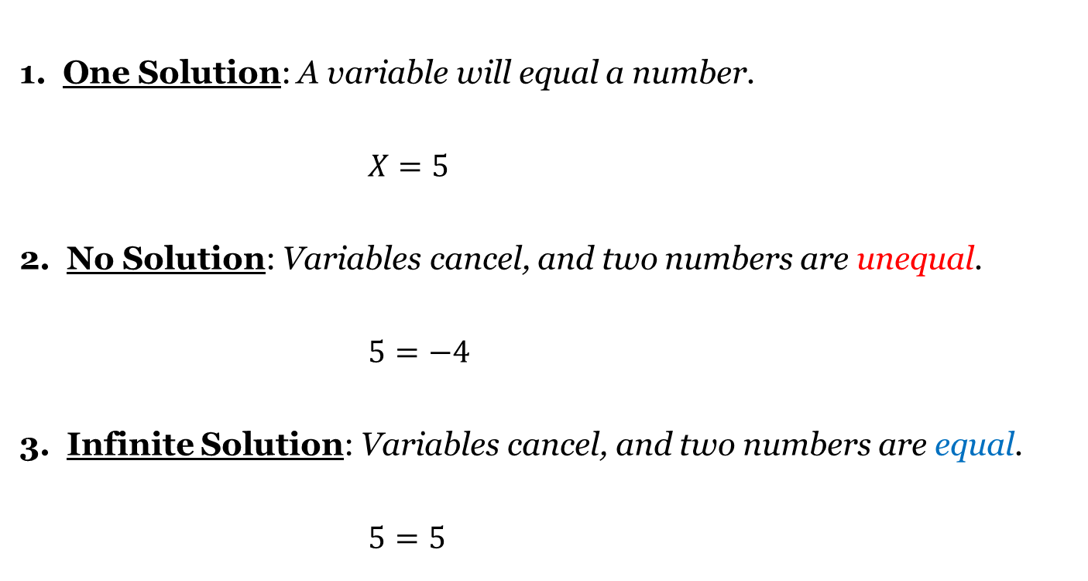
Three Types of Solutions

Slide 11
Solving Literal Equations
Directions: Solve for the variable x. Show all work.
$xy+1=4$
$\frac{xy+z}{w}=3$
$2x+3y=6$
Q: What happens when you rearrange your bedroom?
A: Instead of “solving” think of “rearranging.”
Rule: To isolate a variable, place a box around the indicated variable.

Slide 12
Homework Assignment
Announcements

