Slide 1
Unit 1 – Section 4 Pt. 3 “Linear Regression: Line of Best Fit”
Objectives
The student will write a line of best fit using data.

Slide 2
Scatter Plots and Lines of Best Fit
Scatter Plot: Two sets of data are represented as ordered pairs (x,y) on the Coordinate Plane.
Correlation: Describes the overall nature of the scatter plot.
Lines of Best Fit: A prediction equation of a scatter plot, in which a straight line intersects as many points as possible.
Prediction Equation: The equation of a line y=mx+b from estimating the line of best fit.

Slide 3
Three Types of Correlations

Slide 4
Line of Best Fit
The following scatter plot shows the relationship between time spent studying (x), and overall grade (y).
Directions: Answer the following question based upon the scatter plot.
What is the correlation of this graph?
What does a positive correlation say about the relationship?
What would be the line of best fit for this scatter plot?
(Hint: Find the y-intercept and slope and then replace it in the equation y=mx+b).

Slide 5
Scatter Plots
The following scatter plot shows the relationship between the number of items purchased at a store (x), and how much money is left for the customer to spend (y).
Directions: Answer the following question based upon the scatter plot.
What is the correlation of this graph?
What does a negative correlation say about the relationship?
What would be the line of best fit for this scatter plot?
(Hint: Find the y-intercept and slope and then replace it in the equation y=mx+b).

Slide 6
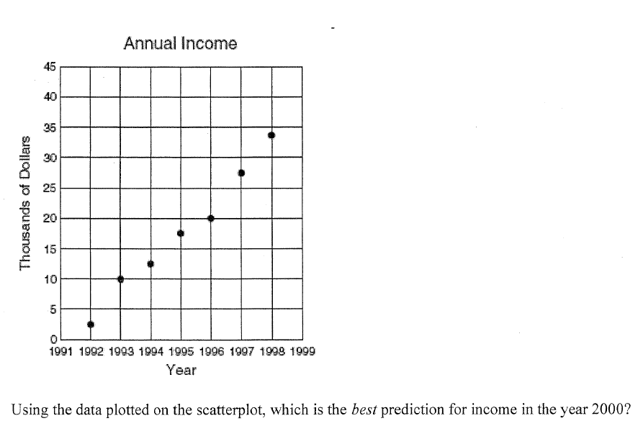
Line of Best Fit
Directions:
Determine the line of best fit for the data on the left. Determine the best prediction of income for the year 2000, 2016.

Slide 7
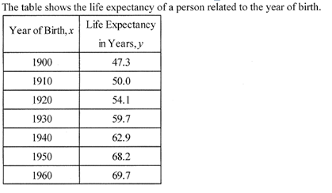
Line of Best Fit
Calculator Directions for TI-83 and TI-84
To enter data:
1. Go to Stat→Edit→$L_{1}$, enter all data for x.
2. Scroll to $L_{2}$, enter a;; data for y.
3. Go to Stat→Calc→4:LingReg(ax+b)
To delete data:
Go to Stat→Edit
Highlight $L_{1}$, push Clear
Highlight $L_{2}$, push Clear
What equation would give the best estimate of life expectancy, given the year of one’s birth?

Slide 8
Line of Best Fit
Calculator Directions for TI-83 and TI-84
To enter data:
1. Go to Stat→Edit→$L_{1}$, enter all data for x.
2. Scroll to $L_{2}$, enter a;; data for y.
3. Go to Stat→Calc→4:LingReg(ax+b)
To delete data:
Go to Stat→Calc
Highlight $L_{1}$, push Clear
Highlight $L_{2}$, push Clear
What is the line of best fit for this data?

Slide 9
Homework Assignment
Announcements

