Slide 1
Unit 1- Section 6“Solving Absolute Value Equations”
Objectives covered
The student will be able to solve absolute value equations
The student will be able to find extraneous solutions

Slide 2
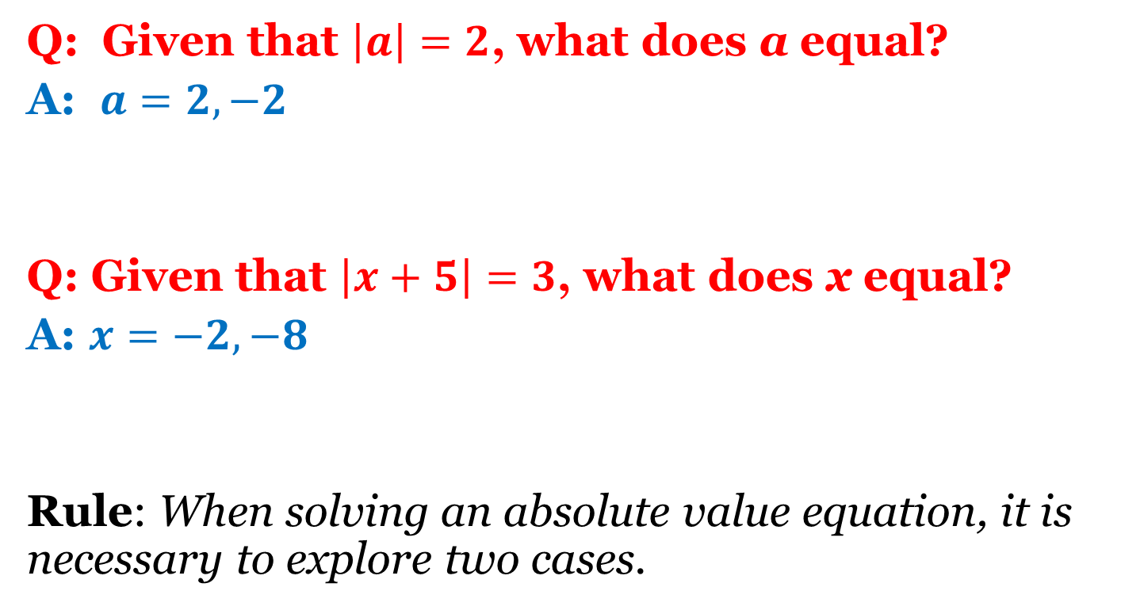
Absolute Values
Q: Given that $\left|a\right|=2$, what does a equal?
A: $a=2,−2$
Q: Given that $\left|x+5\right|=3$, what does x equal?
A: $x=−2,−8$
Rule: When solving an absolute value equation, it is necessary to explore two cases.

Slide 3


Directions: Solve the absolute value equation. Show all work. Check the solution(s). $\left|x+6\right|=9$
Case #1: Remove the absolute value sign.
Case #2: Remove the absolute value sign and make the number on the right negative.
$$X+6=−9$$
$$X+6=9$$

Slide 4
Absolute Value Equations
Steps:
Set up both cases; Change the sign in the second case.
Solve each equation.
Check for both solutions in the ORIGINAL equation.
Directions: Solve the equation. Show all work. Remember to check all solutions.
$\left|x+6\right|=2x$
$5\left|x+4\right|=45$
$−2\left|x+3\right|=6$

Slide 5

Cluster Examples
Directions: Solve the equation. Use both cases. Check all solutions.
$\left|2x+5\right|=2x−3$
$\left|x−4\right|+5=20$

Slide 6
Summary Questions
Directions: On a sheet of paper respond to the following questions. Be prepared to either turn it in or discuss answers with the class.
What is it important to check your solutions?
The equation $−5\left|x−7\right|=25$ does not have a solution. How is this possible?

Slide 7
Homework Assignment
Announcements

