Slide 1
Unit 1- Section 8 Section “Systems of Equations – Elimination”
Objectives covered
To solve systems of equations by using elimination method with multiplication and addition
To determine the best method for solving systems of equations.
To solve systems of equations by using elimination method with addition or subtraction

Slide 2
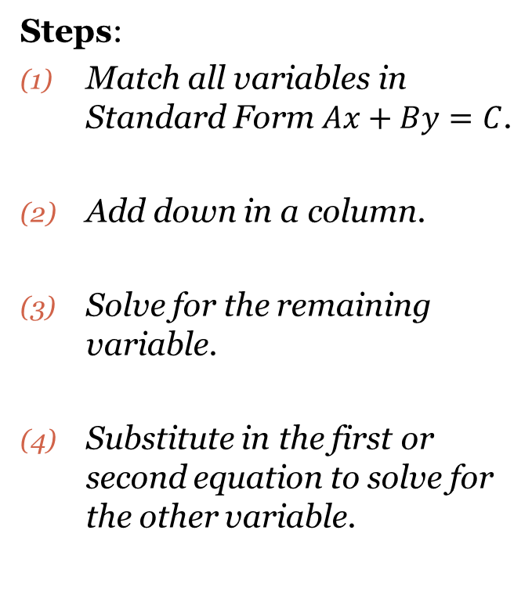
Elimination
Note: Change the -9 to +9

Slide 3
Cluster Examples

Slide 4
Special Case Elimination: “The Case of ‘Negating’ the Sign”

Slide 5
Least Common Multiple (L.C.M.)
Least Common Multiple: The first number that two numbers have in common by multiplication.
EX: LCM of 5 and 3 is _____.
of 6 and 4 is _____.
of 2 and 8 is _____.

Slide 6
Multiplication Elimination

Slide 7
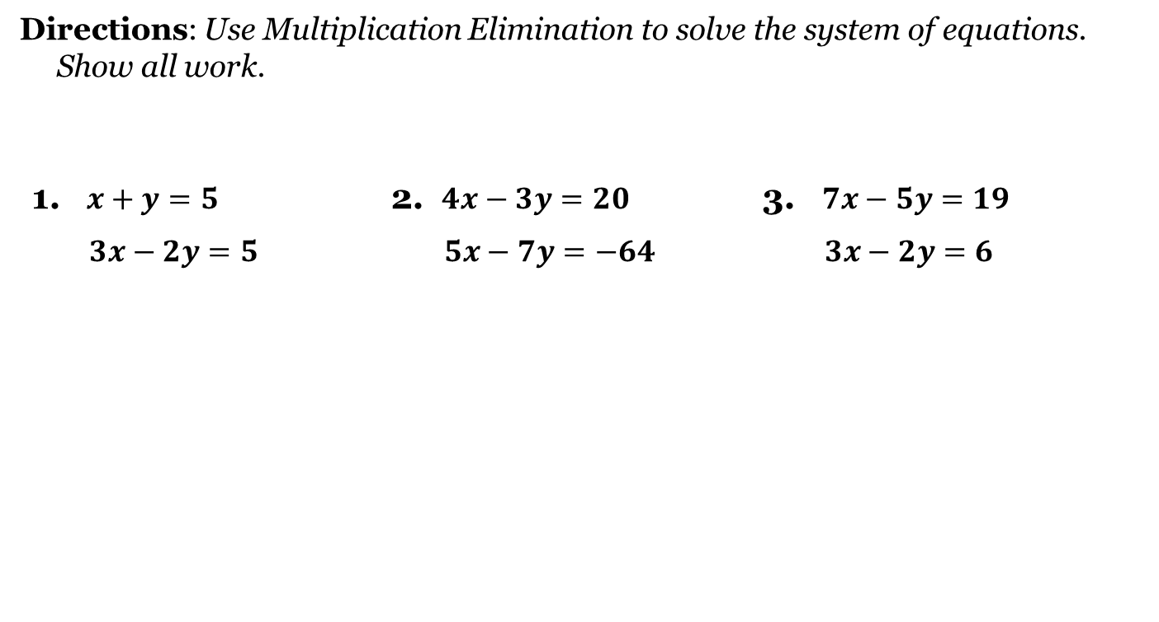
Cluster Examples

Slide 8
Closing Questions
Complete and turn in.
Use any method.

Slide 9
Homework Assignment
Announcements

