Slide 1
Unit 2 – Section 1 “Graphing Quadratic Functions in Standard Form $ax^{2}+bx+c$”
Objectives Covered
The student will find the axis of symmetry and vertex of a quadratic equation
The student will determine whether the graph yields maximum or minimum values based on transformation of graphs

Slide 2
Quadratic Functions
Standard Form:
$$f\left(x\right)=ax^{2}+bx+c$$
Quadratic term: $ax^{2}$
Linear term: $bx$
Constant term: $c$
Directions: Identify the quadratic term, linear term, and constant term for the quadratic function.
Hint: Multiply the polynomials.
$$f\left(x\right)=(x+3)(2x+3)$$

Slide 3
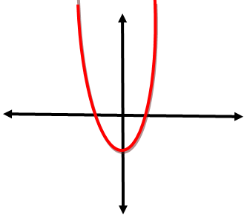
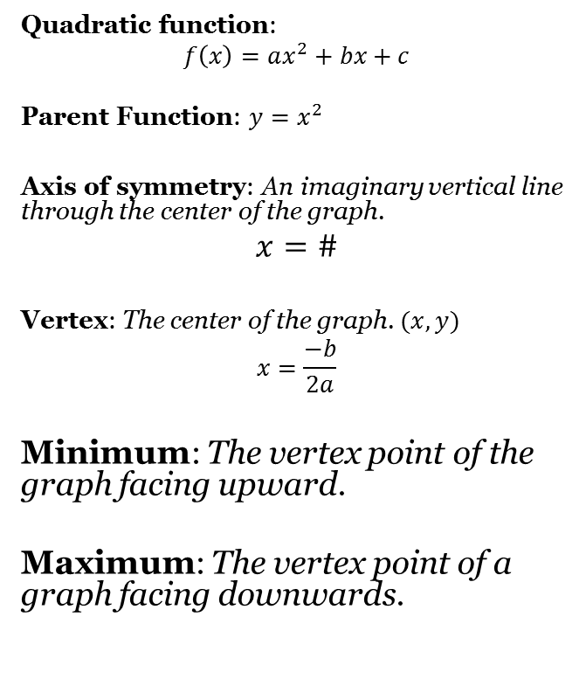
Graphing Quadratic Functions
Quadratic function:
$$f\left(x\right)=ax^{2}+bx+c$$
Parent Function: $y=x^{2}$
Axis of symmetry: An imaginary vertical line through the center of the graph.
$$x=\#$$
Vertex: The center of the graph. $(x,y)$
$$x=\frac{−b}{2a}$$
Minimum: The vertex point of the graph facing upward.
Maximum: The vertex point of a graph facing downwards.

Slide 4
Graphing Quadratic Functions
Directions: Find the vertex and axis of symmetry for each quadratic equation. Label whether the vertex is a maximum or minimum value. Do not graph.
${f\left(x\right)=x}^{2}+3x−28$
AoS:
v:
$f\left(x\right)=4x^{2}+5x−1$
AoS:
v:
$f\left(x\right){=x}^{2}−10x+25$
AoS:
v:

Slide 5
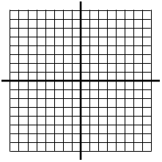
Graphing Quadratic Functions
Directions: Find the axis of symmetry and the vertex of the quadratic equations. Graph the result.
$$f\left(x\right)=x^{2}−10x+21$$

Slide 6
Closing Questions
Directions: Respond to the following questions. Be prepared to discuss your answers in class.
1. Convert the function $f\left(x\right)=(x−3)(x+5)$ into standard form $ax^{2}+bx+c$
2. Find the vertex of the function $y=x^{2}−10x+26$. Is the vertex a maximum or minimum? What is the axis of symmetry?

Slide 7
Homework Assignment
Announcements

