Slide 1
Chapter 2-Section 2 “Graphing Quadratic Functions in Vertex Form $y={(x−h)}^{2}+k$”
The student will
Graph an equation of in vertex form

Slide 2
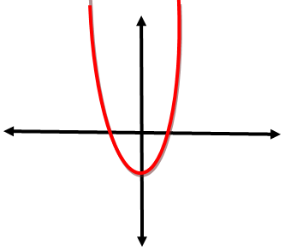
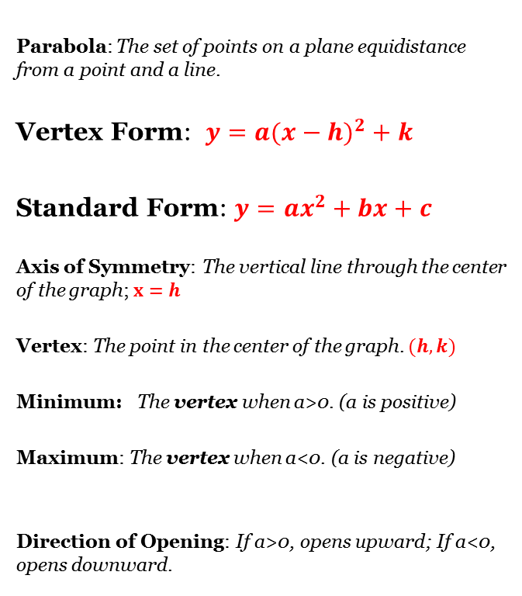
Vertex Form Terminology
Parabola: The set of points on a plane equidistance from a point and a line.
Vertex Form: $y={a(x−h)}^{2}+k$
Standard Form: $y=ax^{2}+bx+c$
Axis of Symmetry: The vertical line through the center of the graph; $x=h$
Vertex: The point in the center of the graph. $(h,k)$
Minimum: The vertex when a>0. (a is positive)
Maximum: The vertex when a<0. (a is negative)
Direction of Opening: If a>0, opens upward; If a<0, opens downward.

Slide 3
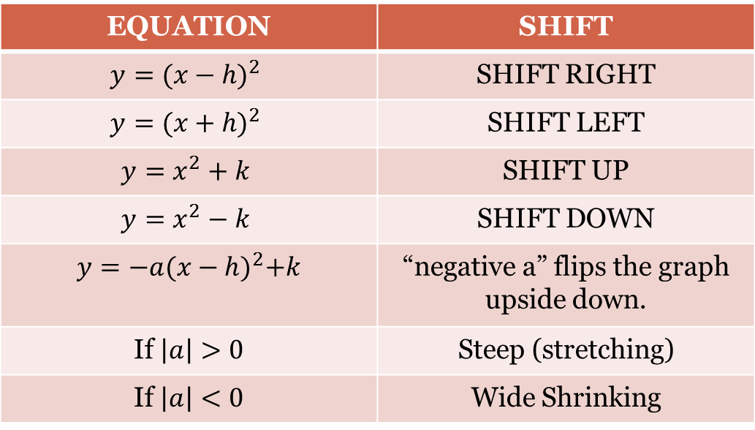
Parabolas and their Shifts
Given the parabola $y=a{(x−h)}^{2}+k$ use the following shifts:
+
-
₊ ₋
EQUATION | SHIFT
$$y={(x−h)}^{2}$$ | SHIFT RIGHT
$$y={(x+h)}^{2}$$ | SHIFT LEFT
$$y=x^{2}+k$$ | SHIFT UP
$$y=x^{2}−k$$ | SHIFT DOWN
$y=−a{(x−h)}^{2}+k$ | “negative a” flips the graph upside down.
If $\left|a\right|>0$ | Steep (stretching)
If $\left|a\right|<0$ | Wide Shrinking

Slide 4
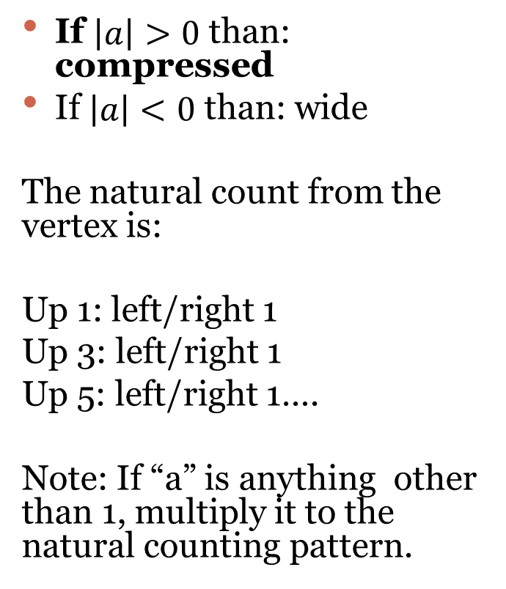
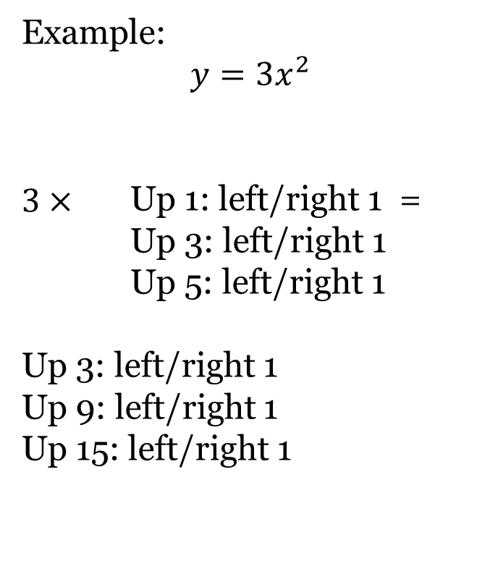
The Role of “a” in $y={ax}^{2}+bx+c$ in Vertex Form
If $\left|a\right|>0$ than: compressed
If $\left|a\right|<0$ than: wide
The natural count from the vertex is:
Up 1: left/right 1
Up 3: left/right 1
Up 5: left/right 1….
Note: If “a” is anything other than 1, multiply it to the natural counting pattern.
Example:
$$y=3x^{2}$$
$3×$ Up 1: left/right 1 =
Up 3: left/right 1
Up 5: left/right 1
Up 3: left/right 1
Up 9: left/right 1
Up 15: left/right 1

Slide 5
Completing the Square by Rewriting in Vertex Form
Steps:
Place function in quadratic form: ${y=ax}^{2}+bx+c$
Place parenthesis: ${(ax}^{2}+bx)+c$
Factor out the coefficient of “$x^{2}$” (if necessary), resulting in:
${a(x}^{2}+bx)+c$.
4. Take the coefficient b and:
Divide it by 2. (remember this #)
Square it.
Add on the inside subtract from the out .
5. Factor the parenthesis, simplify the outside.
New function: $y=a{(x−h)}^{2}+k$
Directions: Write each equation in parabola form by completing the square. Label the vertex and the axis of symmetry.
$y=x^{2}+4x+1$
$y=x^{2}+4x+3$
$y={2x}^{2}−12x+6$

Slide 6
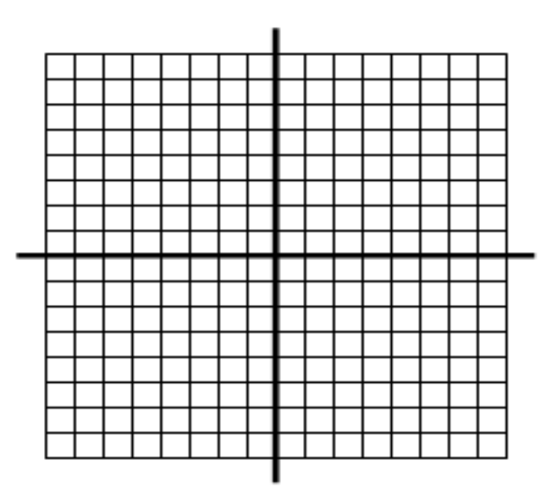
Using Vertex Form to Graph
Directions: Describe the following functions. Label the vertex and axis of symmetry. Graph your result.
$y=\frac{−1}{2}{(x−2)}^{2}+3$
$y={(x+1)}^{2}−2$
$y=2{(x−1)}^{2}+4$

Slide 7
Closing Questions
Directions: Respond to the following questions. Be prepared to discuss your answers in class.
Convert the function $f\left(x\right)=x^{2}+2x+7$ into vertex form by completing the square.
How do you graph the function $y=−{\left(x+3\right)}^{2}+5$?

Slide 8
Homework Assignment
Announcements

