Slide 1
Unit 2 – Section 4 “Solve by Factoring”
Objectives Covered
The student will solve quadratic equations.
The student will find x intercepts for quadratic equations

Slide 2
Solutions to Quadratic Functions
Root: The solution to a quadratic function.
Zero: The solution to a quadratic function.
X-Intercepts: The solutions to a quadratic function.
Solution: The x-intercepts, zeros, and roots of a function. (Notice: They all mean the same thing).
Rule: Solve by factoring, write your solutions as x-intercepts and graph the zeros.

Slide 3
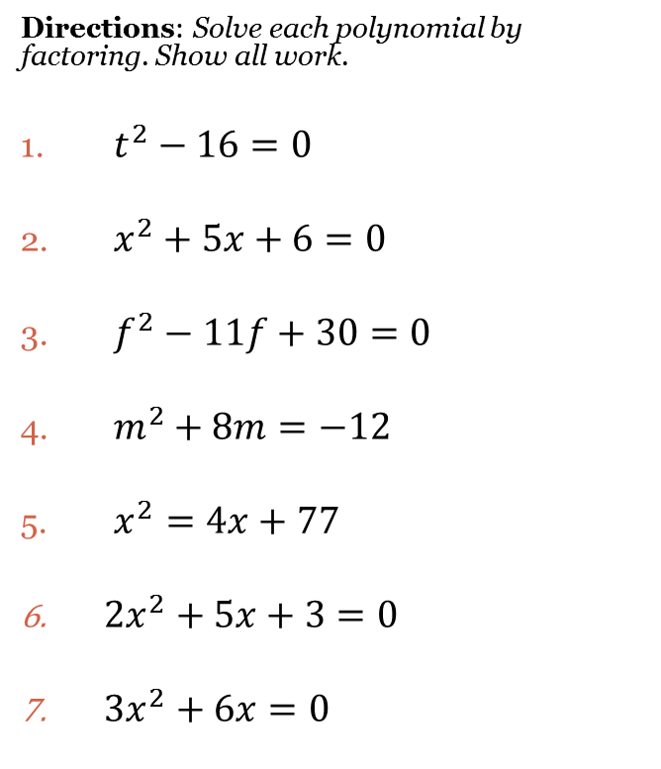
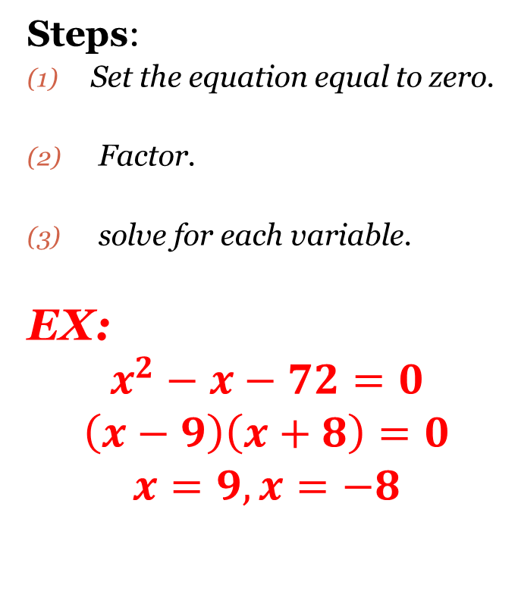
Solve by Factoring
Steps:
Set the equation equal to zero.
Factor.
solve for each variable.
EX:
$$x^{2}−x−72=0$$
$$\left(x−9\right)\left(x+8\right)=0$$
$$x=9, x=−8$$
Directions: Solve each polynomial by factoring. Show all work.
$t^{2}−16=0$
$x^{2}+5x+6=0$
$f^{2}−11f+30=0$
$m^{2}+8m=−12$
$x^{2}=4x+77$
$2x^{2}+5x+3=0$
$3x^{2}+6x=0$

Slide 4
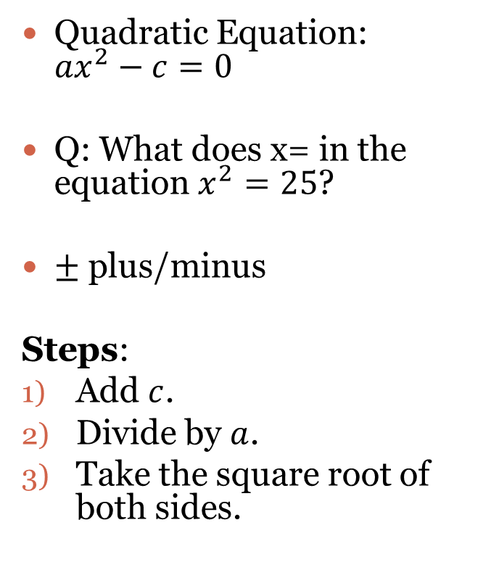
Solve By Finding the Square Root
Quadratic Equation: ${ax}^{2}−c=0$
Q: What does x= in the equation $x^{2}=25$?
$±$ plus/minus
Steps:
Add $c$.
Divide by $a$.
Take the square root of both sides.
Directions: Solve each equation by finding the square roots.
$4x^{2}−25=0$
$3x^{2}=24$
$x^{2}−\frac{1}{4}=0$

Slide 5
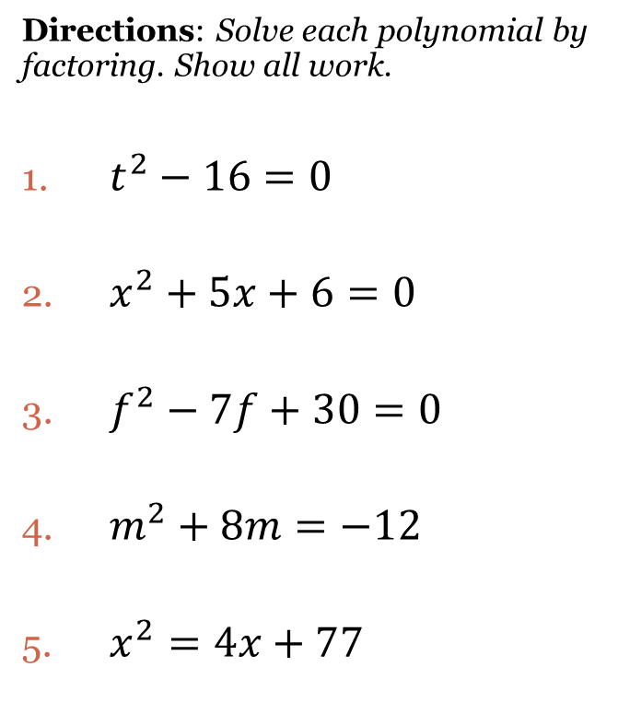
Solve by Factoring
Directions: Find the zeros of the quadratic function by factoring. Graph your result.
$f\left(x\right)=x^{2}−2x−24$
$f\left(x\right)=x^{2}+3x−28$
$h\left(x\right)=2x^{2}−7x−15$

Slide 6
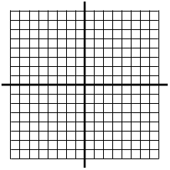
Graphing Quadratic Functions
Directions: Find the axis of symmetry, vertex, and the roots of the quadratic equations. Graph the result.
$$f\left(x\right)=x^{2}−10x+21$$

Slide 7
Closing Questions
Directions: Respond to the following questions. Be prepared to discuss your answers with the class.
What is the difference between solution, x-intercept, zero, and root in terms of quadratic functions?
Solve by factoring: $3x^{2}−20x+25=0$.
Is it possible for a quadratic equation to not have a solution?

Slide 8
Homework Assignment
Announcements

