Slide 1
Unit 2 – Section 8 “The Quadratic Formula and the Discriminants”
Objectives
The student will solve quadratic functions using the quadratic formula
The student will identify three types of solutions using the discriminant and the quadratic formula

Slide 2
Solving Quadratic Equations
Three ways to solve:
Factoring: This method is only good for finding rational and real solutions.
Completing the Square: This method is only good for finding rational, irrational, and real solutions.
The Quadratic Formula: This method is good for finding real solutions and complex solutions.

Slide 3
The Quadratic Formula
The Quadratic Formula:
$$x=\frac{−b±\sqrt{b^{2}−4ac}}{2a}$$
Quadratic Equation:
$${ax}^{2}+bx+c=0$$
Note: The following examples yield rational solutions.
Directions: Find the solutions to each quadratic equation using the Quadratic Formula.
$x^{2}−10x+24=0$
$2x^{2}+4x−30=0$
${3x}^{2}+5x+2=0$

Slide 4
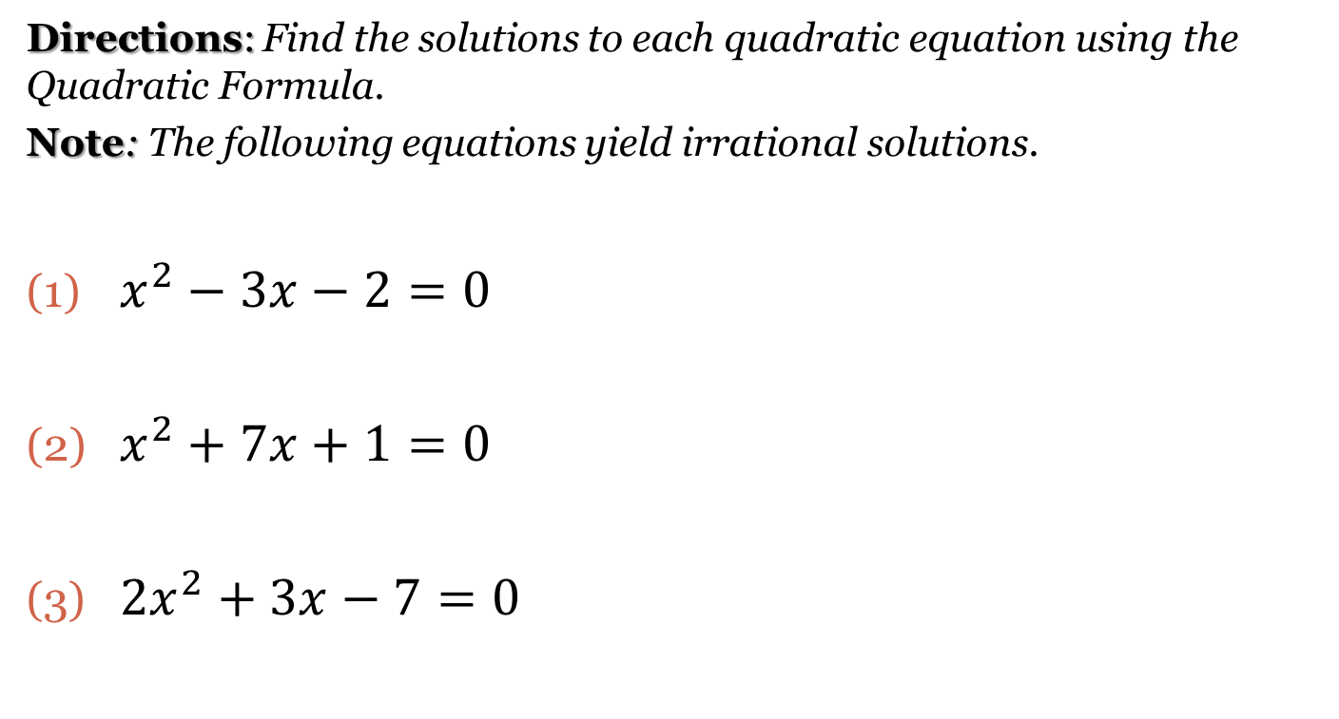
The Quadratic Formula
Directions: Find the solutions to each quadratic equation using the Quadratic Formula.
Note: The following equations yield irrational solutions.
$x^{2}−3x−2=0$
$x^{2}+7x+1=0$
${2x}^{2}+3x−7=0$

Slide 5
The Quadratic Formula
Directions: Find the solutions for each equation using the Quadratic Formula.
Note: The following equations yield complex solutions.
$x^{2}−3x+7=0$
$5x^{2}+7x+3=0$
$−2x^{2}+x−5=0$

Slide 6
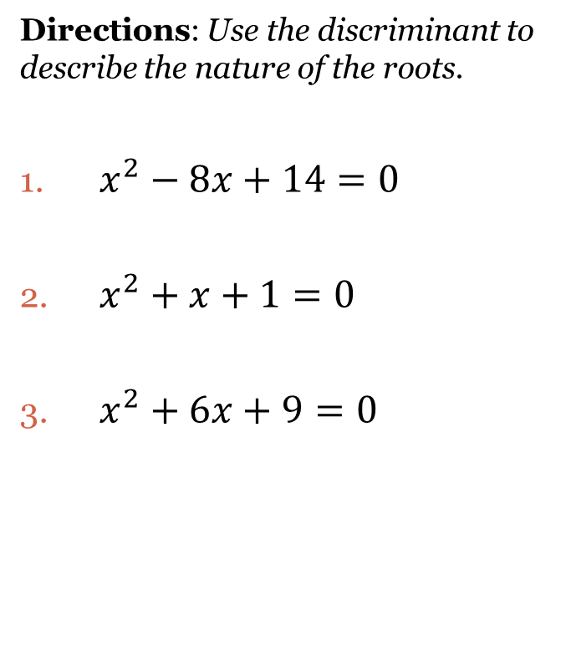
Discriminants
Discriminant: The value of the discriminant determines the nature of the roots.
Discriminant:
$$x=b^{2}−4ac$$
If x<0, then two complex solutions.
If x=0 then one real solution.
If x>0 then two real solutions.
Directions: Use the discriminant to describe the nature of the roots.
$x^{2}−8x+14=0$
$x^{2}+x+1=0$
$x^{2}+6x+9=0$

Slide 7
Closing Question
Directions: Respond to the following questions. Be prepared to discuss your answers with the class.
Which method is best for solving the quadratic function: $x^{2}−4x−6$? Explain your answer.
Use the quadratic formula to determine the solutions to the function: $x^{2}+7x−3$

Slide 8
Homework Assignment
Announcements

