Slide 1
Unit 3 – 1 “Monomials featuring: Laws of Exponents”
Objectives
The students will utilize the laws of exponents.
The students will determine methods for evaluating laws of exponents

Slide 2
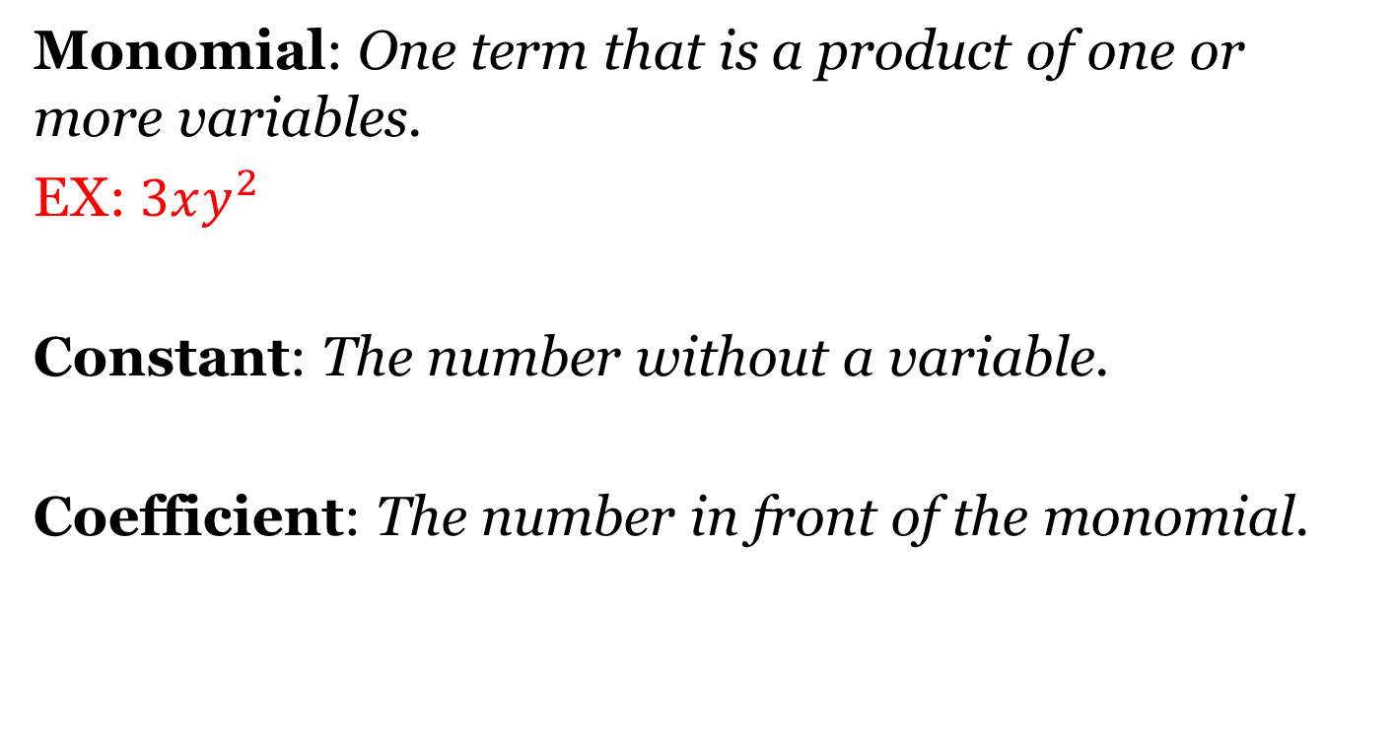
Monomial Terminology
Monomial: One term that is a product of one or more variables.
EX: $3xy^{2}$
Constant: The number without a variable.
Coefficient: The number in front of the monomial.

Slide 3
LoE #1: Multiplication
Rule: When multiplying variables, add the exponents and multiply the coefficients.
$$a^{m}∙a^{n}=a^{m+n}$$
Directions: Evaluate the monomials.
$(x^{2}y^{2})(xy^{4})$
$(3x^{2})(4x^{3})$
$(xy^{4}z^{2})(x^{4}y^{3}z^{6}$)

Slide 4
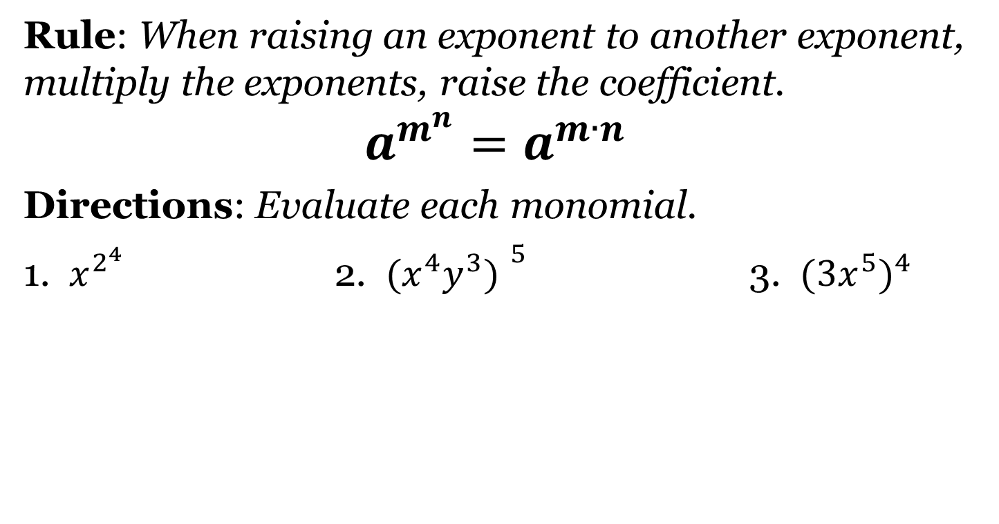
LoE #2: Exponent to Exponent
Rule: When raising an exponent to another exponent, multiply the exponents, raise the coefficient.
$$a^{m^{n}}=a^{m∙n}$$
Directions: Evaluate each monomial.
1. $x^{2^{4}}$ 2. ${(x^{4}y^{3}) }^{5}$ 3. ${{(3x}^{5})}^{4}$

Slide 5
Combining LoE #1 & #2
Rule: Apply LoE#2 first, then apply LoE #1.
Directions: Simplify the monomials. Show all work.
${\left(x^{2}y^{4}\right) }^{3}({2xy^{4}) }^{5}$

Slide 6
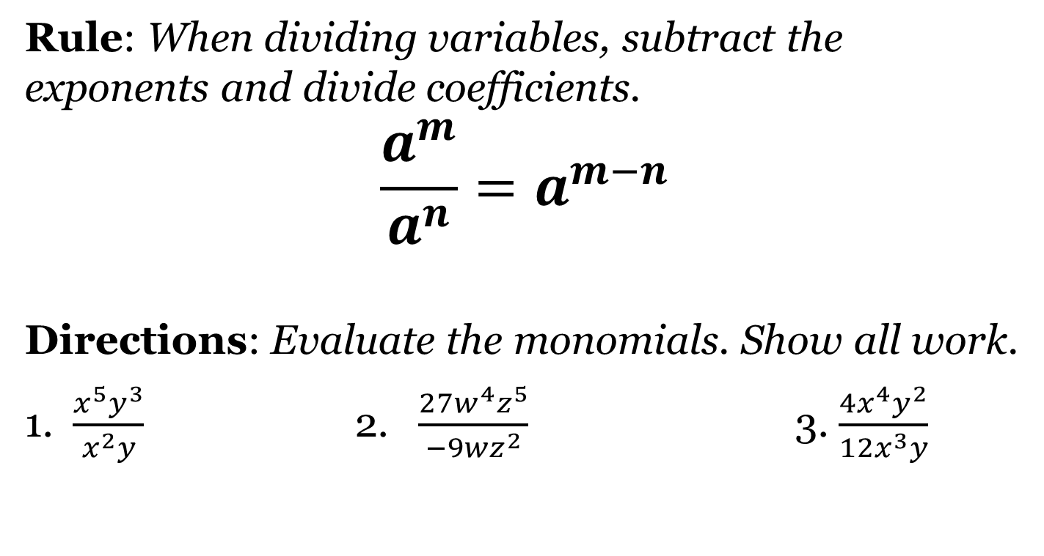
LoE#3 Division
Rule: When dividing variables, subtract the exponents and divide coefficients.
$$\frac{a^{m}}{a^{n}}=a^{m−n}$$
Directions: Evaluate the monomials. Show all work.
1. $\frac{x^{5}y^{3}}{x^{2}y}$ 2. $\frac{{27w}^{4}z^{5}}{−9wz^{2}}$ 3. $\frac{4x^{4}y^{2}}{12x^{3}y}$

Slide 7
LoE#4 Negative Exponents
Rule: Move negative exponents with variables to the bottom of the fraction and make the exponents positive. Negative coefficients do not move.
$$ab^{−1}=\frac{a}{b}$$
Directions: Evaluate the monomials. Show all work.
1. $\frac{x^{5}y^{6}z^{2}}{x^{7}y^{3}z^{5}}$ 2. $\frac{m^{5}n^{7}p^{2}}{m^{6}n^{12}p}$ 3. $\frac{{−10x}^{7}y^{2}}{{2x}^{8}y^{3}}$

Slide 8
Closing Questions
Directions: Respond to the following questions. Be prepared to discuss your answers with the class.
1. Evaluate: $\frac{{(2x^{3}y^{5}z^{2})}^{3}}{4{(x^{3}y^{5})}^{2}}$

Slide 9
Homework Assignment
Announcements

