Slide 1
Unit 3 – Section 3 “Long Division & Synthetic Division”
Objectives
To divide polynomials by long division.
To divide polynomials using synthetic division.

Slide 2

Elementary School Long Division
Directions: Use long division to find the quotient.
1. $2 154$ 2. $5 300$

Slide 3
Using Long Division
Steps:
Divide the first term into the first term.
Multiply.
SUBTRACT.
Bring down the next term.
Repeat steps 1-4 until no more terms are left.
Directions: Use long division to divide each polynomial.
$x+2 x^{2}+10x+16$
$x+2 x^{3}+7x^{2}−5x−6$
$x−5 x^{2}+2x−30$

Slide 4

Using Synthetic Division*
*Only works when dividing by a binomial of degree 1.
Steps:
Reverse sign of the binomial factor.
Rewrite all coefficients in descending order (include any zeros for missing exponents).
Bring down the first coefficient.
Multiply that coefficient by the # from step 1.
Add the result.
Repeat steps 4&5 until all numbers have been used.
Fill in coefficients with new variable/exponent, starting with 1 degree less than the original polynomial.
Directions: Use synthetic division to find the quotient.
${(x}^{3}+4x^{2}+x−6)÷(x+1)$
-1 1 4 1 -6
2. ${(x}^{3}−6x^{2}+4x−1)÷(x−3)$
3 1 -6 4 -1

Slide 5
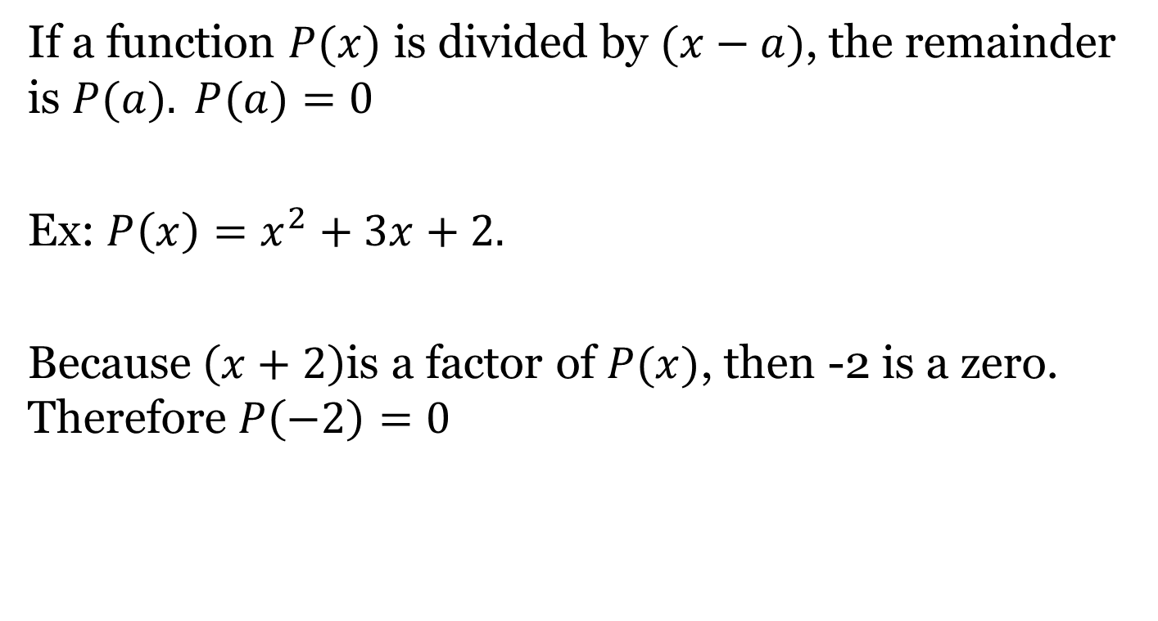
Remainder Theorem
If a function $P(x)$ is divided by $(x−a)$, the remainder is $P(a). P(a)=0$
Ex: $P\left(x\right)=x^{2}+3x+2.$
Because$\left(x+2\right)$is a factor of $P(x)$, then -2 is a zero. Therefore $P\left(−2\right)=0$

Slide 6
Synthetic Division and the Remainder Theorem
Directions: Use synthetic division to show that “a” is a zero of the function P(x). (Remember $0x^{2}$)
$P(3)$ for $P\left(x\right)=x^{4}−2x^{3}+x−9$
If $a=3$, then $(x−3)$is a factor.
If P(3)=0 or if the remainder is zero, than $(x−3)$is a factor of $P\left(x\right)=x^{4}−2x^{3}+x−9$ .
Is $(x−3)$a factor of $P\left(x\right)=x^{4}−2x^{3}+x−9$ ?

Slide 7
Synthetic Division and the Remainder Theorem
Directions: Use synthetic division to show that “a” is a zero of the function P(x).
$P(−1)$for $p\left(x\right)=x^{4}−2x^{3}+x^{2}+x−1$
If $a=−1$, then $(x+1)$is a factor.
If $P\left(−1\right)=0$ or if the remainder is zero, then $(x+1)$is a factor of $p\left(x\right)=x^{4}−2x^{3}+x^{2}+x−1$.
Is $(x+1)$a factor of $p\left(x\right)=x^{4}−2x^{3}+x^{2}+x−1$?
Directions: Use synthetic division to show that “a” is a zero of the function P(x).
$P(1)$for $p\left(x\right)=x^{4}−2x^{3}+x^{2}+x−1$
If $a=1,$then $(x−1)$is a factor.
If $P(1)=0$or if the remainder is zero, then $(x−1)$is a factor of $p\left(x\right)=x^{4}−2x^{3}+x^{2}+x−1$.
Is (x-1) a factor of $p\left(x\right)=x^{4}−2x^{3}+x^{2}+x−1$?

Slide 8
Finding All Factors with Synthetic Division
Directions: Use synthetic division to find all the factors of each polynomial.
$(x^{3}−37x+84)÷(x−4)$
$(x^{3}−2x^{2}−5x+6)÷(x+2)$
$(x^{3}−7x^{2}−x+7)÷(x−1)$

Slide 9
Real World Connection
The volume in cubic feet of a shipping carton is $v\left(x\right)=x^{3}−6x^{2}+3x+10$. The height is $x−5$.
Find the other dimensions. Assume the length is greater than the width.
If the width of the carton is 4 feet, what are the other two dimensions?
V$=lwh$

Slide 10
Closing Questions
Directions: Respond to the following questions. Be prepared to discuss your answers with the class.
Use long division to find the quotient: $(3x^{3}−5x^{2}+10x−3)÷(3x+1)$
Use synthetic division to find the quotient: $(6x^{3}−19x^{2}+16x−4)÷(x−2)$

Slide 11
Homework Assignment
Announcements

