Slide 1
Unit 4 – Section 2 “Operations of Radicals”
Objectives
To simplify sums and differences of radical expressions
To simplify products and quotients of radical expressions

Slide 2
Operations of Radicals
Addition/Subtraction: Only add/subtract radicals with the same radicand.
EX: $\sqrt{3}+\sqrt{3}=2\sqrt{3}$
$\sqrt{2}+\sqrt{3}=\sqrt{2}+\sqrt{3}$
Multiplication: Any radicals can be multiplied together, they do not have to be the same.
EX: $\sqrt{3}×\sqrt{5}=\sqrt{15}$
$\sqrt{3}×\sqrt{3}=3$
Directions: Simplify each set of radicals. Do not use decimals.
$\sqrt{50}+3\sqrt{32}−5\sqrt{18}$
$3\sqrt{20}−\sqrt{45}+4\sqrt{80}$

Slide 3
Double Distribution
Directions: Use double distribution to find the product of the radicals. Simplify the product.
$\left(\sqrt{6}+\sqrt{3}\right)(\sqrt{3}+\sqrt{2}$)
$(2\sqrt{3}+4\sqrt{5})(\sqrt{3}+6\sqrt{5})$
$(12+\sqrt{3})(1−\sqrt{3})$

Slide 4
Multiplying Conjugates
Conjucates: A pair of radical expressions in which the only difference is the “+” and “-” sign.
EX: $1+\sqrt{3}, 1−\sqrt{3}$
EX: $\sqrt{2}+\sqrt{5}, \sqrt{2}−\sqrt{5}$
Rule: Double distribute each pair of conjugates and simplify.
Directions: Find the product of each pair of conjugates. Show all work.
$(6+\sqrt{3})(6−\sqrt{3})$
2. $(9−\sqrt{7})(9+\sqrt{7})$

Slide 5
Division with Conjugates
Conjucates: A pair of radical expressions in which the only difference is the “+” and “-” sign.
EX: $1+\sqrt{3}, 1−\sqrt{3}$
EX: $\sqrt{2}+\sqrt{5}, \sqrt{2}−\sqrt{5}$
Conjucates: A pair of radical expressions in which the only difference is the “+” and “-” sign.
EX: $1+\sqrt{3}, 1−\sqrt{3}$
EX: $\sqrt{2}+\sqrt{5}, \sqrt{2}−\sqrt{5}$
Steps:
Multiply the top and bottom by the conjugate of the denominator.
Simplify the top and bottom.
Reduce fractions if necessary.
EX: $\frac{\sqrt{3}+2}{\sqrt{3}−5}$

Slide 6

Cluster Examples
Directions: Simplify the radicals. Show all work.
1. $\frac{1+2\sqrt{5}}{6−\sqrt{5}}$ 2. $\frac{1−\sqrt{2}}{6+5\sqrt{2}}$

Slide 7
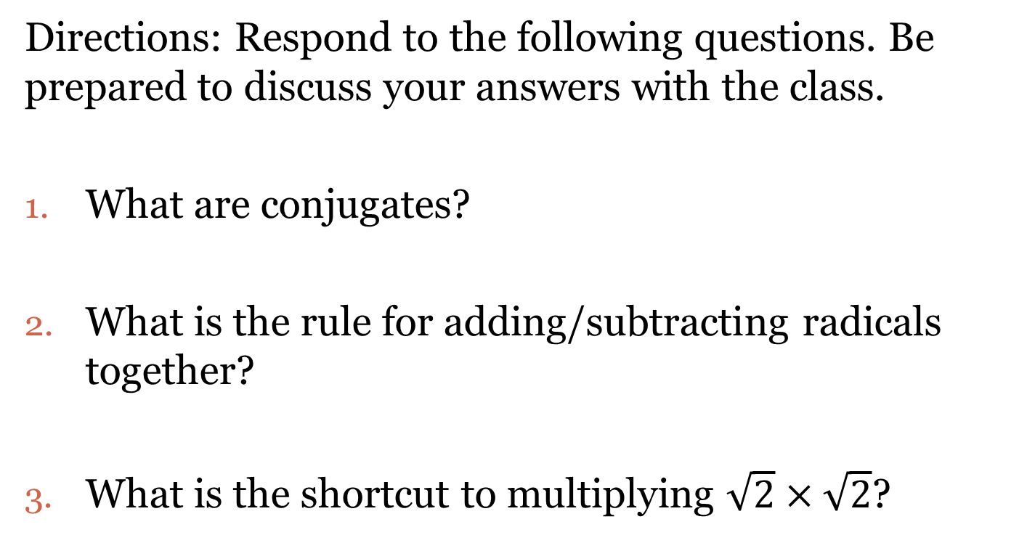
Closing Questions
Directions: Respond to the following questions. Be prepared to discuss your answers with the class.
What are conjugates?
What is the rule for adding/subtracting radicals together?
What is the shortcut to multiplying $\sqrt{2}×\sqrt{2}$?

Slide 8
Homework Assignment
Announcements

