Slide 1
Unit 4 – Section 5 “Inverse Functions”
Objectives
The student will find the inverse of a function.
The student will determine if an inverse is a function.

Slide 2

Inverse Functions
Inverse: (y,x)
Property of Inverse Functions:
Given that f(x) is a function, $f^{−1}(x)$ is an inverse function of $f(x)$.
Directions: Find the inverse of the function. Show all work. After finding the inverse, determine whether the inverses are functions. Label the domain.
$y=2x−3$
$y={(x+1)}^{2}−3$
$f\left(x\right)=\frac{x−7}{2}$
Steps:
Switch x and y.
Solve for y.
Note: $f(x)=y$
Rule: In order for an equation to be a function, cannot have $±$.

Slide 3
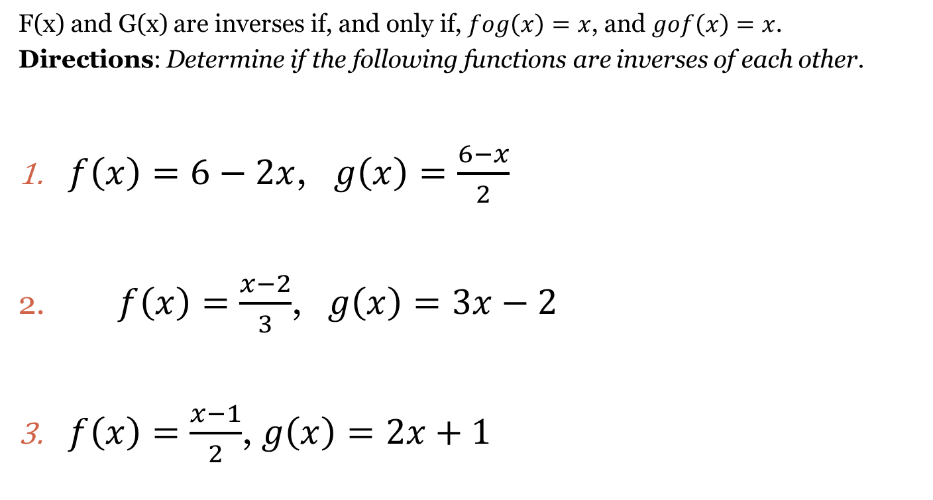
Definition of Inverse Function
F(x) and G(x) are inverses if, and only if, $fog\left(x\right)=x$, and $gof\left(x\right)=x$.
Directions: Determine if the following functions are inverses of each other.
$f\left(x\right)=6−2x$, $g\left(x\right)=\frac{6−x}{2}$
$f\left(x\right)=\frac{x−2}{3}$, $g\left(x\right)=3x−2$
$f\left(x\right)=\frac{x−1}{2}$, $g\left(x\right)=2x+1$

Slide 4
Closing Questions
Directions: Respond to the following prompt. Be prepared to discuss your answers with the class.
Find the inverse of $y=x^{3}+2$.
Does the inverse from #1 form a function?

Slide 5
Homework Assignment
Announcements

