Slide 1
Unit 4 – Section 8 “Solve Radical Equations”
Objectives Covered
The student will solve a radical equation
The student will solve an equation with rational exponents
The student will find extraneous solutions.

Slide 2
Radical Equations
Radical Equation: An equation that has a variable underneath the radical sign or has a variable with a rational exponents.
EX: (1) $3+\sqrt{x}=10$
(2) ${(x−2)}^{\frac{2}{3}}=25$

Slide 3
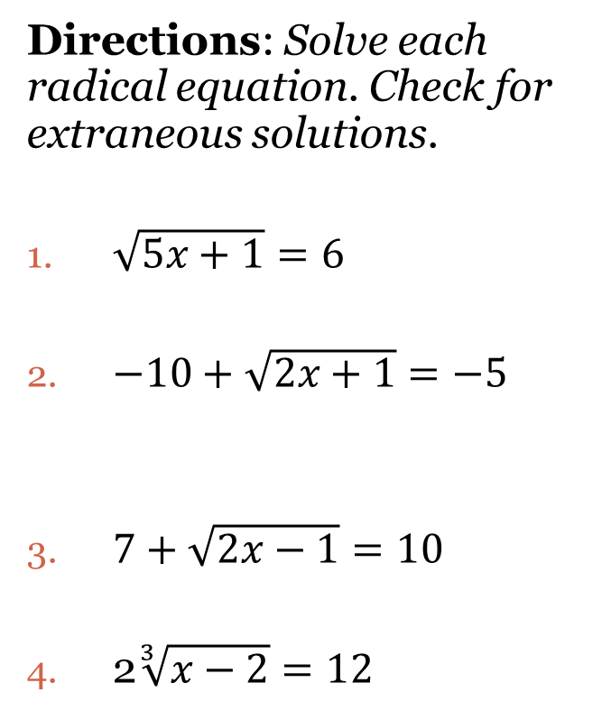
Solving Radical Equations
Steps:
Get the radical by itself.
Raise both sides of the equation to the power of the radical’s index.
Solve and check.
Directions: Solve each radical equation. Check for extraneous solutions.
$\sqrt{5x+1}=6$
$−10+\sqrt{2x+1}=−5$
$7+\sqrt{2x−1}=10$
2$\sqrt[3]{x−2}=12$

Slide 4
Solving Radical Equations with Extraneous Solutions
Steps:
Get the radical by itself.
Raise both sides of the equation to the power of the radical’s index.
Use double distribution.
Get everything equal to zero.
Solve by factoring.
Check solutions because some won’t work!!!
Directions: Solve each radical equation. Check for extraneous solutions.
$\sqrt{x+2}=x$
$\sqrt{2x−1}=x−8$
$x+1=\sqrt{7x+15}$
$\sqrt{10x+9}=x+3$

Slide 5
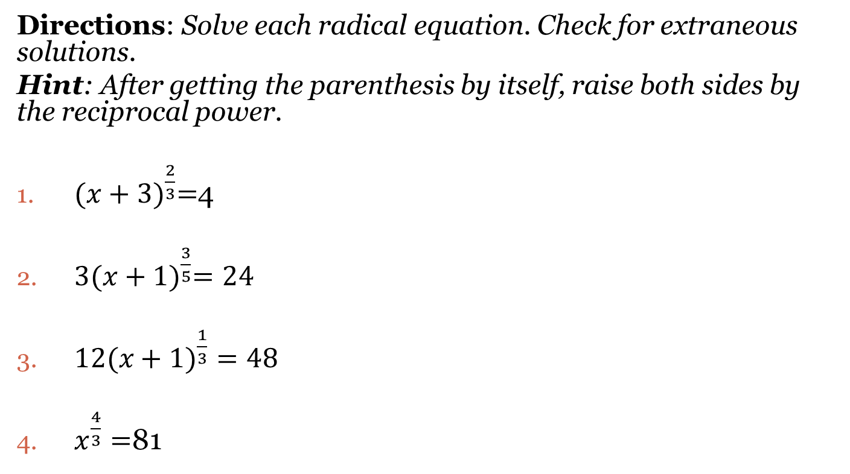
Solving Radical Equations with Rational Exponents
Directions: Solve each radical equation. Check for extraneous solutions.
Hint: After getting the parenthesis by itself, raise both sides by the reciprocal power.
${(x+3)}^{\frac{2}{3}}=$4
$3{(x+1)}^{\frac{3}{5}}=24$
${12(x+1)}^{\frac{1}{3}}=48$
$x^{\frac{4}{3}}=$81

Slide 6
Closing Questions
Directions: Respond to the following questions. Be prepared to discuss your answers with the rest of the class.
What is an extraneous solution?
How do you cancel a radical sign when solving radical equations?
Solve the following equations:
A. ${(x+5)}^{\frac{2}{3}}=16$ B. $2\sqrt{x+5}−8=10$

Slide 7
Homework Assignment
Announcements

