Slide 1
Unit 5 – Section 2 “Properties of Logarithms and Natural Logs”
Objectives
To use properties of logarithms
To expand logarithms
To condense logarithms
To simplify logarithms

Slide 2
Properties of Logarithms
Multiplication:
$$\log_{b}MN=\log_{b}M+\log_{b}N$$
Division:
$$\log_{b}\frac{M}{N}=\log_{b}M−\log_{b}N$$
Exponent:
$\log_{b}M^{x}=x\log_{b}M$

Slide 3
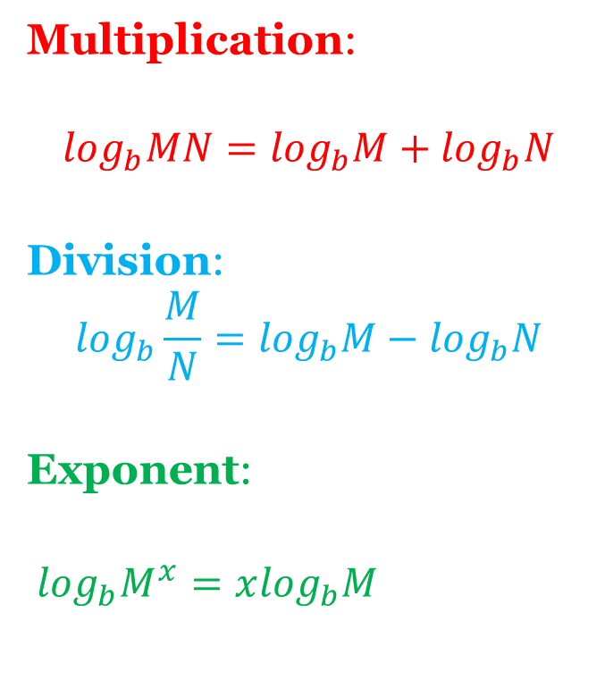
CONDENSE Logarithms Using Property Rules
Multiplication:
$$\log_{b}MN=\log_{b}M+\log_{b}N$$
Division:
$$\log_{b}\frac{M}{N}=\log_{b}M−\log_{b}N$$
Exponent:
$\log_{b}M^{x}=x\log_{b}M$
Directions: Condense each expression using the Properties of Logarithms.
$\log_{5}2+\log_{5}6=$
$3\log_{b}4−3\log_{b}2=$
$\log_{b}2{−log}_{b}3=$
$2\log_{b}x+\log_{b}y$

Slide 4
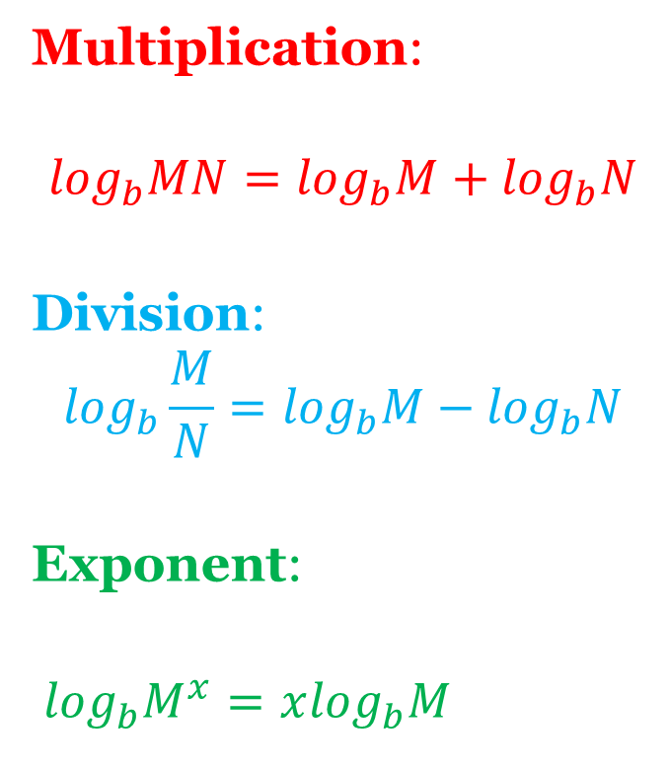
EXPANDING Logarithms Using Property Rules
Multiplication:
$$\log_{b}MN=\log_{b}M+\log_{b}N$$
Division:
$$\log_{b}\frac{M}{N}=\log_{b}M−\log_{b}N$$
Exponent:
$\log_{b}M^{x}=x\log_{b}M$
Directions: Expand each log using the Properties of Logarithms.
$\log_{2} 7b$
$log⁡({\frac{y}{3})}^{2}$
$\log_{7}(a^{3}b^{4}$)

Slide 5
Evaluating Logarithms Using Property Rules
Multiplication:
$$\log_{b}MN=\log_{b}M+\log_{b}N$$
Division:
$$\log_{b}\frac{M}{N}=\log_{b}M−\log_{b}N$$
Exponent:
$\log_{b}M^{x}=x\log_{b}M$
Directions: Simplify each expression using the Properties of Logarithms.
$\log_{4}64−\log_{4}16$
$6\log_{2}1+\log_{2}$ 4
$3\log_{2}2+\log_{2}4−\log_{2}16$

Slide 6
Change of Base Formula
Change of Base Formula:
$$\log_{b}M=\frac{\log_{c}M}{\log_{c}b}$$
Note: This is to be used when converting between the “b” value in logs.
Steps:
Use the Change of Base Formula, round up to 4 digits past decimal.
Set answer from step 1 equal to new conversion base.
Write in exponential form
$\log_{b}y=x$ → $y=b^{x}$
4. Solve
Directions: Use the Base Change Formula to evaluate each logarithm. Round your answer to 4 decimals.
$\log_{5}400$
$\log_{6} 12$
$\log_{2}9$

Slide 7
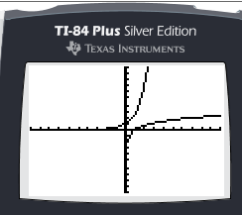
Natural Logarithms
Given the function $y=e^{x}$, the inverse of that function is: $y=ln⁡(x)$.
$$e≈2.718281828 or 2.7183$$
The graphs on the left show both functions.

Slide 8
Using Properties Simplifying Natural Logarithms
Steps:
Rewrite using Properties of Logarithms, (The same apply for natural logarithms), and evaluate.
Multiplication:
$$\ln{MN}=\ln{M}+\ln{N }$$
Division:
$$\ln{\frac{M}{N}}=\ln{M}−\ln{N }$$
Exponent:
$ln M^{x}=xln M$
Directions: Simplify each natural logarithm, using the properties of logarithms.
$5\ln\left(2\right)−ln⁡(4)$
$\frac{1}{4}ln \left(3\right)+$ $\frac{1}{4}ln(x)$
$3\ln\left(x\right)+ln⁡(y)$

Slide 9
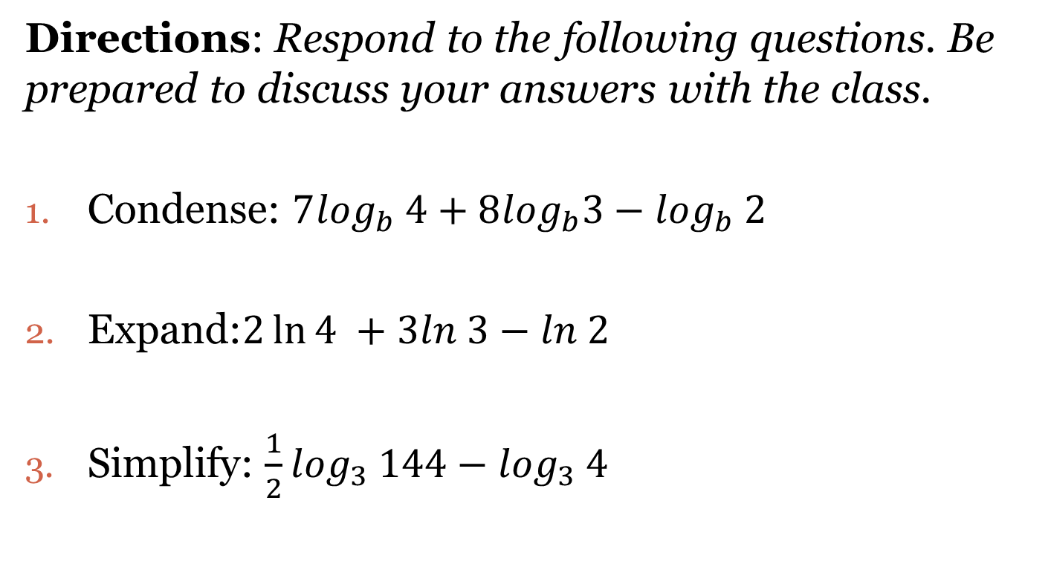
Closing Questions
Directions: Respond to the following questions. Be prepared to discuss your answers with the class.
Condense: $7\log_{b} 4+8\log_{b}3−\log_{b} 2$
Expand:$2\ln{4} +3ln 3−ln 2$
Simplify: $\frac{1}{2}\log_{3} 144−\log_{3} 4$

Slide 10
Homework Assignment
Announcements

