Slide 1
Unit 5 – Section 3 “Solving Logarithms and Natural Log Equations”
Objectives
To solve Natural Log equations.
To solve logarithmic equations.

Slide 2
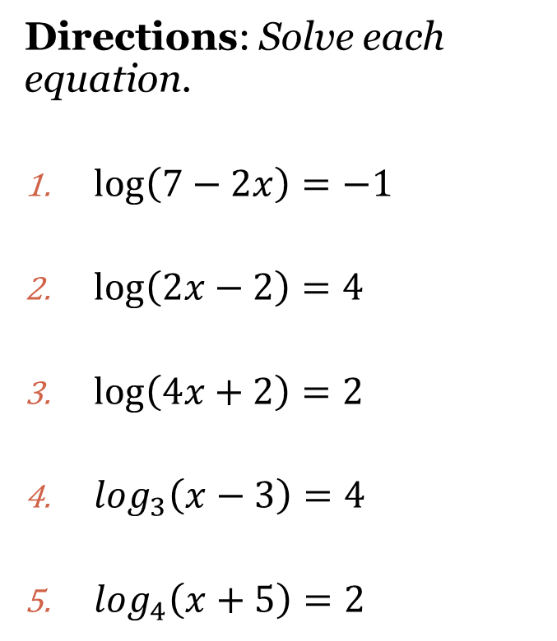
Solving Logarithmic Equations
Steps:
Write equation in exponential form: $\log_{b}y=x$ → $y=b^{x}$
Solve.
Hint: Use 10 as the base!
Directions: Solve each equation.
$\log\left(7−2x\right)=−1$
$\log\left(2x−2\right)=4$
$\log\left(4x+2\right)=2$
$\log_{3}\left(x−3\right)=4$
$\log_{4}\left(x+5\right)=2$

Slide 3
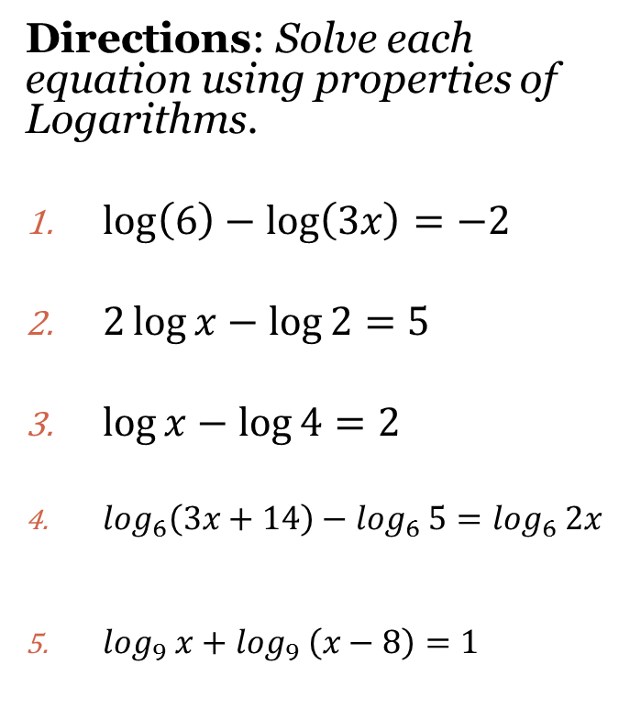
Using Logarithmic Properties to Solve Equations
Steps:
Write as a single log.
Rewrite in exponential form with base 10 (that’s the common log)
Solve.
Multiplication:
$$\log_{b}MN=\log_{b}M+\log_{b}N$$
Division:
$$\log_{b}\frac{M}{N}=\log_{b}M−\log_{b}N$$
Exponent:
$\log_{b}M^{x}=x\log_{b}M$
Directions: Solve each equation using properties of Logarithms.
$\log\left(6\right)−\log\left(3x\right)=−2$
$2\log{x}−\log{2}=5$
$\log{x−\log{4=2}}$
$\log_{6}\left(3x+14\right)−\log_{6} 5=\log_{6} 2x$
$\log_{9} x+\log_{9} \left(x−8\right)=1$

Slide 4
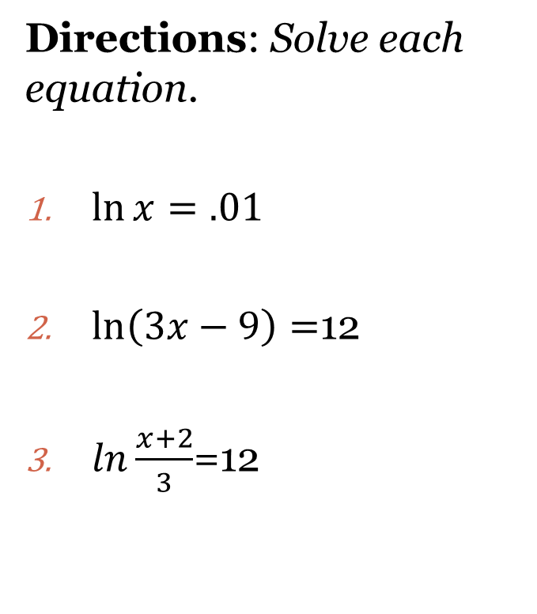
Solving Natural Logarithmic Equations
Steps:
Rewrite in exponential form. (Use $e$ as a base), and solve.
$\ln{y}=x$ → $y=e^{x}$
Directions: Solve each equation.
$\ln{x=.01}$
$\ln\left(3x−9\right)=$12
$ln\frac{x+2}{3}$=12

Slide 5
Closing Questions
Directions: Respond to the following closing questions. Be prepared to discuss your answers with the class.
1. $\ln\left(x−5\right)=12$
2. $\log\left(x−5\right)=4$
3. $\log_{4} x+\log_{4} \left(x−12\right)=$3

Slide 6
Homework Assignment
Announcements

